Slide 1
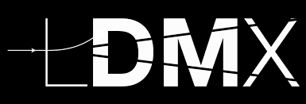
LDMX: A Search for Dark Matter Using a High Intensity Electron Beam
E. Craig Dukes
University of Virginia
(on behalf of the LDMX collaboration)
September 9, 2022

Slide 2
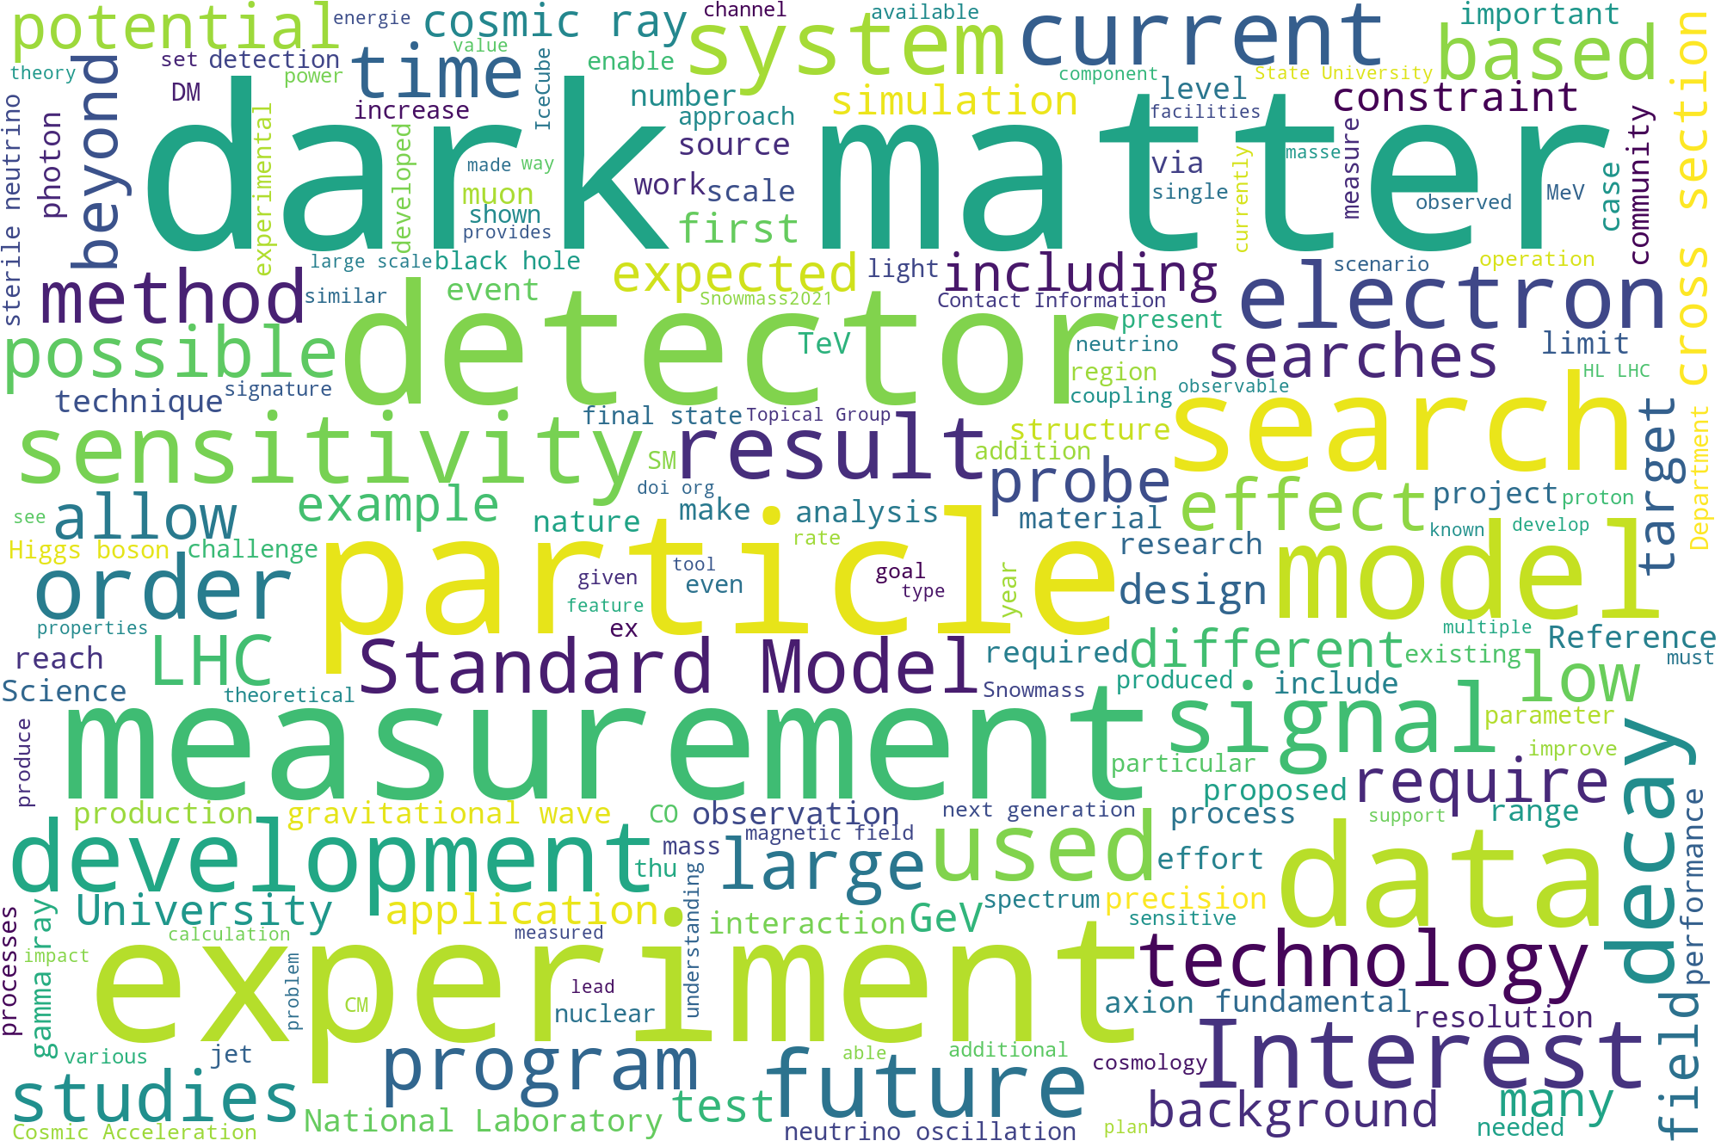
Dark Matter is Hot: Snowmass 2022 Letters of Intents
Word clouds from 522 Letter of Intents submitted for the USA decadal planning study (Snowmass 2022) for elementary particle physics, which was help this July
Identifying the nature of this exotic matter is the outstanding particle physics goal of our time

Slide 3
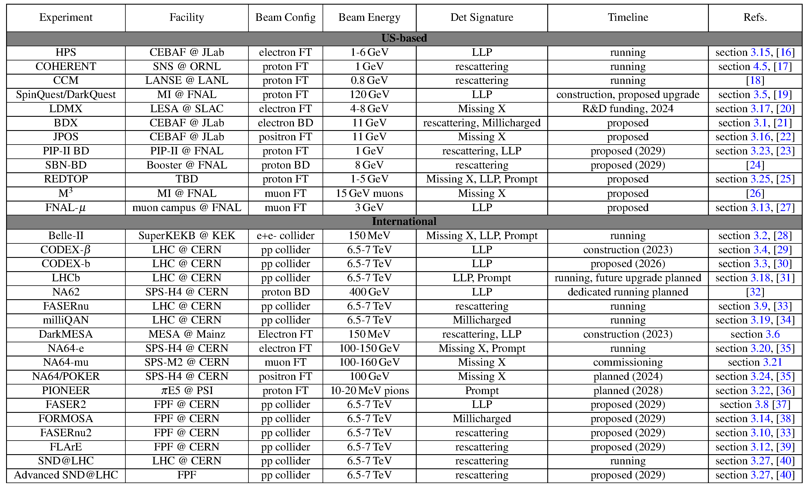
Dark Matter: Accelerator Searches Landscape Keeps Growing
Experiments and Facilities for Accelerator-Based Dark Sector Searches (arXiv.2206.0422)

Slide 4
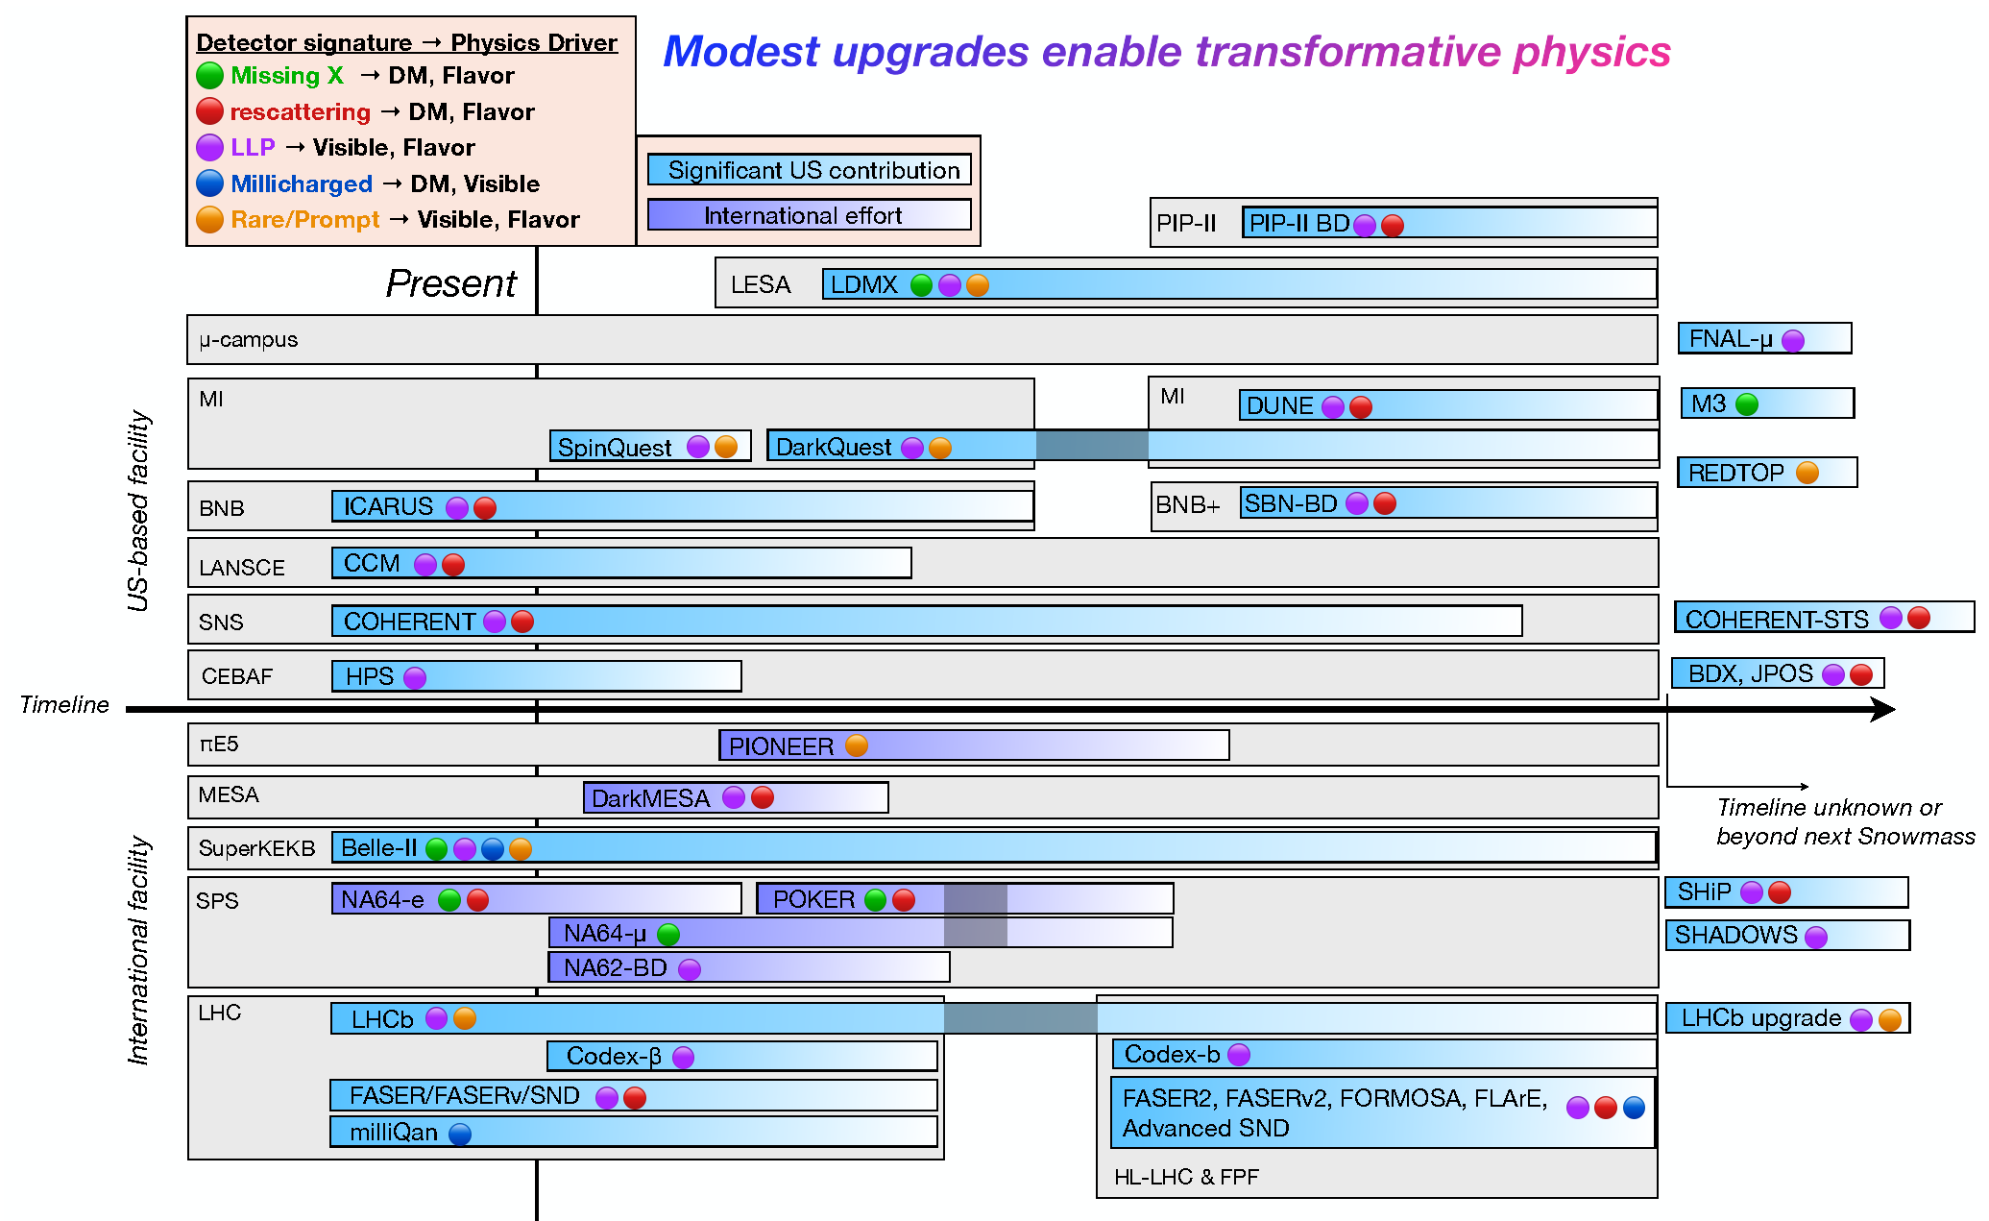
Dark Matter: Accelerator Searches Landscape
Experiments and Facilities for Accelerator-Based Dark Sector Searches (arXiv.2206.0422)

Slide 5
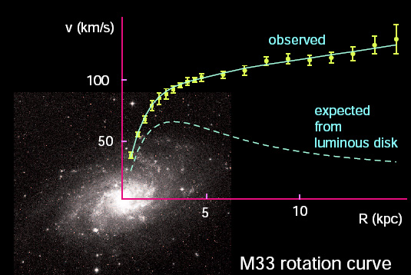
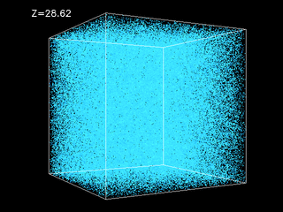
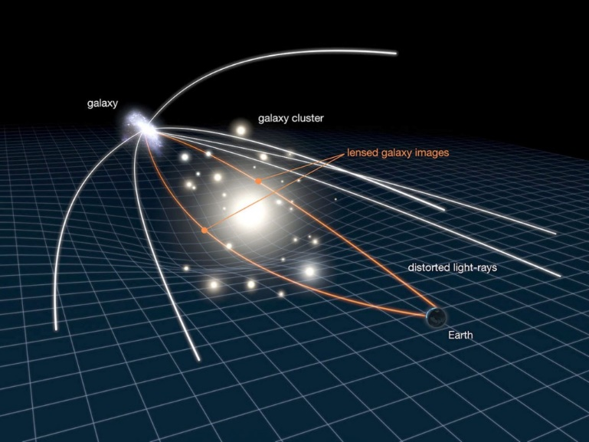
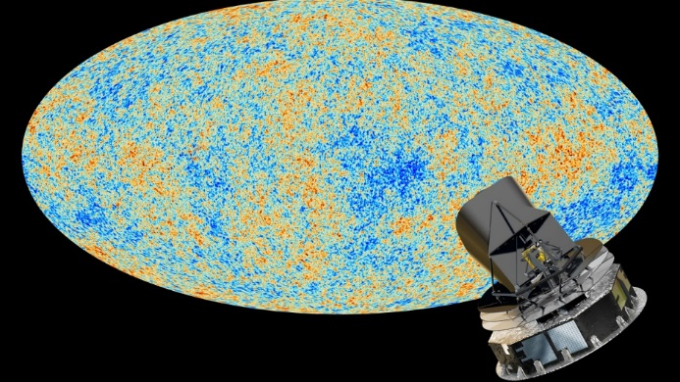
Dark Matter Exists: Gravitational Evidence
Four sources on vastly different scales: galactic to universal
Galactic rotation curves
Gravitational lensing
Large scale structure of universe
Microwave background radiation
Best estimate: 85% of the mass of the universe is dark matter
Dark matter was present at the beginning of the universe

Slide 6
Composition of Matter in Universe
DM density: ~0.3 GeV/cm
Flux: ~30,000/s∙cm² @100 km/s (if mass is 100 GeV)
We know the DM was present in the early universe
The fact that the densities of DM and SM are roughly the same suggest that they were perhaps coupled in the early universe
1% Stars
7% Gas
SM Matter
7% Diffuse gas
Dark Matter
85% Dark Matter

Slide 7
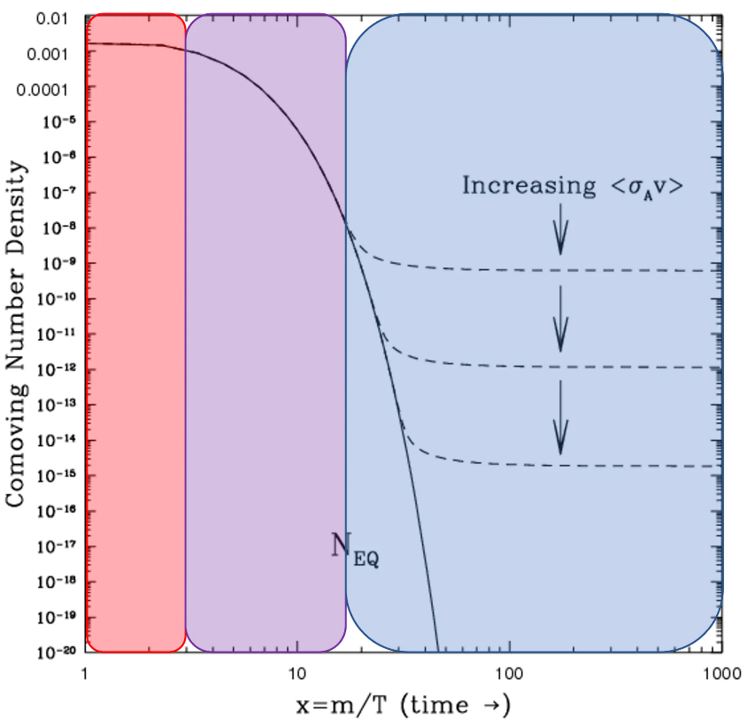
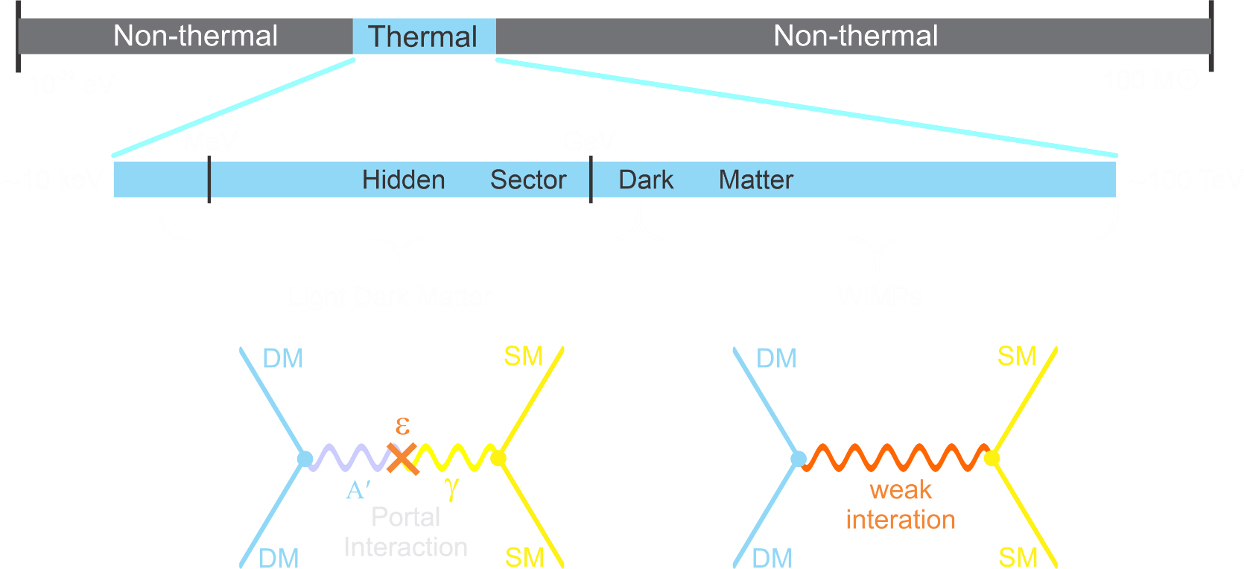
Dark Matter: Thermal Relic Production
Assume DM was in thermal equilibrium with SM in the very early universe:
Universe cooled to the point that DM pairs no longer produced
Universe kept cooling such that DM annihilations ceased
Present density:
LDMX (Light Dark Matter eXperiment) goal is to probe this region with a sensitivity the encompasses the thermal target predictions
Sub-GeV DM:
M_{χ} < 10 MeV: early BBN problems comparatively under-explored
WIMP thermal DM: M_{χ} < 2 GeV: early freeze out, too much DM
Region is being well explored

Slide 8
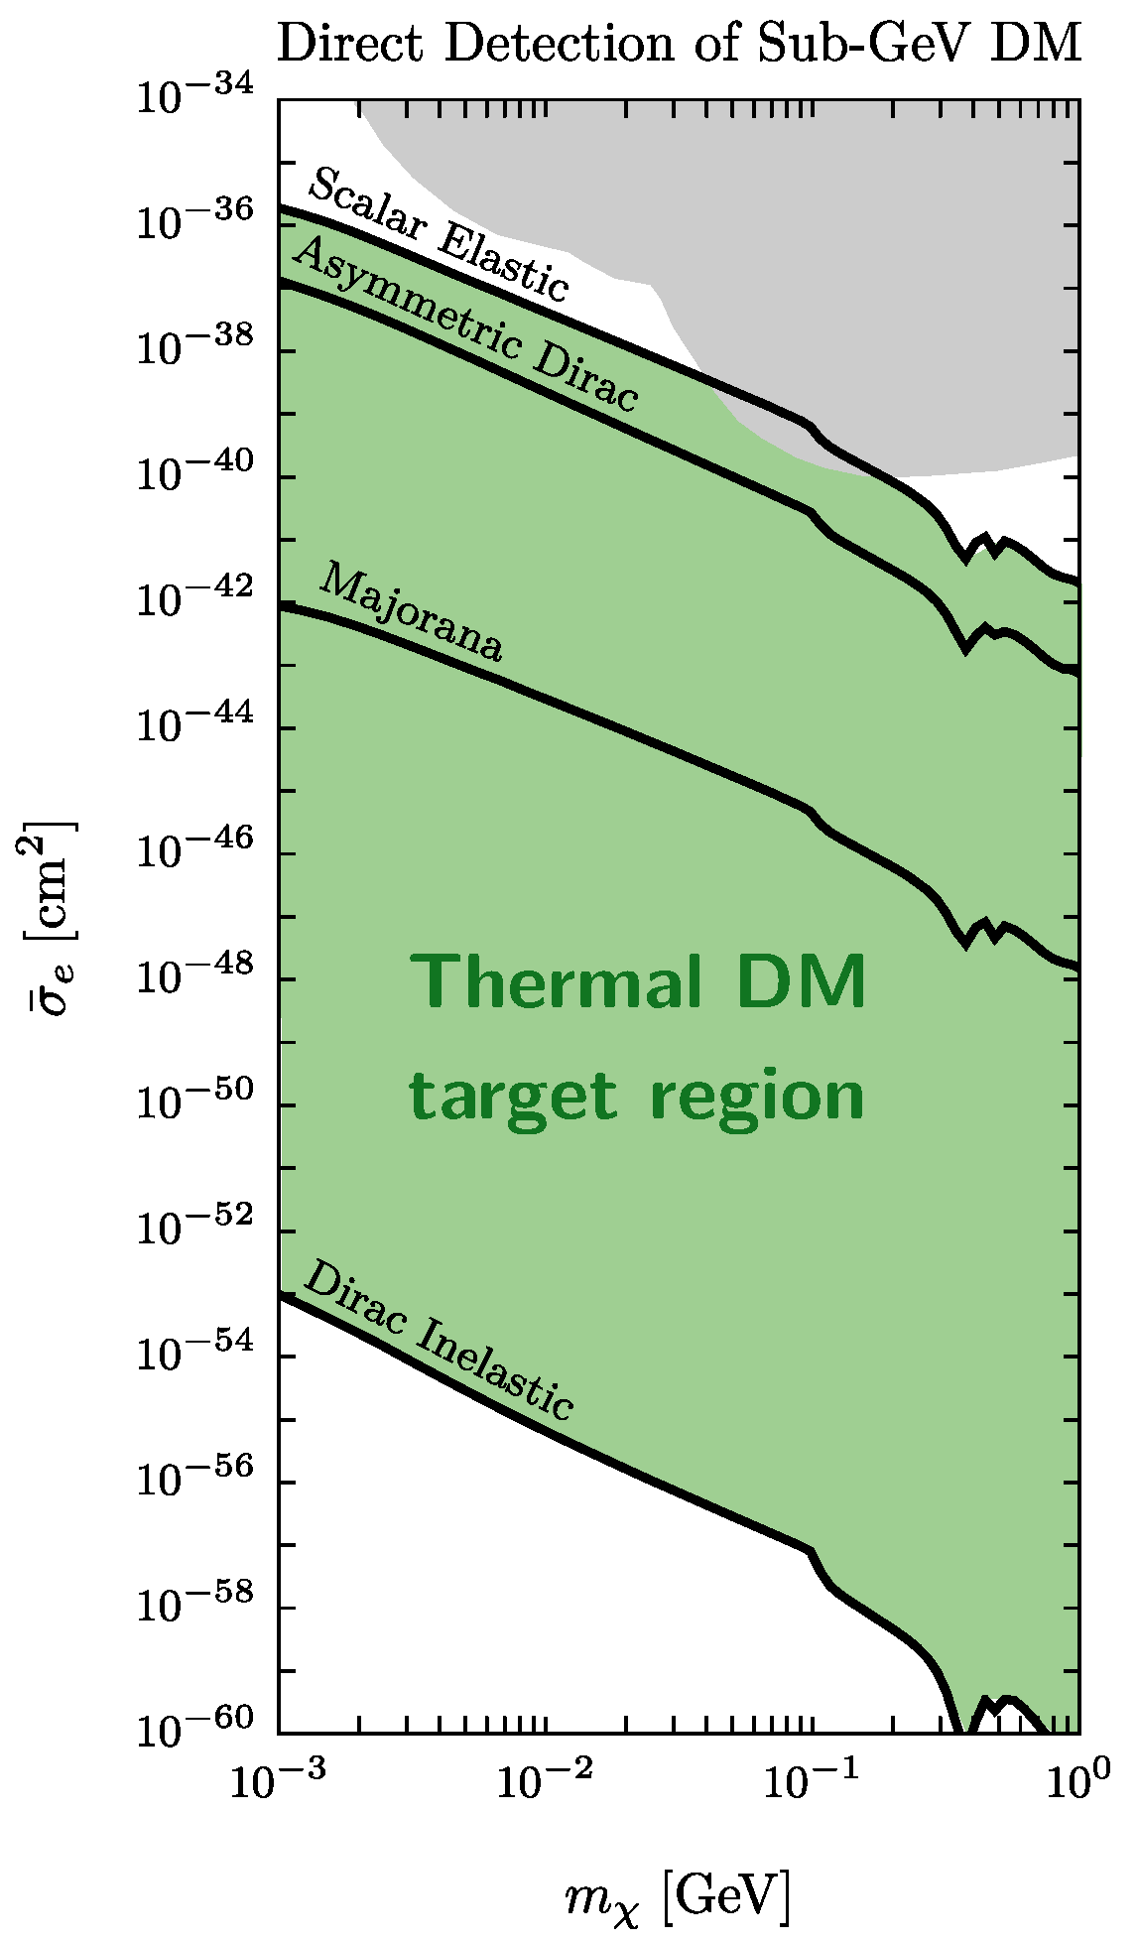
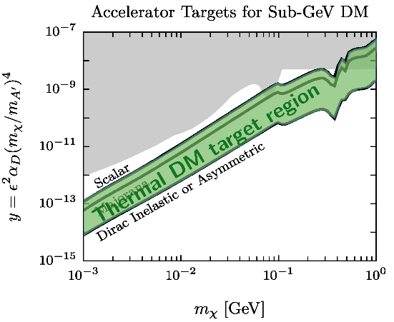
Accelerator Production: Advantages
Direct Detection:
Strong velocity/spin dependence of scattering spreads out direct detection cross sections
Accelerator Production:
Range of freeze-out interaction strengths much more compact: spans factor of ~ 30 for a given DM mass
All thermal targets within reach

Slide 9
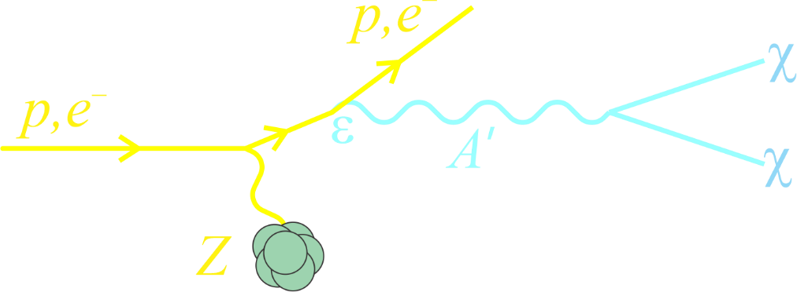
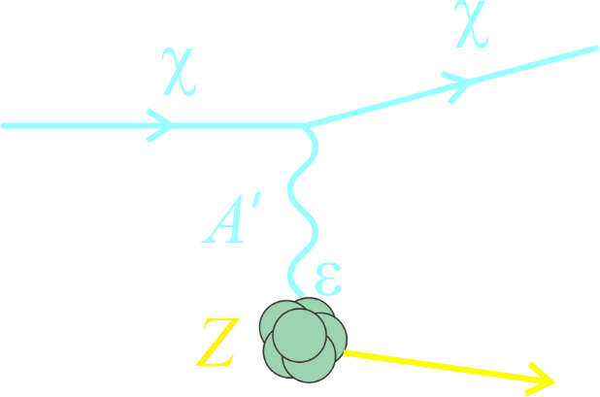
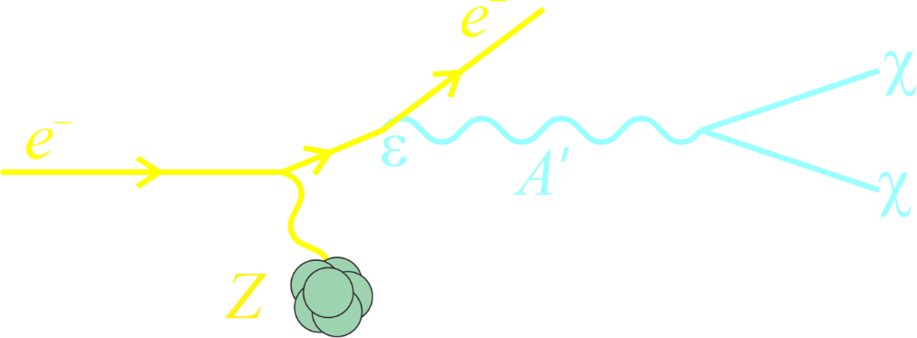
Searching for Dark Matter with Fixed-Target Experiments
Beam dump
Missing energy / momentum
+
Probes dark sector coupling
Suppressed by ε⁴
Large yield, particularly for low mediator masses
No DM detection penalty
LDMX has chosen this path

Slide 10
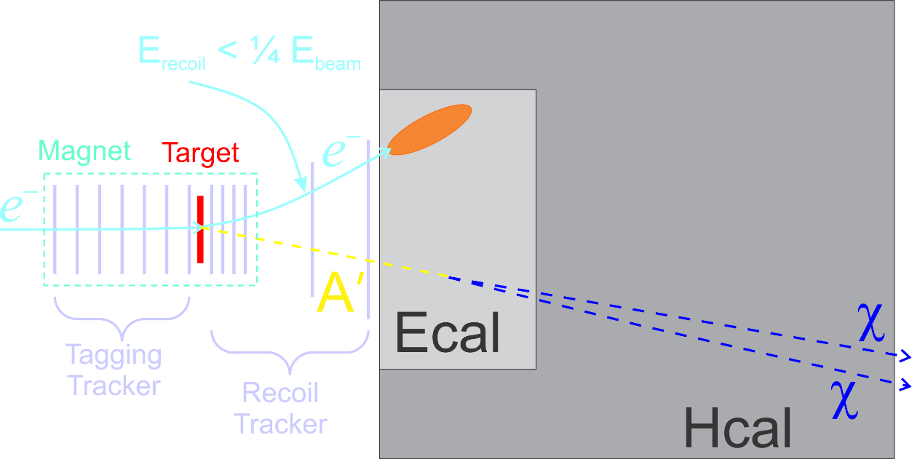
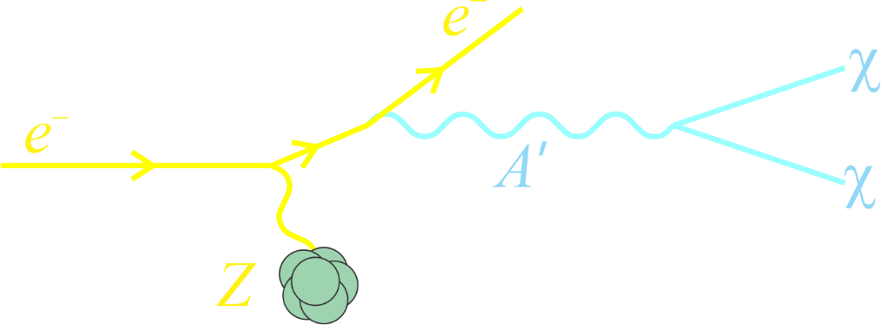
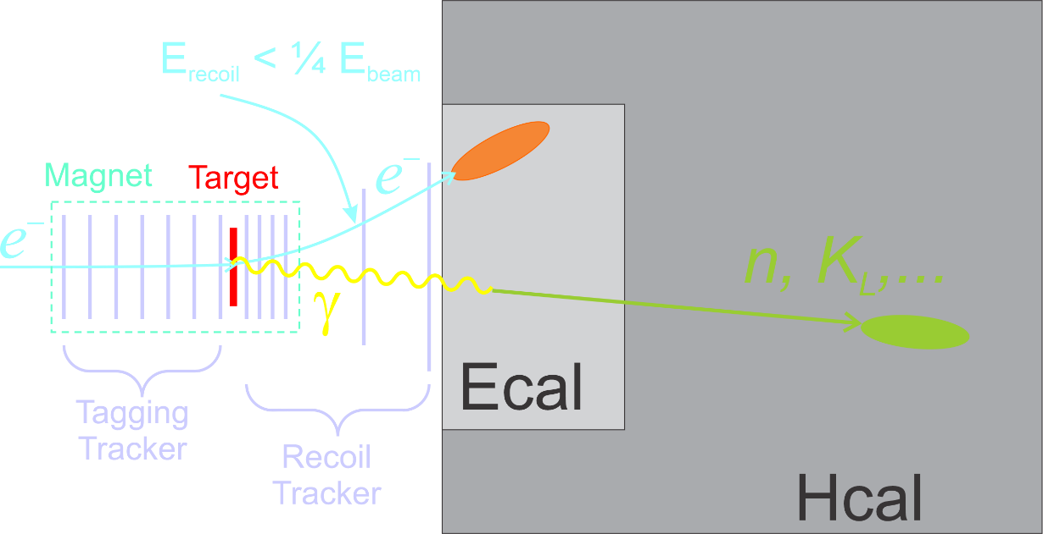
Experimental Technique in a Nutshell
LDMX uses missing momentum technique
Beam:
Parasitically use the SLAC LCLS II beam (4 GeV): ~40 MHz e⁻
Signal:
Substantial energy loss by the 4 GeV beam electron
Large recoil electron p_{T}
Absence of any additional visible final-state particles
Apparatus
Thin production target to produce DM bremsstrahlung
Precision tracking of the electron before/after target
Excellent EM and Hadronic calorimetry to capture background gammas, neutrons produced by photo-nuclear and electro-nuclear processes, as well as other backgrounds
Signal
Background

Slide 11
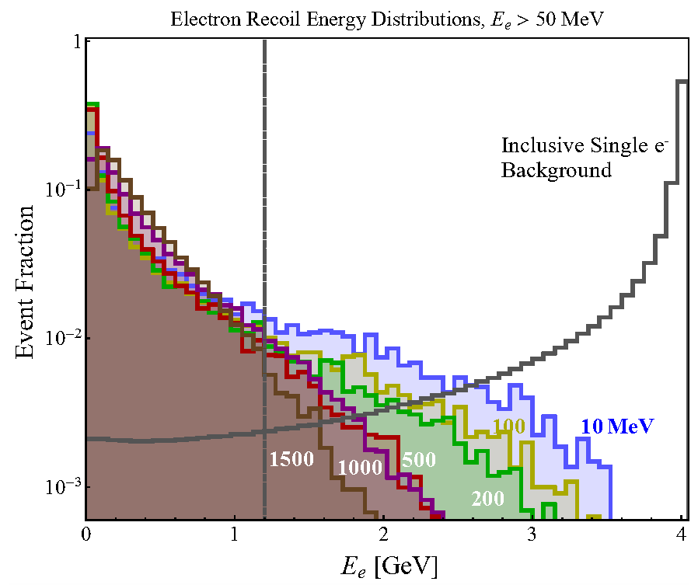
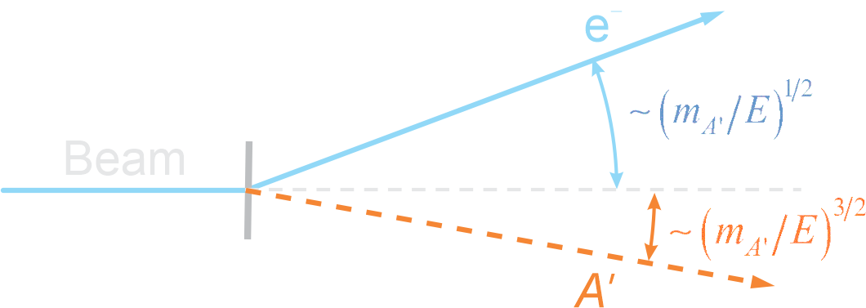
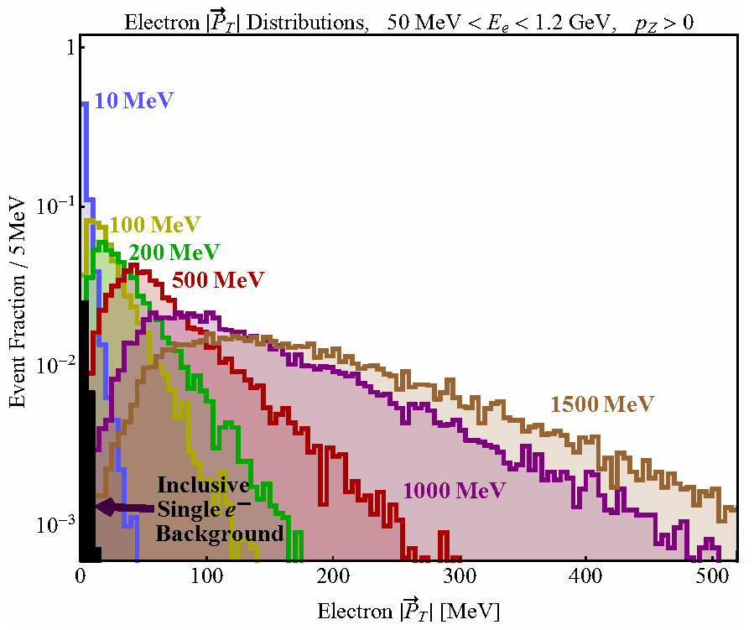
Electron Parameters: Signal & Background
Difference between SM and Dark A’ bremsstrahlung is the latter carries away much more of the beam energy and transverse momentum than SM bremsstrahlung
Larger the A’ mass, the greater the difference from SM bremsstrahlung
Recoil Electron Energy
DM
Signal:
Background:
Recoil Electron p_{T}
DM

Slide 12
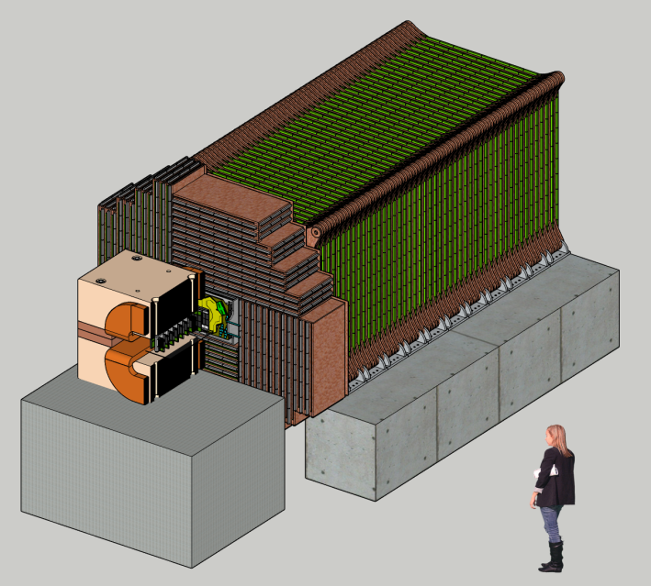
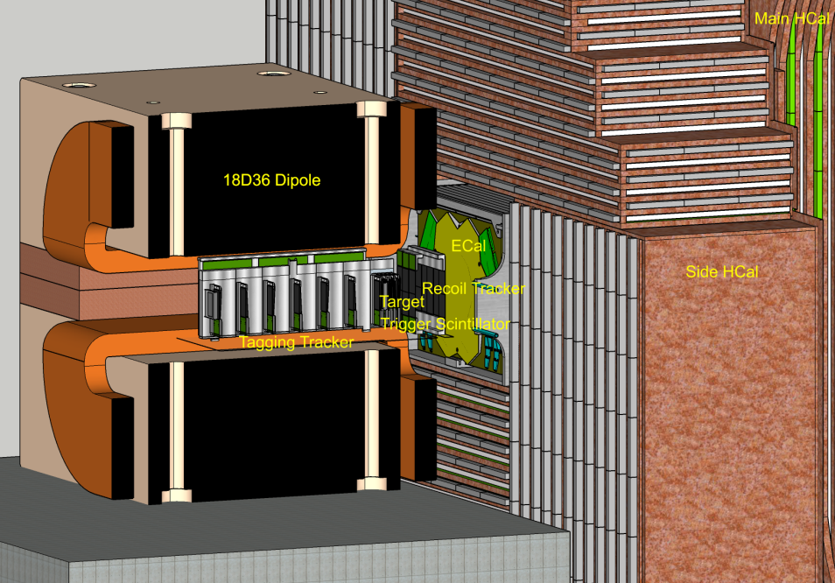
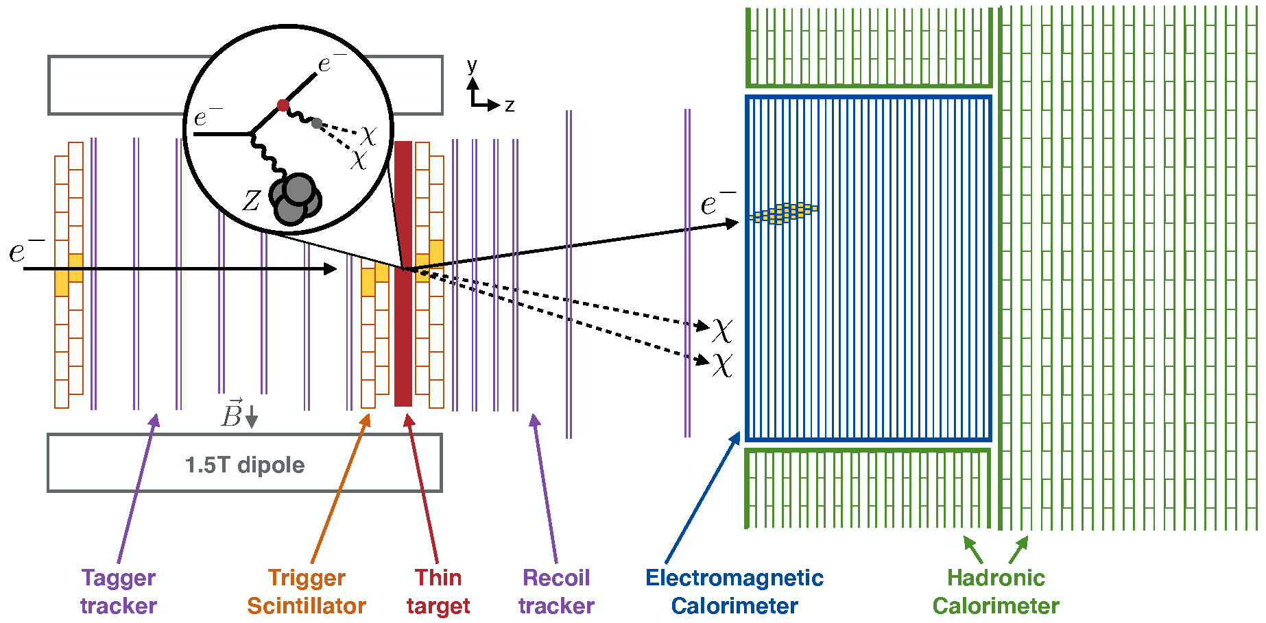
Apparatus
Quasi-beam dump experiment: tag and measure each incoming electron
Use existing detector technologies that have been designed for high rate / high radiation environments: (1) to keep costs down, and (2) to allow the apparatus to be fabricated quickly
Hadronic Calorimeter
1 m
EM Calorimeter

Slide 13
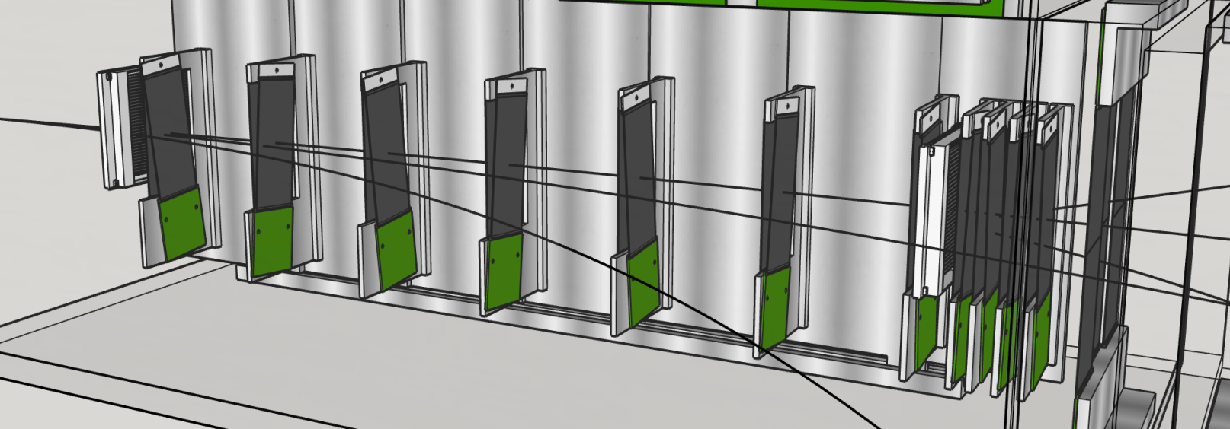
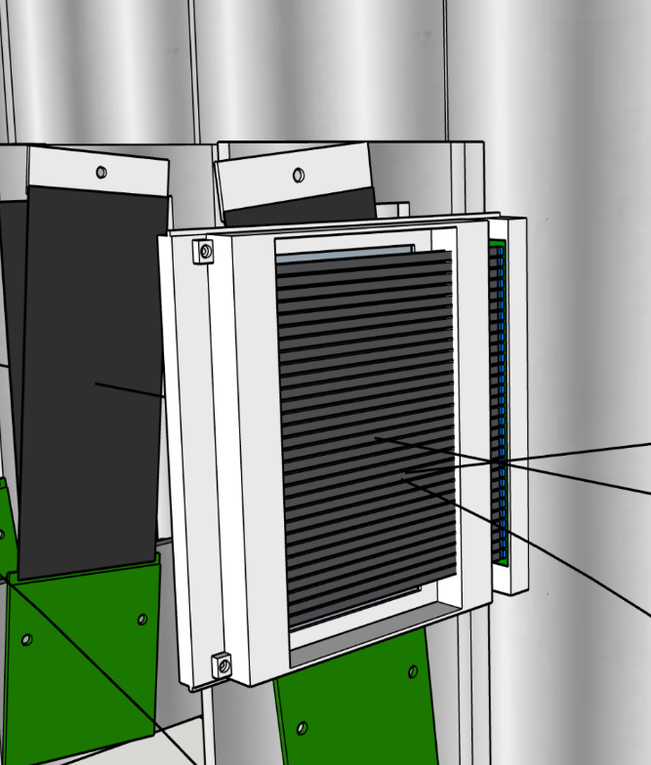
Apparatus: Trigger Scintillator
Low-energy ECal trigger requires knowledge of #e⁻/pulse: average ~1 e⁻/25 ns pulse
Thin segmented scintillator:
2 offset layers/station: 48 total counters
3 mm pitch
Note: 40 MHz e⁻ beam spot is large: ~20 cm²
2 mm deep x 3 mm wide strips

Slide 14
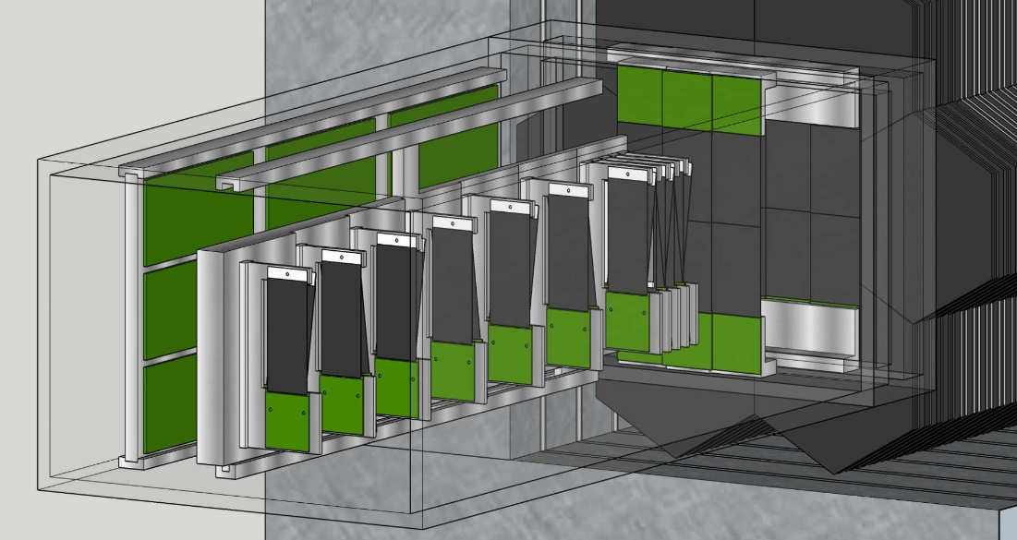
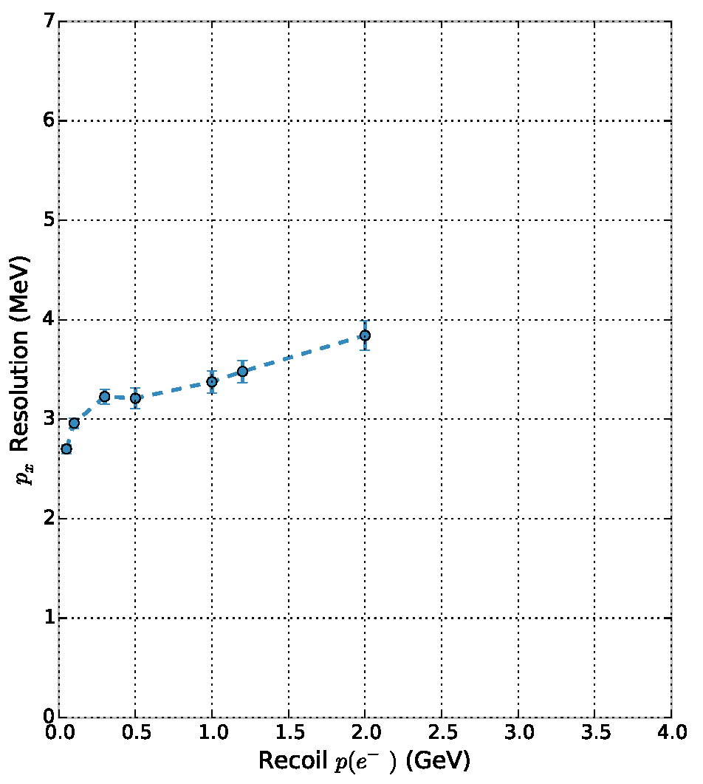
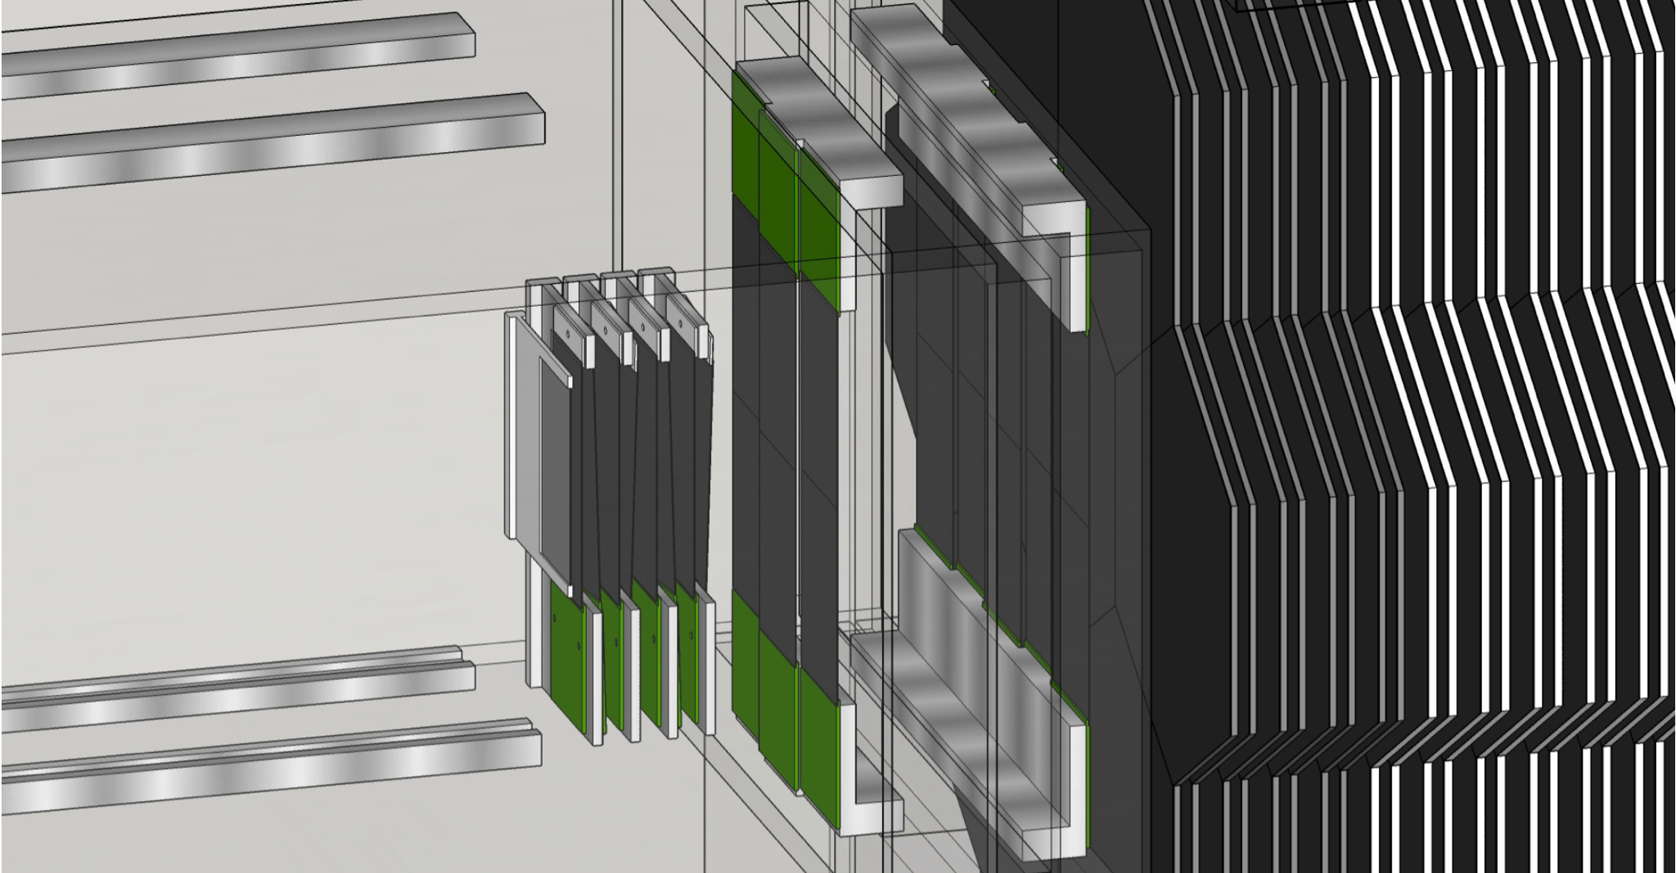
LDMX Apparatus: Tagger & Recoil Tracker
Tagger / Recoil tracker inside 1.5 T dipole field / fringe field measure momentum of incoming / recoil e⁻ to <1%
Double-sided silicon, Based on Vtx Tracker for HPS expt (JLab)
4 MHz/mm² rate capability
0.7% X₀ per 3d hit
6 (60) μm hor (ver) resolution; ~2 ns timing resolution

Slide 15
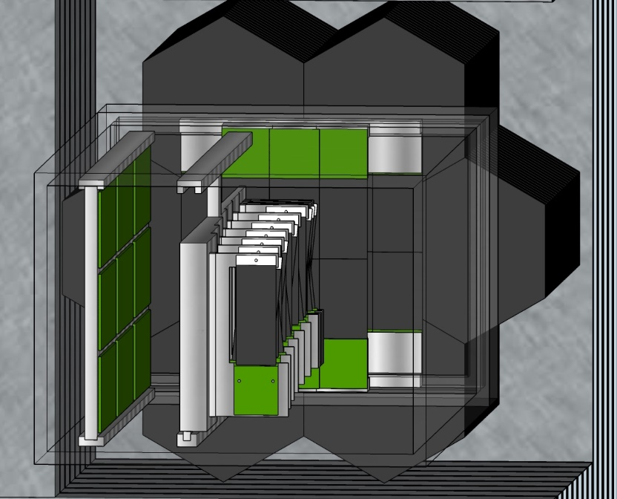
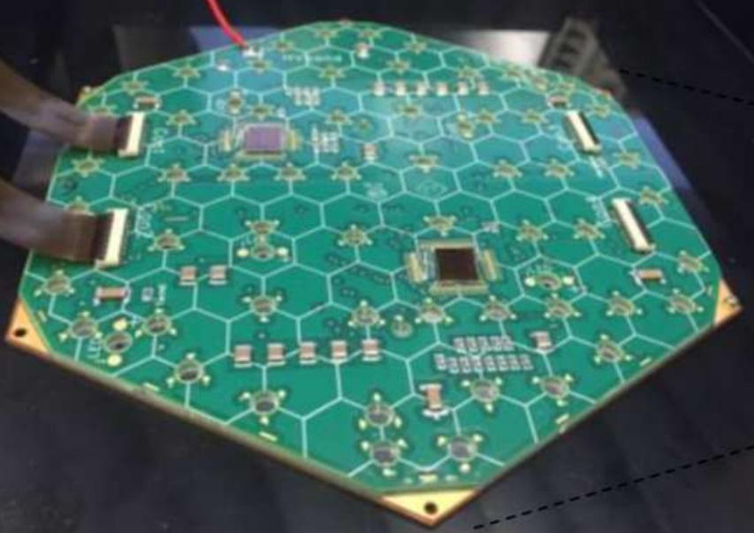
LDMX Apparatus: Electromagnetic Calorimeter
Based on CMS Phase-II forward high granularity calorimeter (HGC) upgrade
Tungsten-Silicon sampling calorimeter: σ(E)/E∼20%/√E
High granularity (0.56 cm² pad area): 68% of EM shower <1 cm 1st 15 layers
Deep: 40 X₀
Radiation hard: max dose for LDMX is 3 x 10¹³ n/cm²
Provides a fast energy trigger: E < 1.2 GeV
ECal
ECal
ECal

Slide 16
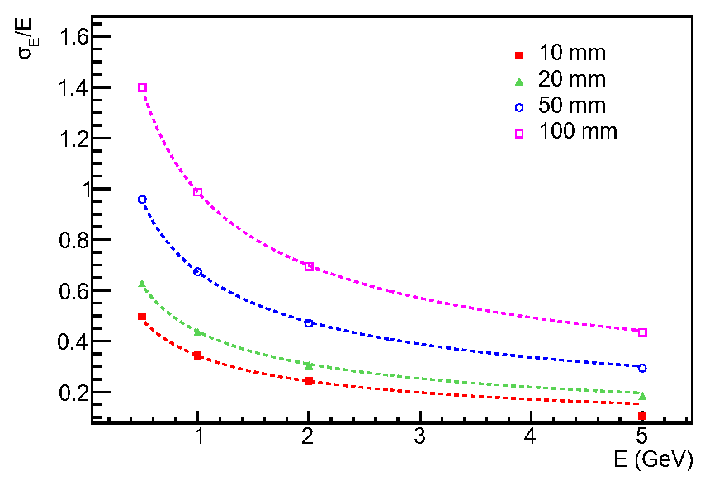
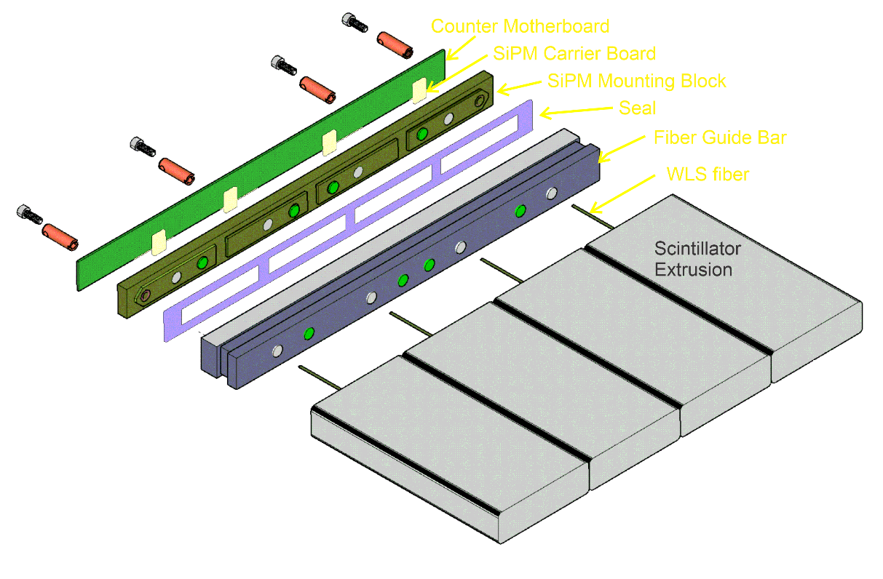
LDMX Apparatus: Hadronic Calorimeter
Detects neutral hadrons/neutrons produced in photonuclear reactions in ECal/target with high effi., EM showers escaping ECal, and MIPs (muons)
Iron-scintillator sampling calorimeter: 96 layers of 20/25 mm PS/Fe
Extruded 5x2 cm² scintillator bars with inserted wavelength-shifting fibers, read out with Silicon Photomultipliers (SiPMs)
Active element based on the Mu2e Cosmic Ray Veto detector
Deep: 17λ_{I}
Energy resolution for neutrons
HCal
Readout manifold for 4 counters

Slide 17
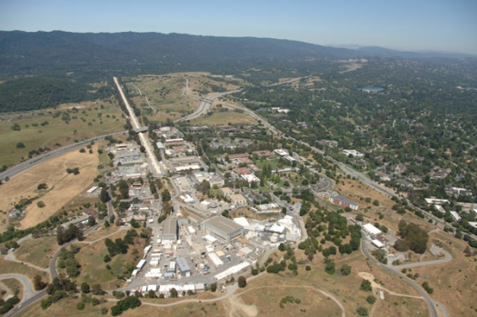
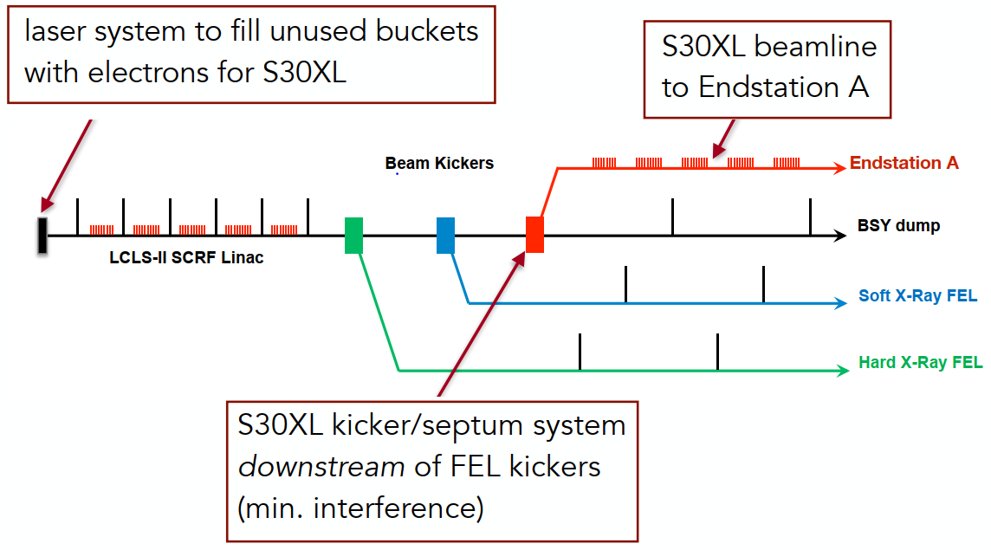
LDMX Mounted SLAC Linac Coherent Light Source
LDMX will use new beamline (LESA) being built for the upgraded SLAC Light Source (LCLS-II) to be commissioned in 2023-2024
Need a tiny fraction of the LCLS-II beam
Parasitic: 55% duty factor (600 ns/1100 ns)
Phase I: 4 GeV bean @ 40 MHz → O(10¹⁴) e⁻ in a 1 year run
Phase II: 8 GeV beam (LCLS-II-HE) → O(10¹⁶) e⁻ in a 3 year run
Future: eSPS (16 GeV) at CERN?
Endstation A

Slide 18
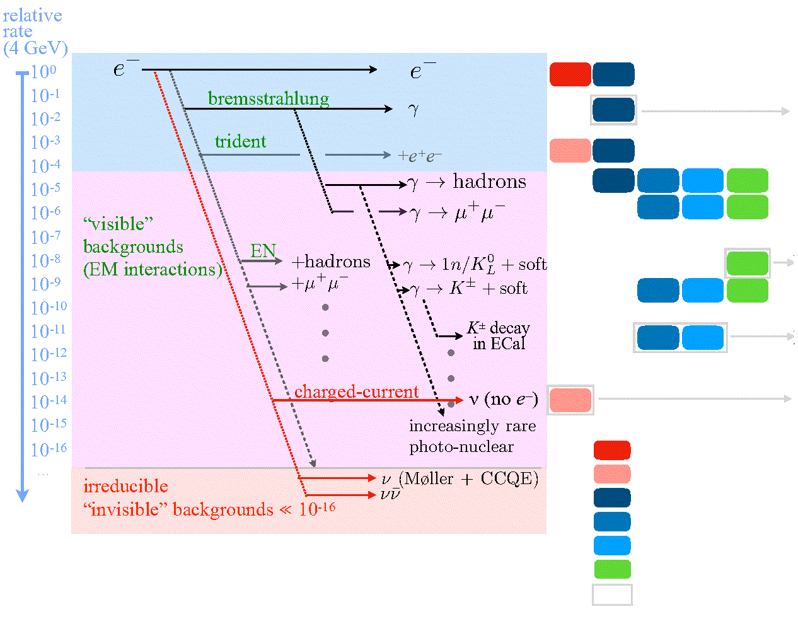
Backgrounds, Backgrounds, Backgrounds . . .
Incoming Outgoing Veto Handles Design Drivers
Gaussian energy fluctuations
ECal depth, resolution,
hermiticity
Rare reactions: products escape HCal and/or anomalous energy deposition
HCal depth, segmentation,
hermiticity
All systems combined: < 1 background event with signal efficiency ~30-50% for O(4x10¹⁴) electrons
ECal 3D granularity, MIP-sensitivity
Recoil Tracker acceptance
Track momentum
Track multiplicity
ECal energy/segmentation
ECal Boosted decision tree
ECal track
HCal hits/depth
Design driver
Neutrino “floor”
Tools
Åkesson et al, JHEP04 (2020) 003.
Note: transverse momtnum not used as a discriminant in these studies

Slide 19
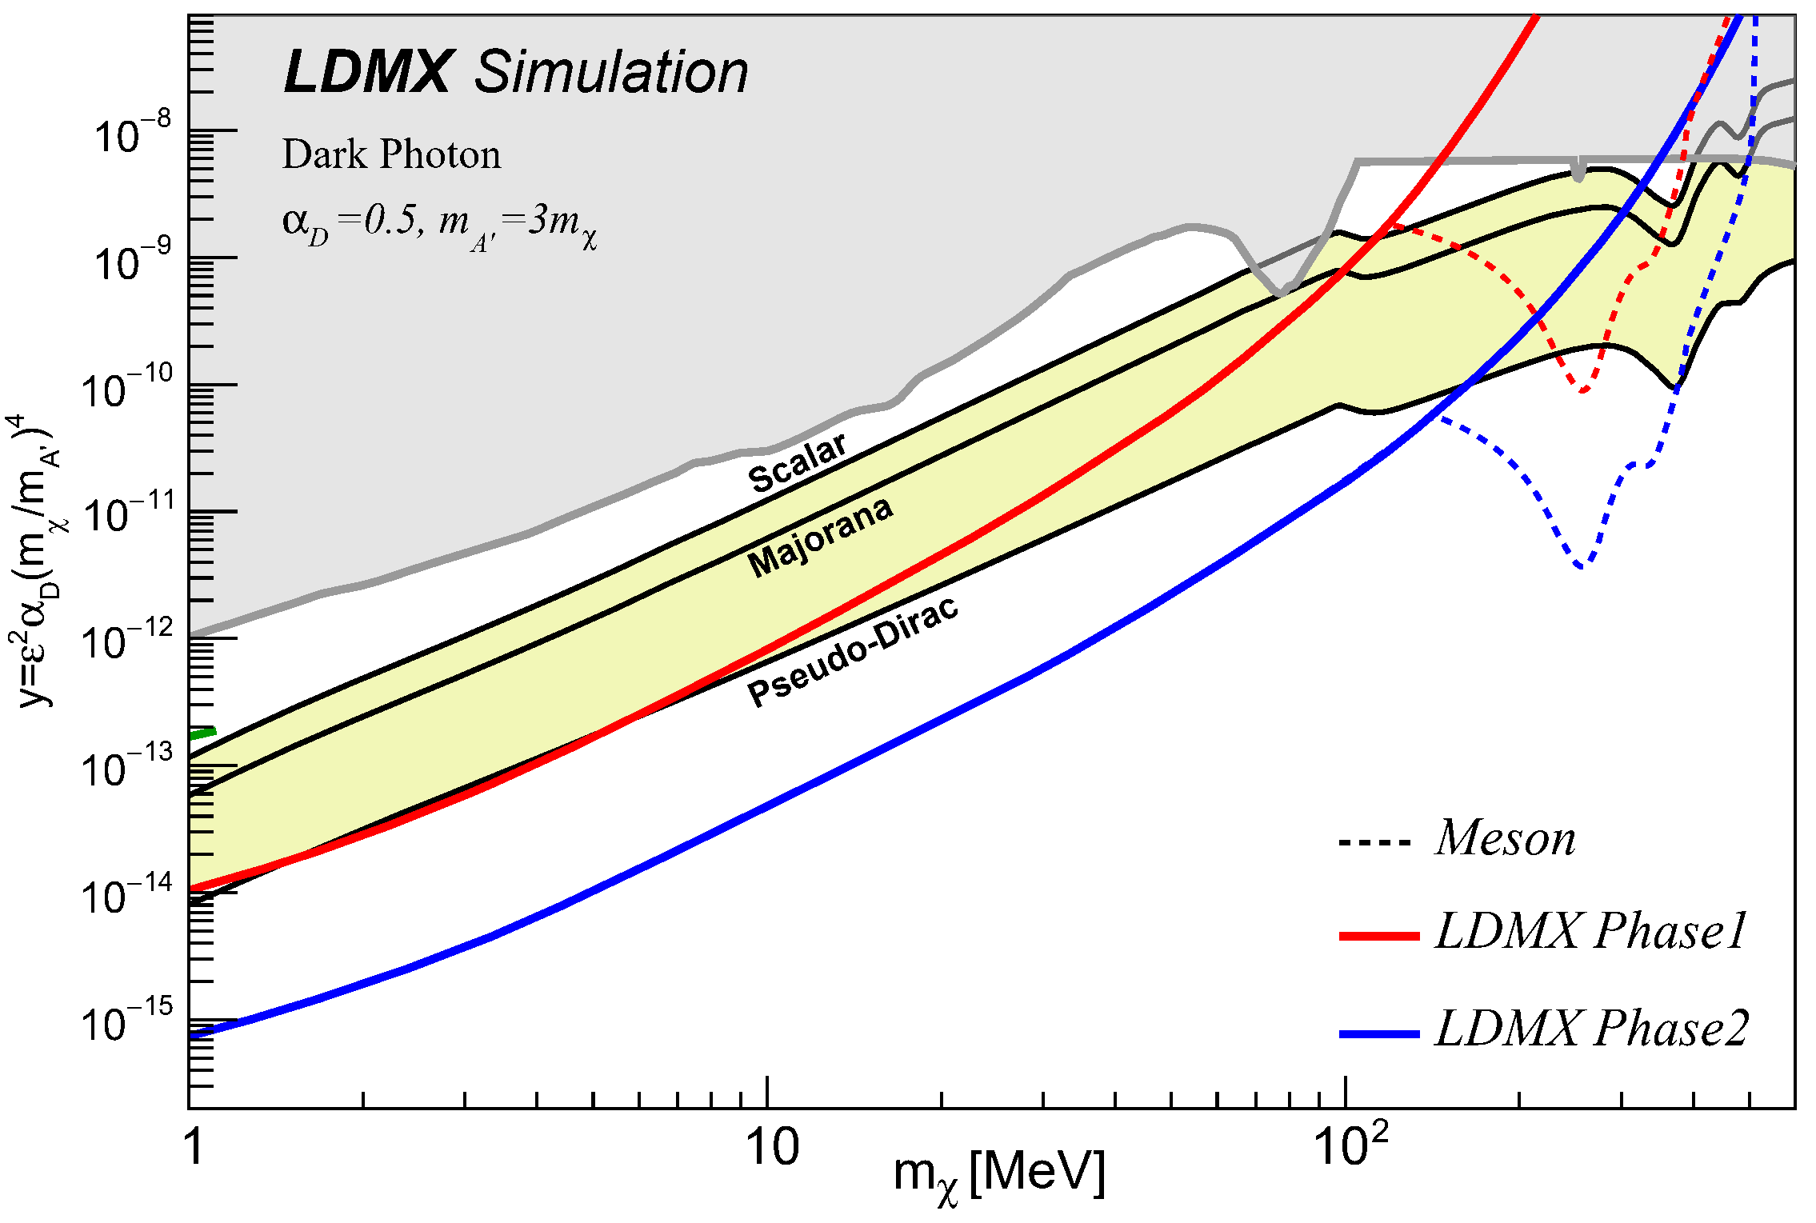
Putting it all Together: LDMX Dark Matter Reach
We are sensitive to a broad range of the m_{χ} parameter space for a wide range of thermal targets, assuming a Dark Photon portal
Present limits
LDMX
Phase 1: 4 GeV
O(10¹⁴) electrons
Phase 2: 8 GeV
O(10¹⁶) electrons
Thermal targets

Slide 20
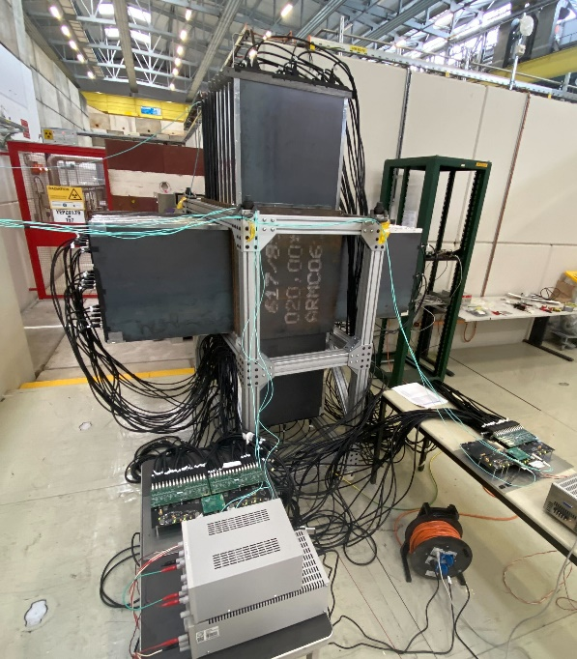
Timeline
2009 Bjorken, Essig, Schuster, and Toro: “New Fixed-Target Experiments to Search for Dark Gauge Forces”; PRD 80 (2009) 075018
2015 Izaguirre, Krnjaic, Schuster, and Toro explore possibilities of a missing momentum experiment; PRL 115, 251301 (2015)
2015 Dark Sectors Workshop: LDMX at SLAC
Detailed initial design study completed (arXiv:1808.05219)
Collaboration formed
2021 LDMX received prototype funding in FY22 as part of the DOE Dark Matter New Initiatives project
2022 Successful test-beam run at CERN
2023 Fabrication starts, beamline (LESA) commissioning
2025 First beam LDMX Phase-I
2026-2028 8 GeV upgrade (LCLS-II-HE)
2028 First beam LDMX Phase-II
Past
Future

Slide 21
LDMX Collaboration
“Small” collaboration by modern HEP standards
Strong set of collaborating institutions
Strong support from the funding agencies, in USA and in Europe
And finally: apologies for leaving out other physics topics that will be addressed by LDMX: such as: direct DM search, Axion-like particles, milli-charged particles, electron-nucleus scattering measurements

