Slide 1

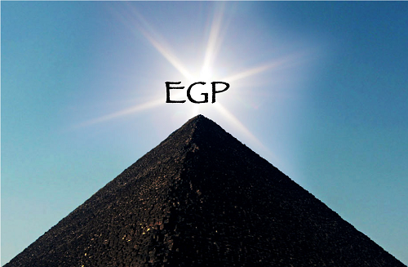
Using Muography to Probe the Internal Structures of the Great Pyramid of Giza
Ralf Ehrlich
University of Virginia
on behalf of the EGP collaboration
APS meeting - April 16, 2023

Slide 2
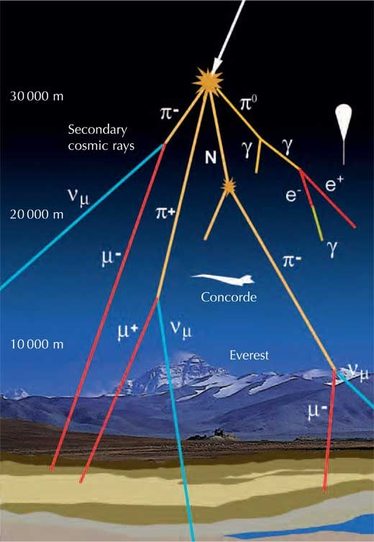
The Idea behind Muography – I
Muography
  Tomography with cosmic-ray muons instead of X-rays.
  Cosmic-ray muons are naturally occurring.
  So no artificial radiation is required.
  Non-invasive, non-destructive method to create
  a 3D image of the internal structures of objects.
Cosmic-ray muons
  Earth’s upper atmosphere gets hit by cosmic rays
  (high-energy particles from outside the solar system).
  They interact with the atomic nuclei in the atmosphere
  to produce e.g. charged pions.
  Charged pions decay almost exclusively into muons.
  Due to their high energies, large numbers of them make
  it to the surface of the Earth.
Image credit: Alberto Izquierdo; courtesy of
Francisco Barradas Solas, Science in School

Slide 3
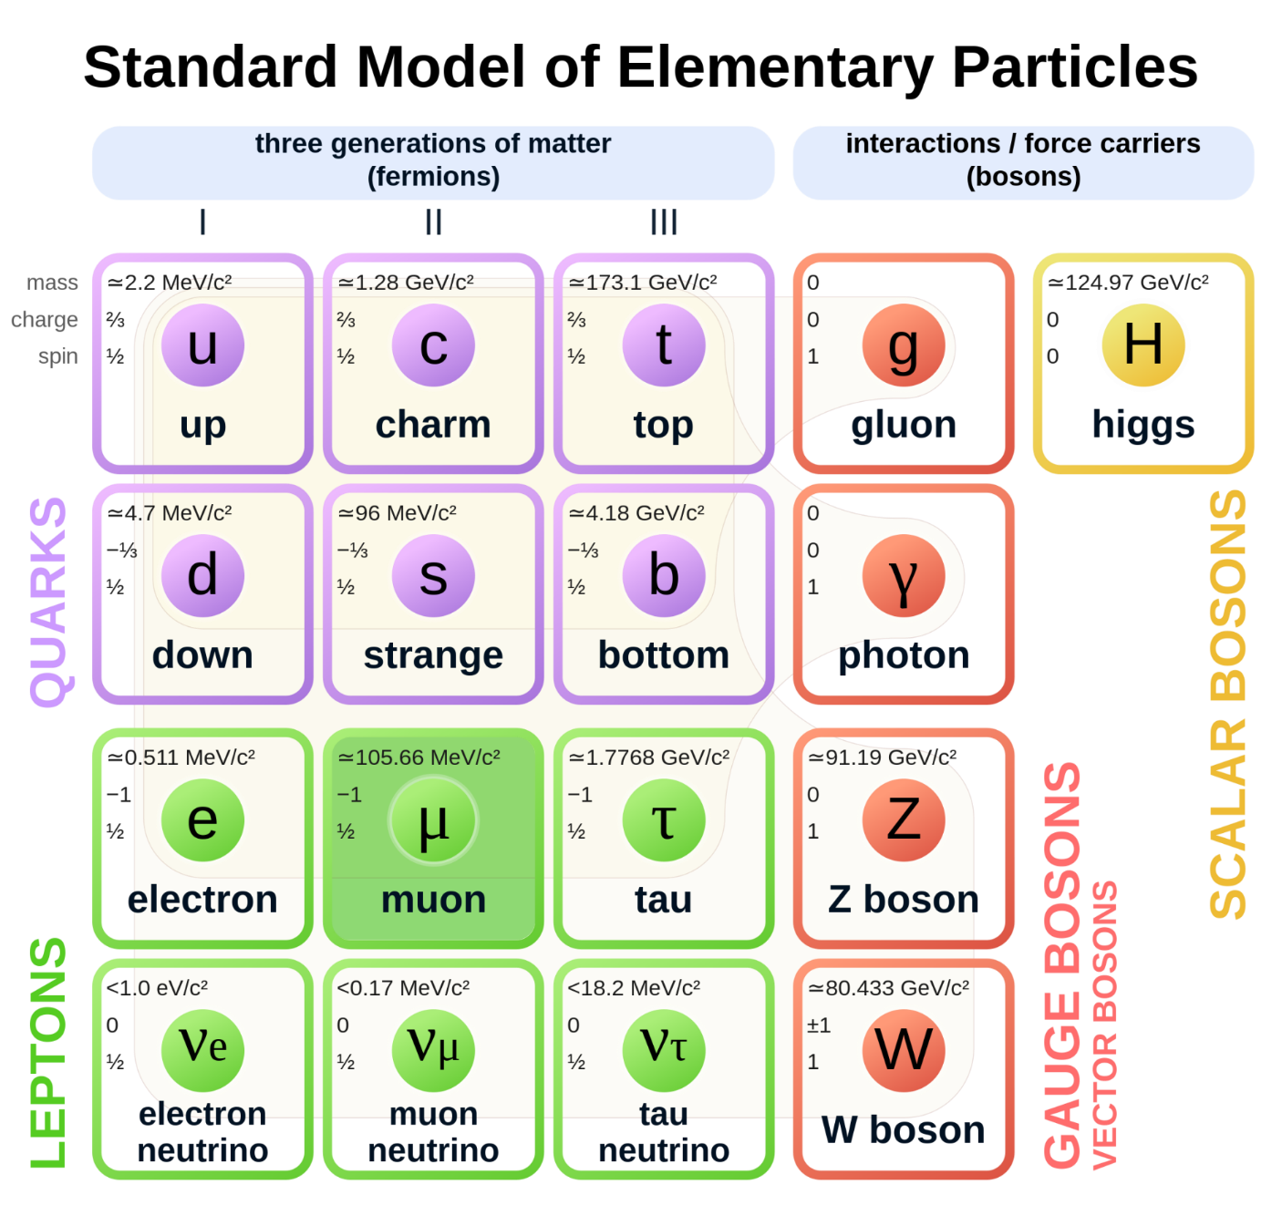
Muons
Electrically charged elementary particle.
Similar to electrons,
but with a 200 times higher mass.
Unstable with a mean life time of 2 μs.
Courtesy to Wikipedia: 'Standard Model of Elementary Particles' by MissMJ

Slide 4
The Idea behind Muography – II
Muons
  can penetrate matter better than X-rays.
  can scan larger / denser objects that
  cannot be scanned with X-rays.
Muon detectors are placed around the
object that needs to be scanned.
  Fewer muons will be detected at
  paths that go through high-density materials
  (only muons with a high enough initial energy).
Muography has a wide range of applications.
  Scanning volcanos, nuclear reactors,
  cargo containers, …., and pyramids.

Slide 5
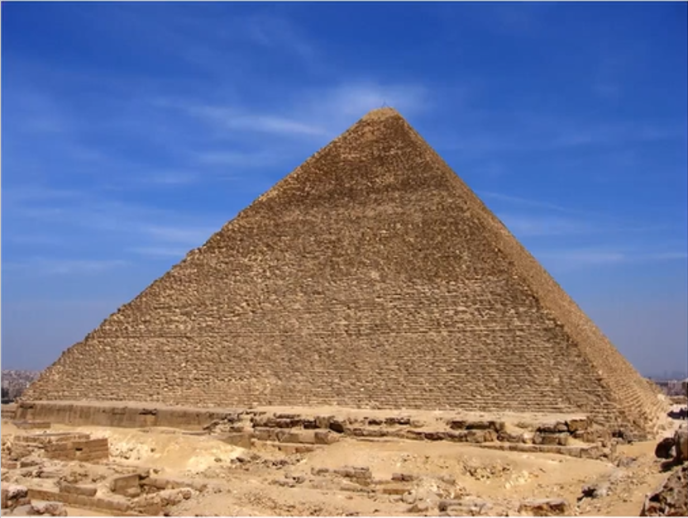
The Great Pyramid of Giza
Pyramid of Khufu (Greek: Cheops)
Built in the 26th century BC
Height: 147 m (originally), 139 m (today)
  World’s tallest building until 1311
Base: 230 m
Made of 2.5 million blocks
  Each block about 1 m³
Mostly limestone, but also granite
Still many open questions
  Details regarding how it was built.
  What is the full internal structure?
Pyramid of Khufu
Ron Gatepain, Encyclopædia Britannica
Notes:
1311: Lincoln Cathedral

Slide 6
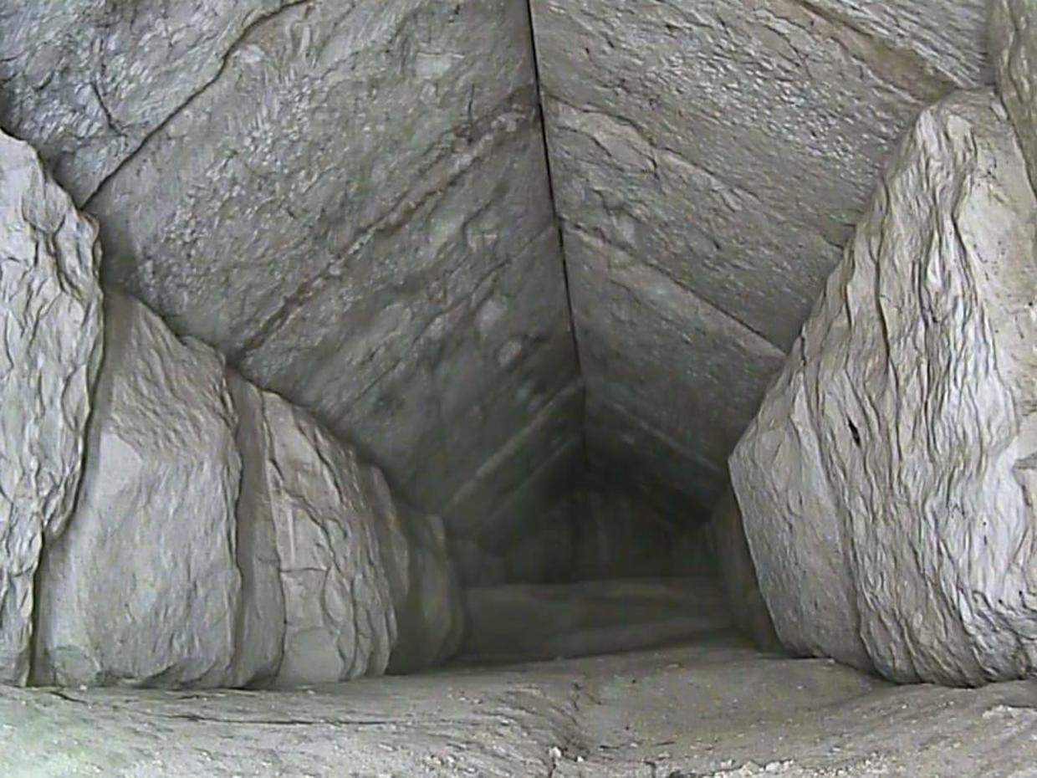
Muographic experiments at the pyramids of Giza
1970: Luis Alvarez et al. scanned the interior of Khafre’s pyramid
(2nd largest of the pyramids of Giza)
  No unknown voids found.
2017: The Scan Pyramid Project
scanned the interior of Khufu’s pyramid
  A big void above the Grand Gallery
  was discovered.
2023: The Scan Pyramid Project
discovered a corridor near the
entrance of Khufu’s pyramid.
Inside of hidden corridor
ScanPyramids/Egyptian Ministry of Tourism and Antiquities
Notes:
Alvarez: Tried to find out why the 2nd pyramid has much less complex internal structure. Used spark chambers.
Big Void: The first new structure discovered since the 19th century. Used Micromegas detectors, nuclear emulsion films, and scintillators.

Slide 7
Exploring the Great Pyramid (EGP)
The EGP mission
  A project that will scan the interior of
  Khufu’s pyramid using cosmic-ray muons.
  Will use much larger detectors than
  previous muographic scans to probe
  the pyramid with a greater precision.
  Intends to create a detailed 3D image
  of the internal structures of the
  entire pyramid.
  May reveal previously unknown
  internal structures.
  May allow us to find answers
  regarding the construction techniques.
Great Pyramid of Khufu: cross section of interior
Encyclopædia Britannica, Inc./Patrick O'Neill Riley

Slide 8
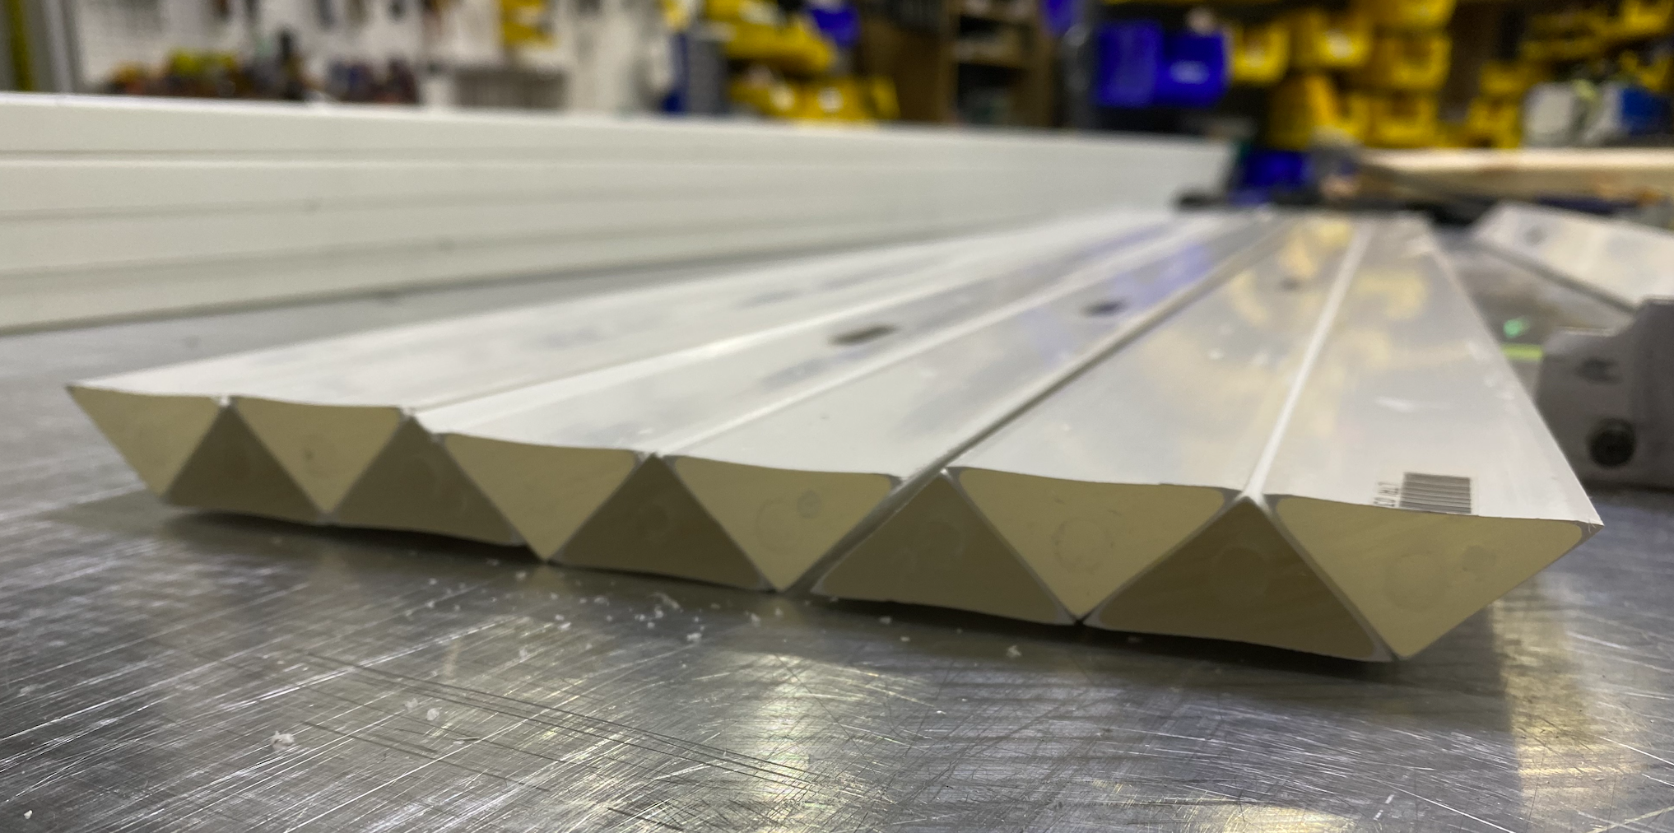
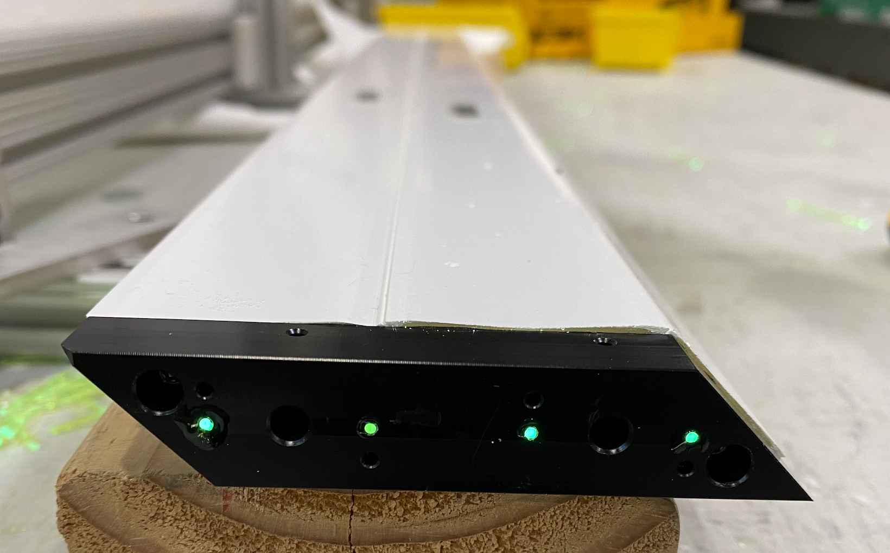
EGP Muon Detectors – I
Muon detector will be made
of scintillator counters
  Triangular cross section,
  4cm base, 2cm height
  Embedded wavelength-shifting
  fiber.
Light from the fibers is readout
with Silicon Photomultipliers.
Uses technology developed for the
Mu2e experiment at Fermilab.
Notes:
Counters made of polystyrene and 1% PPO + 0.03% POPOP, coextruded with a TiO₂ coating

Slide 9
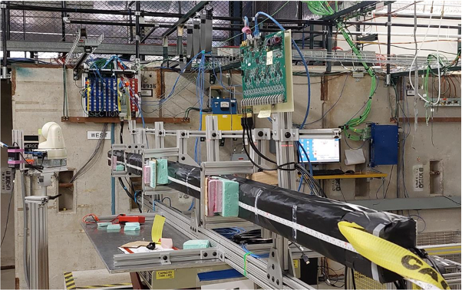
EGP Muon Detectors – II
Prototype counters were
fabricated at University of Virginia.
Tested at Fermilab’s test beam facility.
Determined that the detector
resolution is about 2 mm.
  Using light sharing
  between adjacent counters.
muon

Slide 10
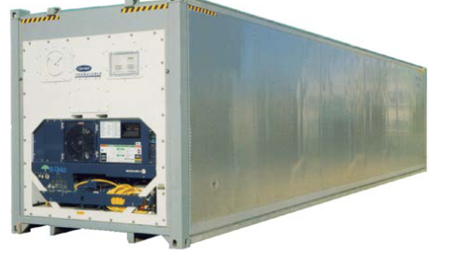
EGP Muon Detectors – III
Scintillator counters will be assembled into detector arrays.
  Detector banks have vertical and horizontal layers to
  determine the x and y location of the muon.
  Need two detector banks to reconstruct the direction of the muon.
Detectors will be placed into temperature-controlled cargo containers.
Notes:
Cargo container: Length: 40’, Width : 8’, Height: 9.5’
6 vertical modules per bank and array, 80 counters per module with a counter length of 2.4 m
3 horizontal modules per bank and array, 80 counters per module with a counter length of 4.8 m
Distance between left and right bank: 2 m

Slide 11
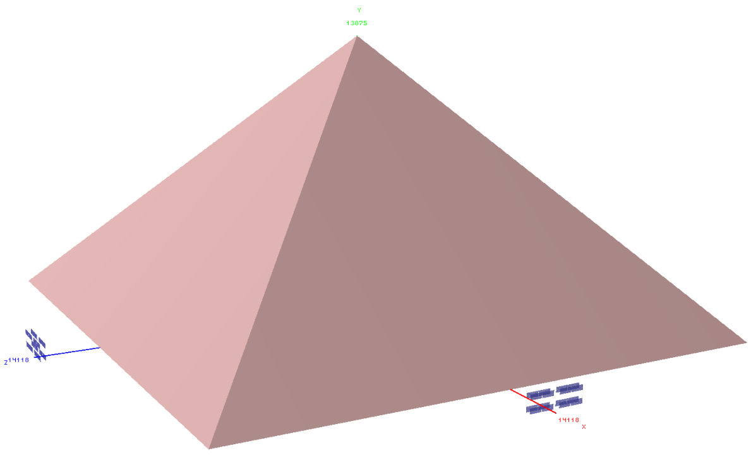
EGP Muon Detectors – IV
8 containers will be outfitted with muon detectors.
Configured into two 2×2 container arrays.
Moved into different locations
around the pyramid every few months.
Total scan time about 2 years
will allow internal
structures to be imaged
with great precision.
Notes:
Cargo container: Length: 40’, Width : 8’, Height: 9.5’

Slide 12
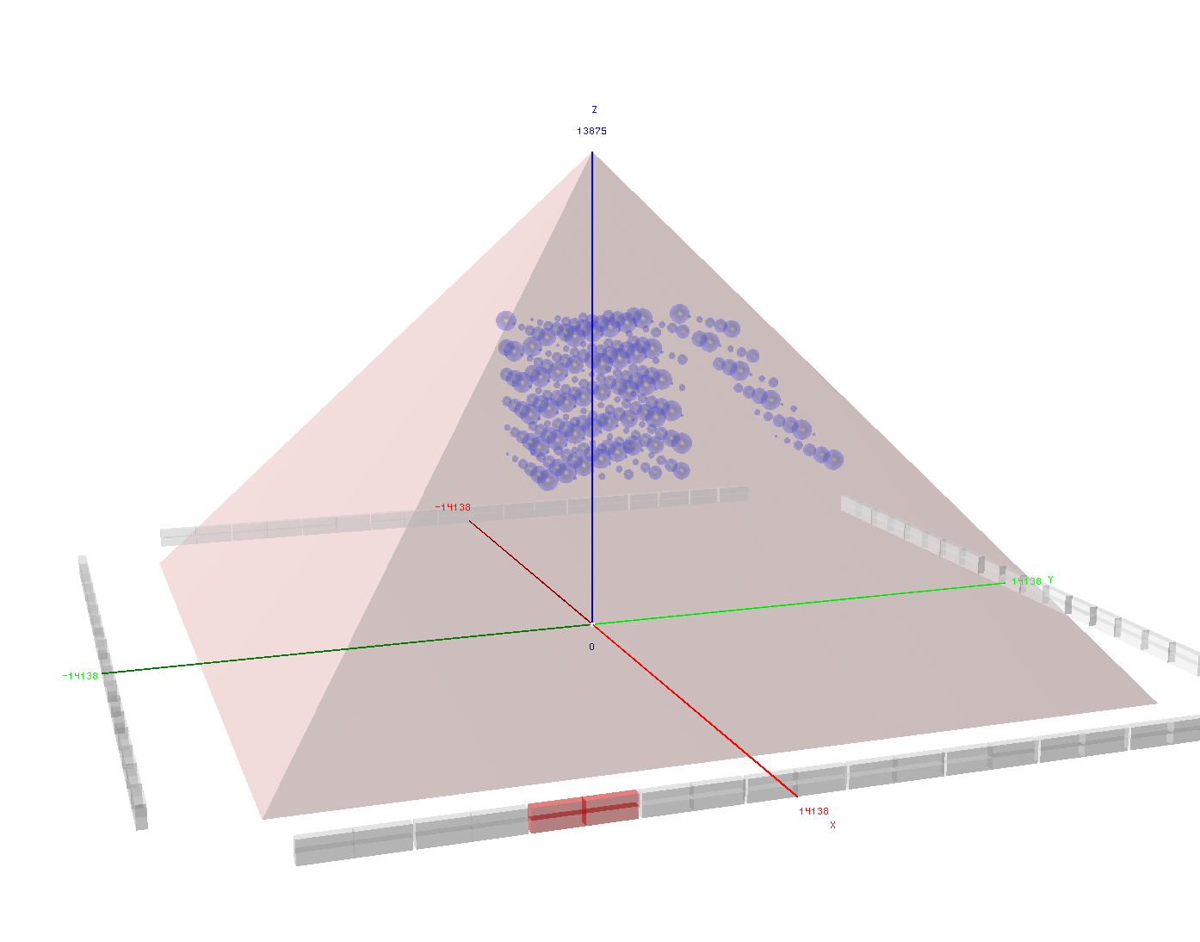
Determining the resolutions for finding voids
Simulation of pyramid with spherical voids with diameters between 1m and 6m.
  To determine the smallest possible structure visible with the EGP detectors.
z
Height 138.75m
Not all shown detector
locations will be possible
25m
y
230.33m
230.33m
25m
x
Other locations of container array
2×2 container array

Slide 13
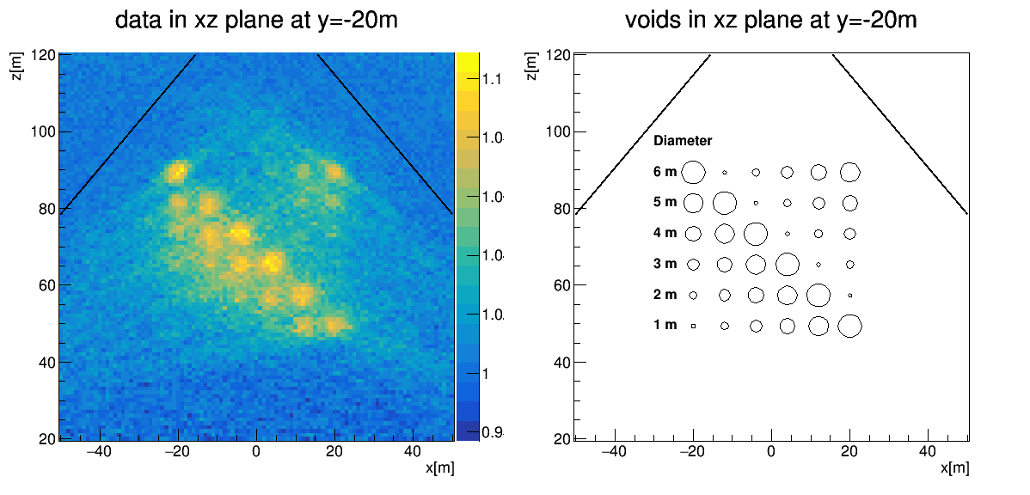

Determining the resolutions for finding voids
Simulation of pyramid with spherical voids with diameters between 1 m and 6 m.
  Total exposure time about 2 years (of two 2×2 container arrays at different locations).
  Back projection of simulated data.
  Voids with diameters as small as 3 m are visible.
  Shown here: one slice through the 3D image (xz plane at y=-20 m).
z
y
x
Simulated voids
Reconstructed voids

Slide 14
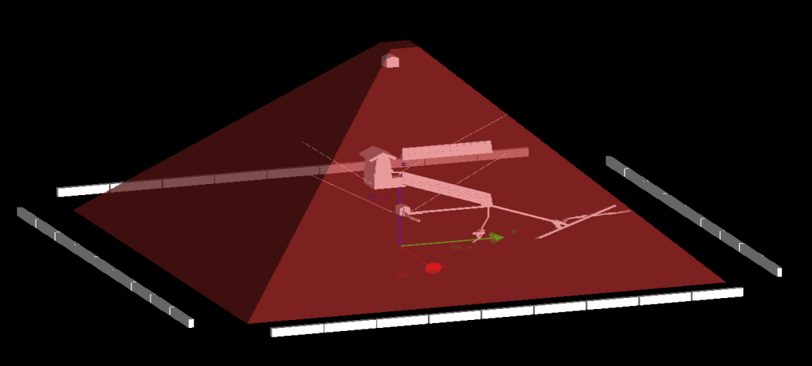
Simulating a realistic model of the pyramid with additional structures
Pyramid based on a CAD model of Khufu’s pyramid plus additional voids.
  To show EGP capability to see known and additional internal structures.
Hypothetical 2nd King’s chamber
Scan Pyramid’s
Big Void
King’s chamber
Additional structures
Big void:
based on results of
the Scan Pyramid
project.
2nd King’s chamber:
based on
micro-gravity data.
Grand Gallery
Detector locations
Queen’s chamber
Not all shown detector locations will be possible.

Slide 15
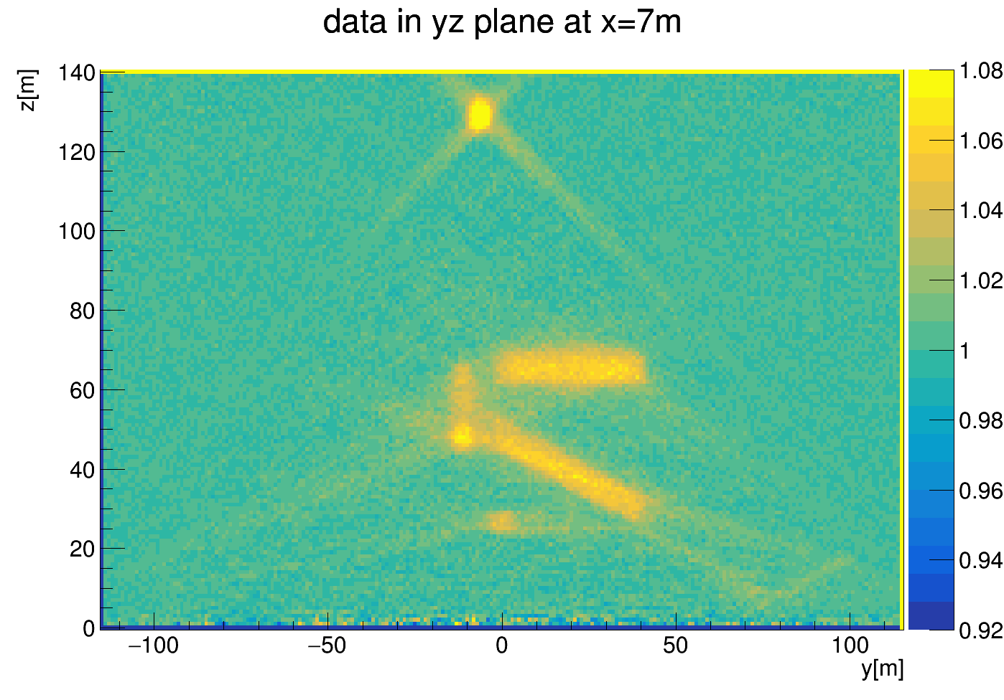
Simulating a realistic model of the pyramid with additional structures
Pyramid based on a CAD model of Khufu’s pyramid plus two additional structures.
  Total exposure time about 2 years (of two 2x2 container arrays at different locations).
  Back projection of simulated data.
  Known and additional internal structures are visible.
Simulated model of the pyramid with
two additional voids
A north-south slice through the King’s
chamber of the reconstructed 3D image
of the simulated pyramid

Slide 16
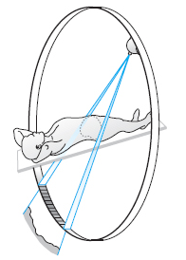
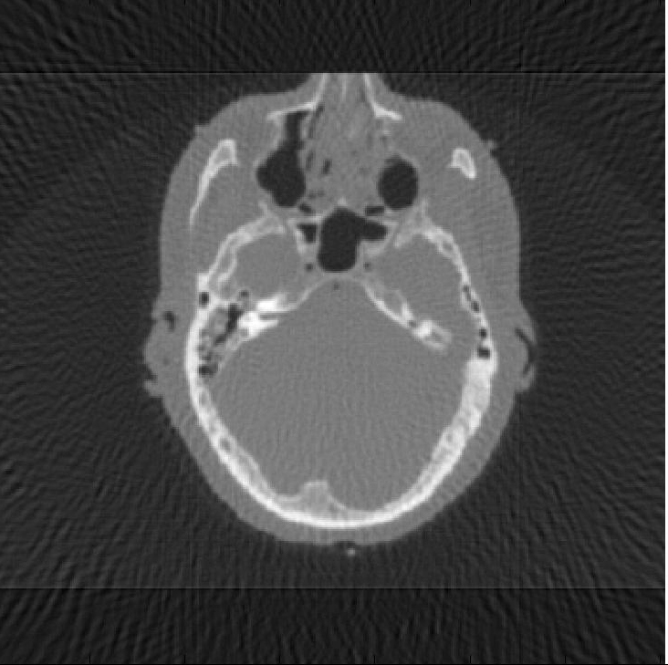
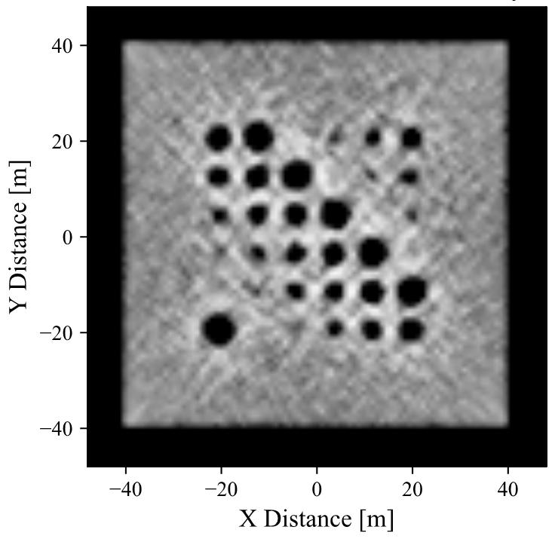
Tomographic reconstruction
Next step: Improve the reconstruction by
using an iterative reconstruction algorithm.
  Similar to CT scans used
  in medical applications.
  Example: Horizontal slice through
  a tomographically reconstructed
  3D image of a pyramid with
  spherical voids.
    Work in progress: Data is not based
    on a full simulation e.g. with multiple
    scattering.

Slide 17
Status of EGP
The Egyptian Ministry of Antiquities requested proposals for a follow-up study after the results of the Scan Pyramid project’s discovery.
  EGP was approved in 2018.
Seed funding
  The EGP mission received a grant from the University of Chicago’s Big Ideas Generator.
  Fermilab/DOE has supplied matching funds.
  We have been given resources at the open science grid to run simulations.
Detector design is ready.
Prototype counters built, tested and found to meet the requirements.
Simulations have been run to determine the capabilities of the detectors.
We are ready to go.

Slide 18







EGP Mission Team
Fermilab:
Alan Bross, Anna Pla-Dalmau, Sten Hansen, Paul Rubinov
University of Virginia:
E. C. Dukes, Ralf Ehrlich, Eric Fernandez
Virginia Tech:
Sophie Dukes
Cairo University:
Mohamed Gobashy
University of Oxford:
Ishbel Jamieson
University of Chicago:
Joren Husic, George Iskander, Patrick LaRiviere, Mira Liu,
Omar Shohoud, Phillip Vargas, Tabitha Welch
Yale University:
Gregory Marouard, Nadine Moeller

