Slide 1


Get Started with
Pearson Mastering Physics and Inclusive Access
I
Image by Tang Yau Hoong
PHYS 2020
Spring 2022
Presentation Title Arial Bold 7 pt
1
Notes:
This presentation is for MyLab courses that are NOT integrated with a third party learning management system (Blackboard, Canvas, etc). For MyLab courses integrated with an LMS, please access Get Your Students Started resources from https://www.pearsonmylabandmastering.com/northamerica/educators/support/lms-integration-services/index.html.

Slide 2
Your Local Pearson Team:
Ashley McPherson
Pearson Representative ashley.mcpherson@pearson.com
Saleem Abu-Tayeh
Pearson Campus Ambassador
UVA Student sa6km@virginia.edu

Slide 3

a $25 gift card
And you’ll be automatically entered to win a $25.00 eCard to the UVA Bookstore
$25.00 eCard to the UVA Bookstore
DATE: tbd
DATE:
DATE:
LOCATION:
https://pearson.zoom.us/j/98778811722?pwd=OWFvSVlYTGJrTklvOTA0VHByb21RQT09

Slide 4
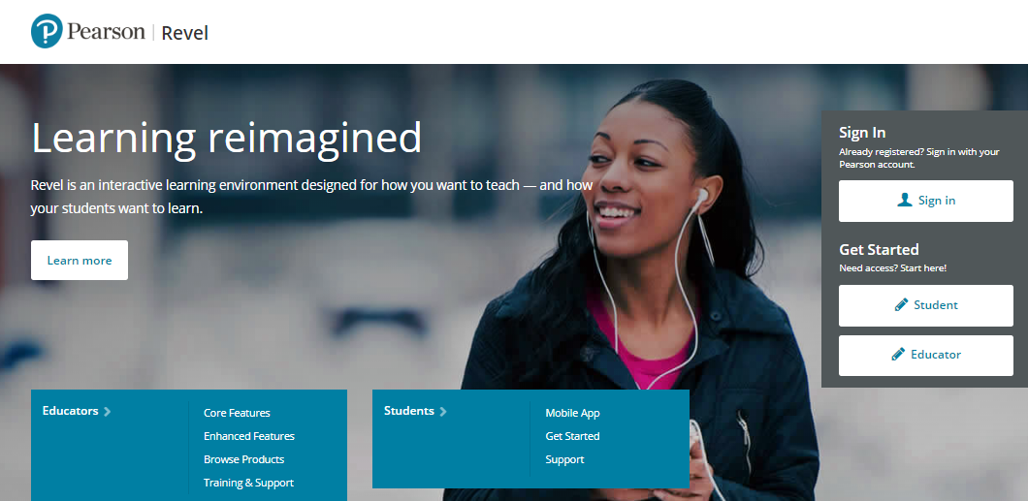
Welcome to First Day of Class
What is Inclusive Access?
How to register your access code?
Using your course materials
Support your success

Slide 5
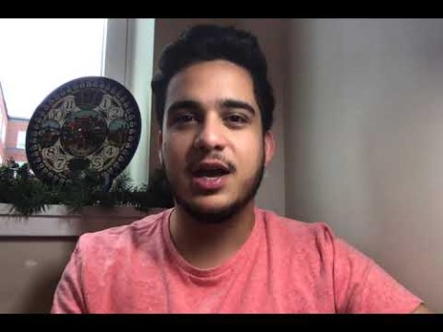
What is Inclusive Access?

Slide 6
How do YOU get registered for Mastering Physics?

Slide 7
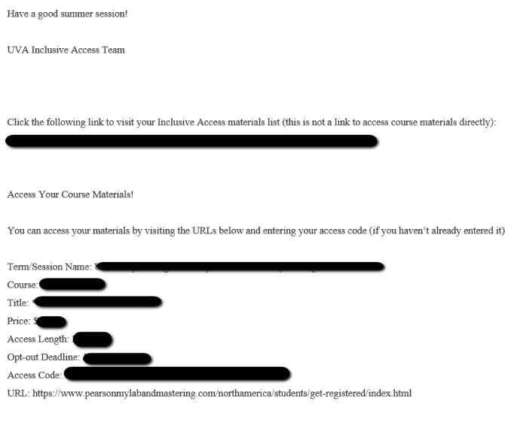
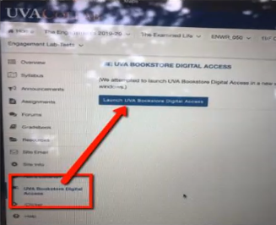
Step 1: Access Code from UVA for Mastering in Inclusive Access
There are multiple places you can locate your access code and information about the Inclusive Access program for this course.
Option 1: You will receive an email like the one below that will include an access code.
Option 2: Login to your Collab Course – Locate UVA Bookstore Inclusive Access
NOTE: It’s the same access code just
located for you in two places.
Notes:
Getting Started is easy! We’ll walk you through the process right now so that you can follow along with us or learn the steps so you can be familiar with the process after class.
Step 1: Log onto MasteringAstronomy.com. Under the large Register Now section on the right side of the page, click the Student button.

Slide 8
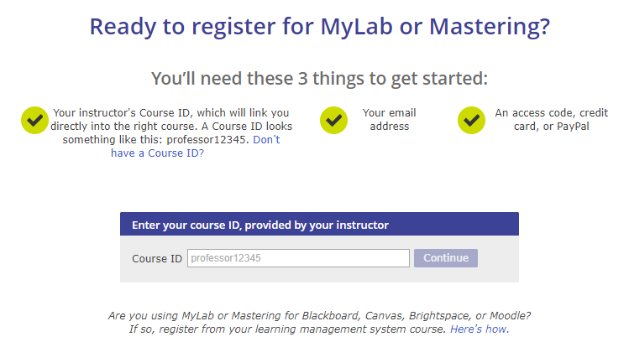
Get Started - Step 2
After you have copied and pasted your access code, you will follow these steps:
Go to www.pearsonmylabandmastering.com
Select Register- Student
Put in the Course ID: (this is unique to your instructor and term)
  Section 1: dukes17529
  Section 2: pham01644
Notes:
Getting Started is easy! We’ll walk you through the process right now so that you can follow along with us or learn the steps so you can be familiar with the process after class.
Step 1: Log onto MasteringAstronomy.com. Under the large Register Now section on the right side of the page, click the Student button.

Slide 9
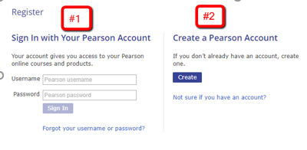
Get Started - Step 3
You will select to either use an existing Pearson account (from another class) or create a new account
Please note, this does not exempt you from needing an access code (from Collab) to register.
Notes:
Getting Started is easy! We’ll walk you through the process right now so that you can follow along with us or learn the steps so you can be familiar with the process after class.
Step 1: Log onto MasteringAstronomy.com. Under the large Register Now section on the right side of the page, click the Student button.

Slide 10
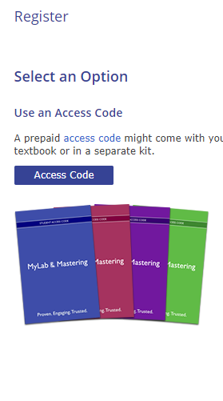
Get Started - Step 4
You will select “Access Code” and use the code you copied from Collab to finish your registration.
Then you will be billed by the University your course fee for the access codes ($65.87)
NOTE: This is where you use the access code in your email or Collab course! It gives you access to MasteringPhysics with e-Book for 18 weeks
If you choose to purchase access else where please be sure to OPT OUT from the Inclusive Access program so you are not charged. Your email from UVA will give you the deadline to OPT OUT.
Notes:
Getting Started is easy! We’ll walk you through the process right now so that you can follow along with us or learn the steps so you can be familiar with the process after class.
Step 1: Log onto MasteringAstronomy.com. Under the large Register Now section on the right side of the page, click the Student button.

Slide 11
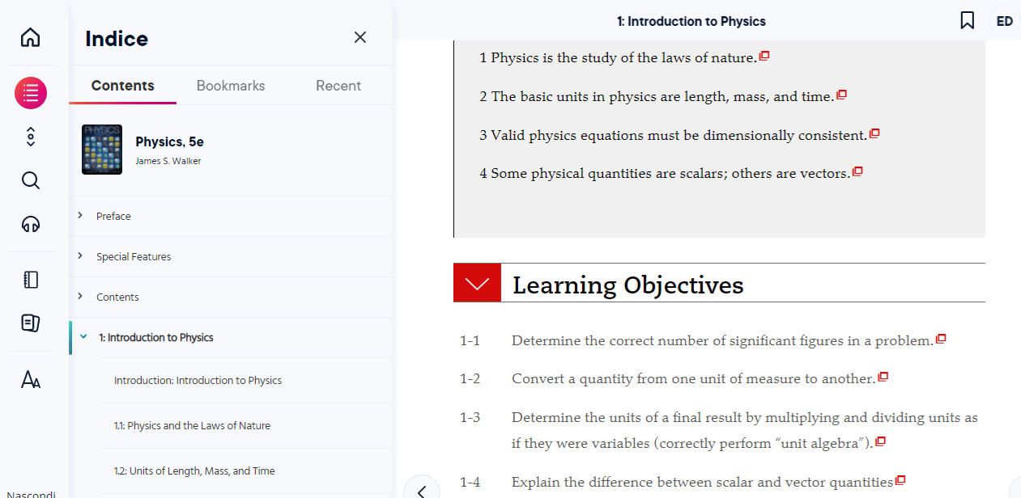
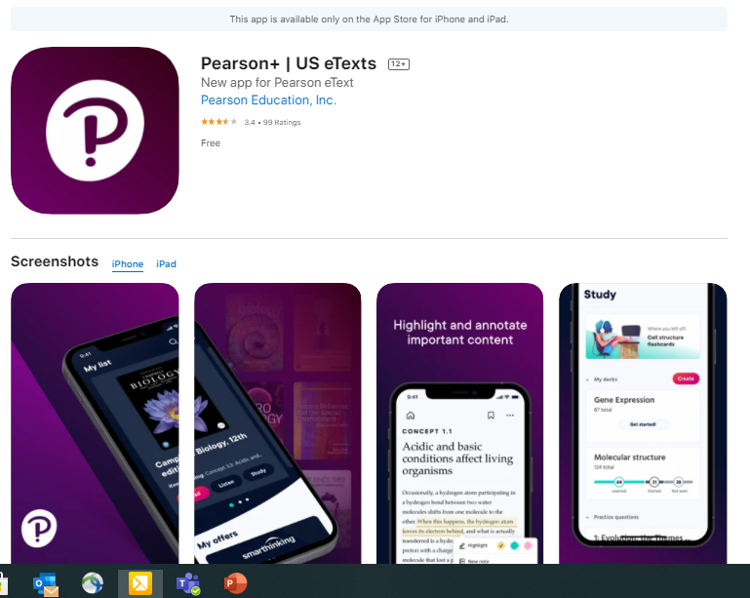
Pearson+ eText (within Mastering and Free App)
Pearson+ eText Features:
      Highlight
      Note Organization
      Exporting Notes
      Study Tools
Download free Pearson+ app to any Andriod/Apple Device

Slide 12
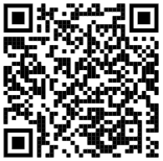


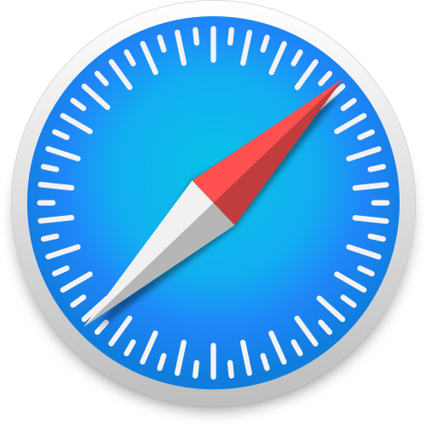
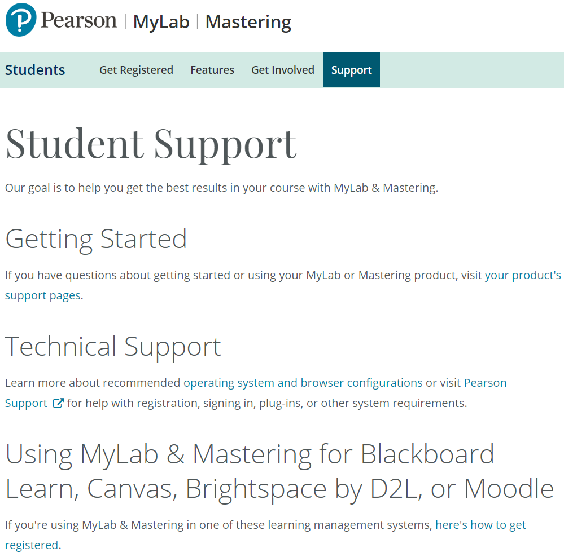
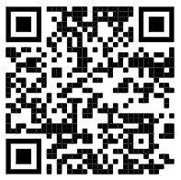
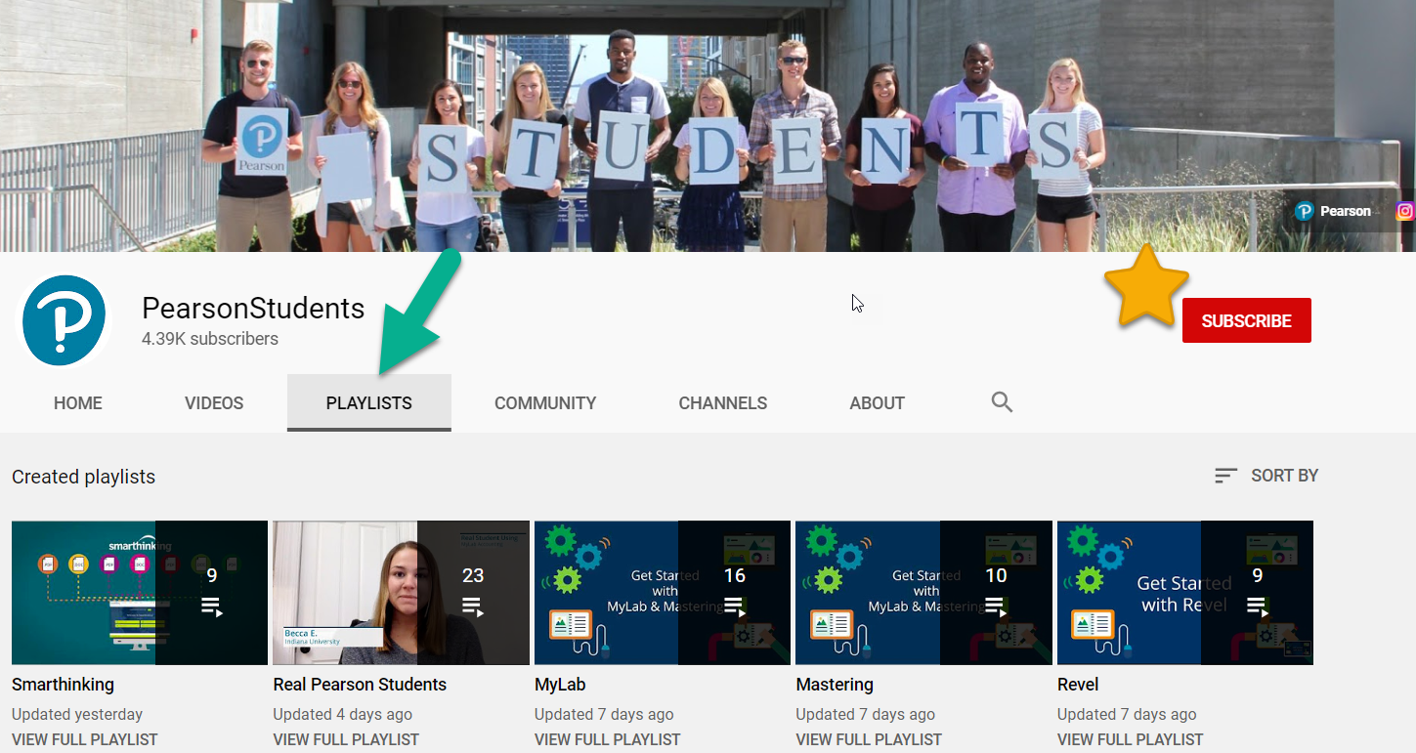
Tips for Success:
Browsers:
ONLY USE CHROME, FIREFOX or SAFARI
Subscribe to Pearson Students YouTube Channel:
Student Support Site
Accessibility – be sure to start with the accessibility office on campus.
  Note: accessibility link available on Mastering site for additional help
FDOC
12

Slide 13
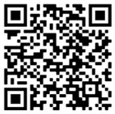
If you need to contact Tech Support for help, please scan this code
You’ll be taken to a survey to fill out your information and then see icons to select how you want to interact with Support. Please include your information so they can quickly help you!

Slide 14
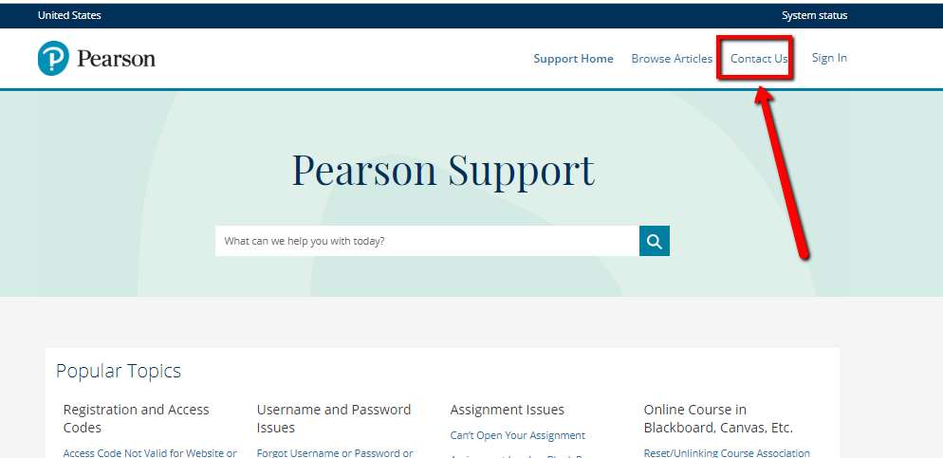
Need Help?
Visit https://support.pearson.com/getsupport/s/Go to: “Get Started” under “Students”
Here you will find:
Helpful videos
Frequently Asked Questions
System Requirements
A “Getting Started” guide
Need more help?
You can visit our Pearson Revel Support site at:
http://support.pearson.com/getsupport
Notes:
Getting Started is easy! We’ll walk you through the process right now so that you can follow along with us or learn the steps so you can be familiar with the process after class.
Step 1: Log onto MasteringAstronomy.com. Under the large Register Now section on the right side of the page, click the Student button.

