Slide 1
Beyond E = mc²
Using Rare Particle Decays to
Probe the Energy Frontier
Exploiting Heisenberg’s Uncertainty Principle to trump Einstein’s E=mc²
E. Craig Dukes
University of Virginia
BCVSPIN 2011
July 27, 2011

Slide 2
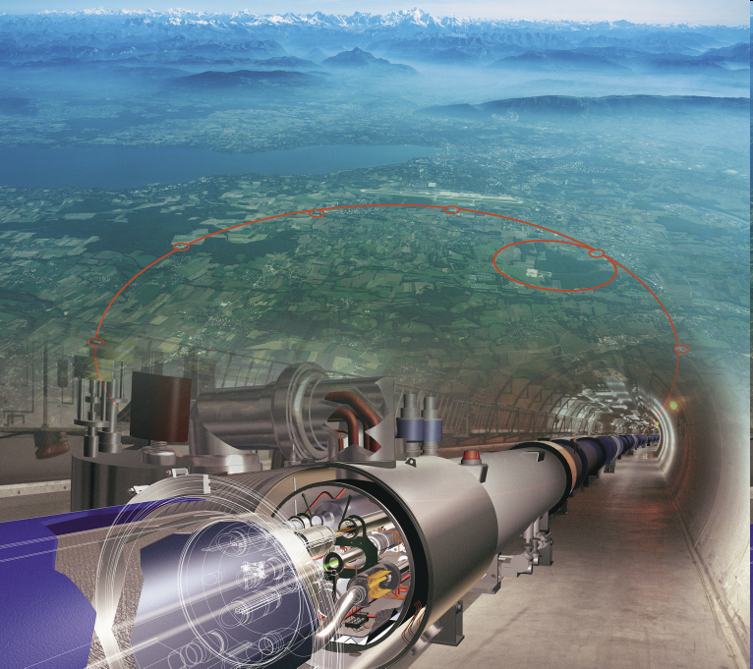
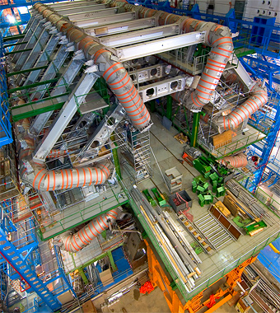
The World Eagerly Awaits Physics from the LHC
7 trillion (10¹²) eV proton energy:
7X Fermilab Tevatron
Notes:
Now if you talk to a particle physicist these days you’ll find him or her all excited about the Large Hadron Collider that has started taking data at CERN in Genevea, Switzerland as it represents a leap of a factor of 7 over the previous highest-energy particle accelerator: the Fermilab Tevatron. Actually, it’s not quite there yet – it may take a few years to get to 7 TeV – but we are all still quite excited.

Slide 3

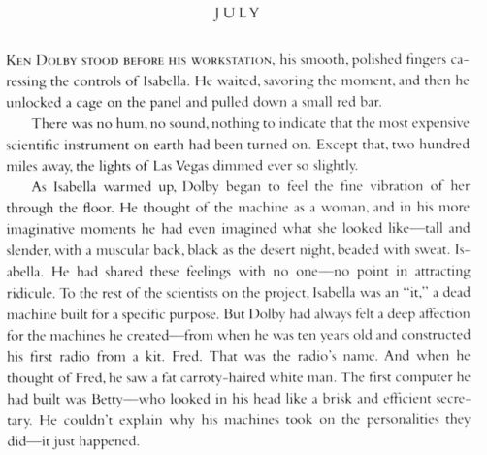
LHC Has Already Had a Profound Impact
On bad literature!
Notes:
Now, although it has not yet really produced any physics, the LHC has already had an impact – on bad literature!
Read passage.

Slide 4




Angels and Demons
Notes:
So if you want to really know what the life of a particle physicist is like, download Angels and Demons, or read the book.

Slide 5

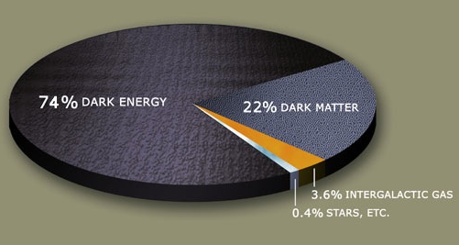
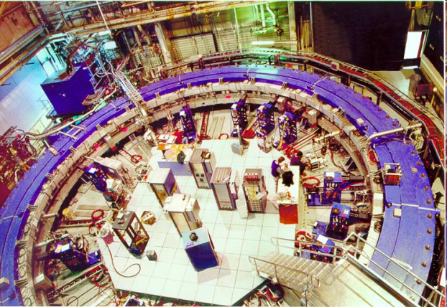
The Cause of our Excitement
Theory
Understanding of the electromagnetic and weak interactions ⇨ Higgs?
Origin of neutrino mass hierarchy
Solution to hierarchy problem ⇨ supersymmetry?
Some of this New Physics may appear
at energies too high
for the LHC
New Physics!
Cosmology
Matter-antimatter asymmetry in the universe
Dark matter
Dark energy
Experiment
Neutrino mass ⇨ first evidence of physics beyond the standard model
Weak interaction studies ⇨ Higgs?
Other hints, muon g-2, NuTeV, CP phases in B_{s} mixing, D_{s} decay rates, W+jets, Top AFB
Notes:
The cause of our excitement is the almost certainty we have that there is New Physics beyond what we call the Standard Model, that the Standard Model is incomplete, and that some of this New Physics lies just around the corner.
The reasons we think there is New Physics are several. There are theoretical reasons, such as our understanding of how the electromagnetic and weak interactions are separated, which presumes a new particle called the Higgs, which actually is the last missing piece of the Standard Model, and the particle that provides the origin of mass, so it holds a really special place in the Standard Model. Solutions to several so-called mass hierarchy problems, for example, why we think the Higgs is so light compared to the scale at which all the forces are unified, and why the neutrinos have the masses they do, also suggest new physics.
There is also evidence from cosmology that our Standard Model is incomplete. For example, the Standard Model seems unable to explain why there is no longer any antimatter in the universe, and provides few clues as to the origin of dark energy and dark matter, which dominate the energy budget of the universe.
There are just a few experimental hints, and they are all marginal. Of course the recent discovery of neutrino mass, through neutrino oscillations, has led to the first evidence that there is indeed physics not explained by the Standard Model. Experimental studies of the weak interaction imply that the Higgs particle, is just within our grasp. And there are other tantalizing experimental hints that suggest New Physics, but nothing that is compelling.
However, before we get too euphoric, I should caution you that some of this New Physics may appear at energies too high for the Large Hadron Collider.

Slide 6
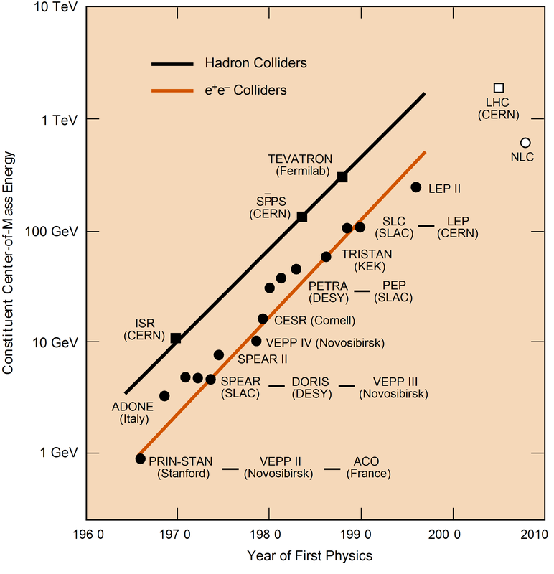
Is the Large Hadron Collider the Last in a Long Line of ever Higher Energy Particle Accelerators?
Presently there are no concrete plans for an accelerator to probe the next energy regime
How are we going to probe
higher mass scales without higher energies?
Notes:
So what about the next step? How are we going to probe energy scales that are beyond the reach of the Large Hadron Collider? Although there has been an inexorable increase in accelerator energies over the last 50 years, as you can see by this plot particle physcists call the Livingston plot, for the first time in brief history of the field there are no concrete plans for the next generation of higher-energy accelerators. There is the International Linear Collider, called the NLC here, but it is designed to make precision studies of the regime first explored by the LHC, not to probe the next energy frontier.
How are we going to probe higher energies?

Slide 7
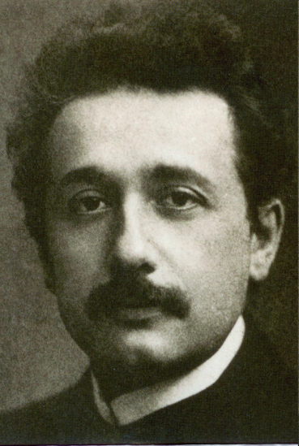
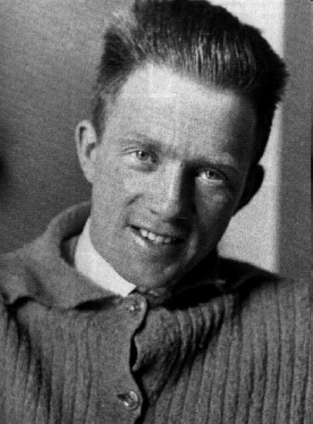
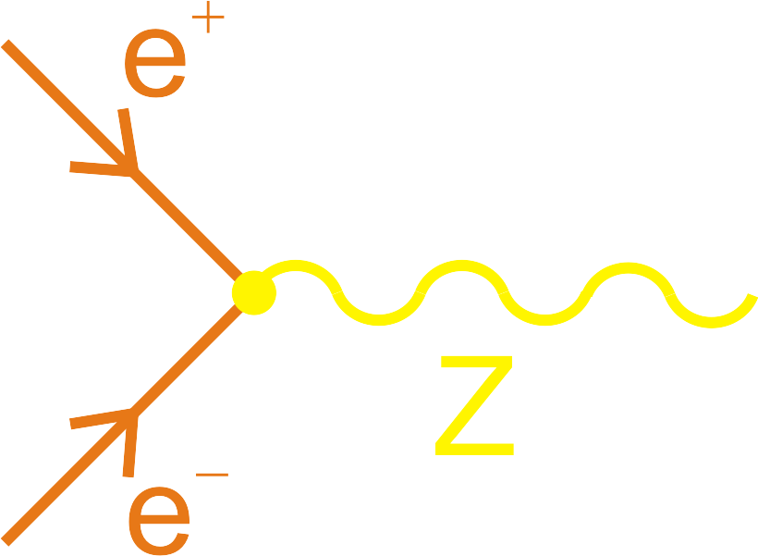
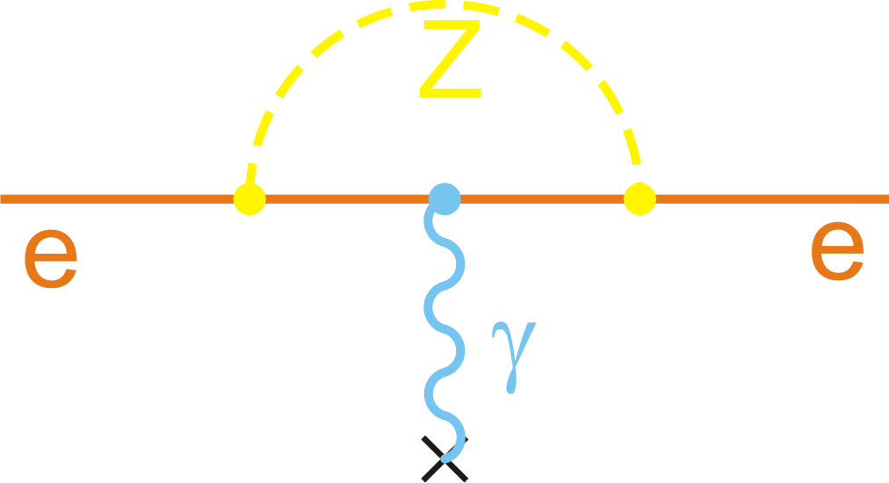
Rather than exploiting Einstein’s mass-energy relation, E=mc², exploit Heisenberg’s uncertainty principle, ΔEΔt≳ħ/2
E=mc²
appearance of real new particles
ΔEΔt ≳ ħ
appearance of virtual new particles
Highest energy crucial
Highest intensities crucial
Loop diagrams
Notes:
The answer is we must turn away from our reliance on Einstein’s mass-energy relation, E=mc2, and exploit Heisenberg’s uncertainty principle. So, for example, rather than directly producing the Z boson, one of the carriers of the weak force, through electron-positron annihilation, we look for the effects of a virtual Z boson, which according to Heisenberg, even at low energies can be produced ever so briefly, and hence change for example, some of the properties of the electron, in particular, its magnetic moment. Such virtual particles appear and then disappear in what particle physicists call loop diagrams, which you will see throughout my talk.
In directly producing real particles the highest energies are crucial, the energy must be greater than the rest mass of the particle to be created. On the other hand, the effects of virtual particles can be quite subtle and hence large numbers are needed.

Slide 8

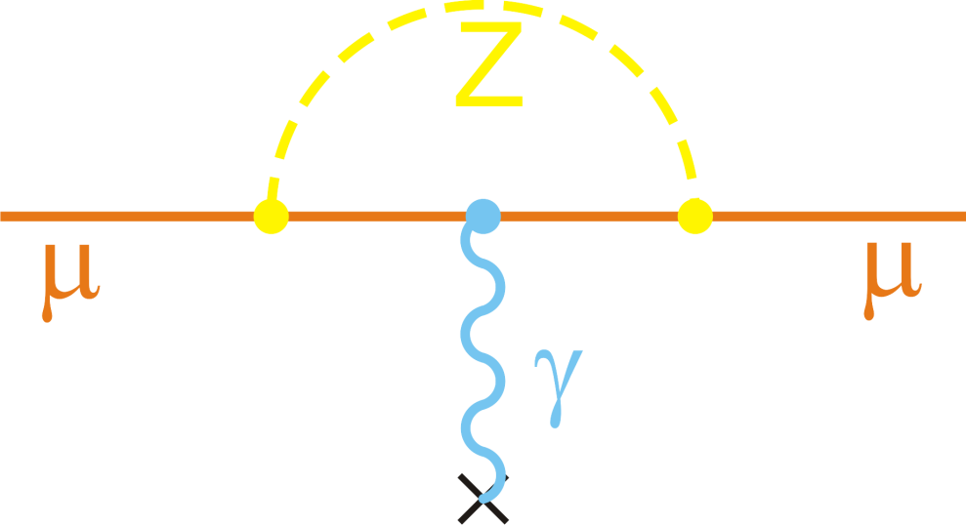
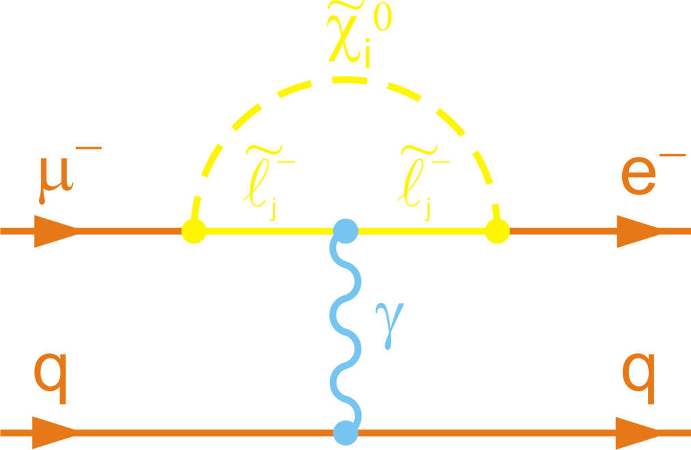
Virtual Particles Can Have Two Effects
They can produce slight deviations from expected properties
$50,000 reward from Cornell lab of ornithology!
Difficult experiments:
incredible precisions often needed
theoretical precision needed too
precision ∝ 1/√N
They can allow forbidden processes, Rare Decays, to occur
Ivory-billed woodpecker
“Easy” search experiments:
theory ⇨ process is “forbidden”
one event can be enough
sensitivity ∝ 1/N
Notes:
These virtual particles can have two effects. They can produce slight deviations from the expected properties of a particle, such as the magnetic moment of a muon. Or they can allow processes forbidden in the Standard Model to occur, such as the decay of a muon into an electron, which I’ve shown here as being due to a yet-to-be-discovered supersymmetric interaction.
Looking for slight deviations is hard, in particular one needs the theoretical precision to match the experimental, and the sensitivity scales only as the square root of the number of events: what I call the tyranny of Possion statistics. Searching for rare decays is easier, all we need theory to tell us is that the process is forbidden, or at least, highly supressed. One event, if sufficiently clean, is enough for a discovery. It is analagous, for example, to searching for the Ivory-billed woodpecker, thought to be extinct, but reported sighted a few years ago. One unambiguous sighting is enough.
Actually it’s not quite the same. You’ll get $50,000 for the ivory-billedwoodpecker. I don’t know of any such offers in particle physics, but it would be amusing to see how motivated such an offer might be to students, postdocs, and even professors!

Slide 9
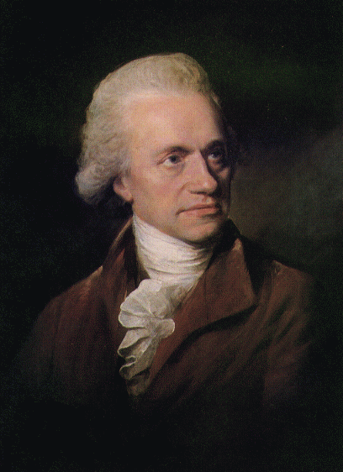
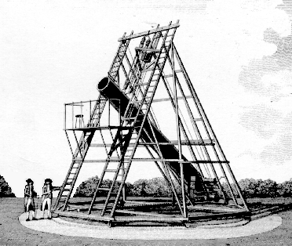
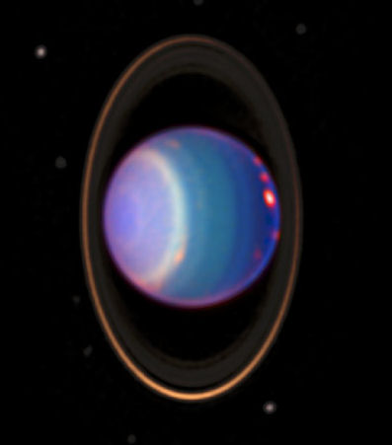
This Indirect Approach has a Distinguished Past
Starts with William Herschel’s discovery Uranus in 1781
Uranus was the first planet to be discovered – all others were known to the ancients
Soon a problem appeared ⇨ orbit of Uranus was found to deviate from predictions from Newton’s Laws
Notes:
There is nothing new to this indirect approach to discovery that I’ve just described. And if you permit me a few minutes digression I’ll say a few words about it’s history. You could say it began with William Herschel’s discovery of Uranus in 1781, the first planet to be discovered. Shortly thereafter a problem appeared: the orbit was found to deviate from the predicted value calculated using Newton’s laws.

Slide 10
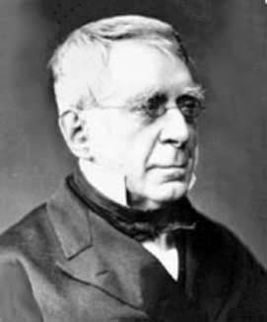
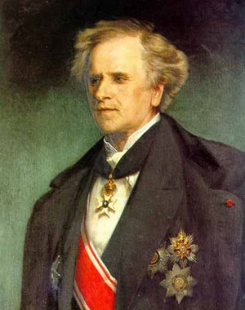
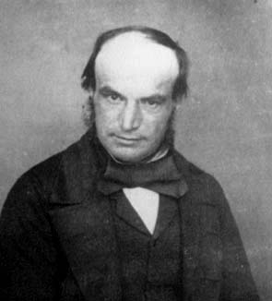
Race to find explanation began
George Airy thought that explanation lied with deviations from Newton’s law of gravitation
Le Verrier (France) and John Adams (UK) thought that the deviations were due to a hitherto unknown planet
Notes:
A race began to find an explanation, with some, like George Airy, proposing that Newton’s law of gravitation had to be modified, whereas others like Le Verrier in France and John Adams in England thought that the cause was perturbations from a hitherto unknown planet.

Slide 11
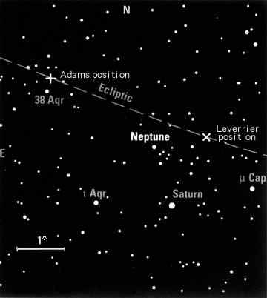
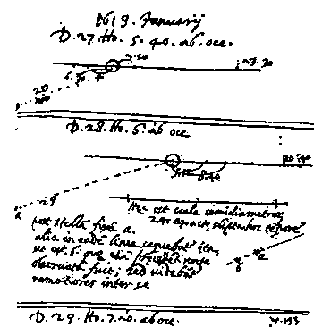
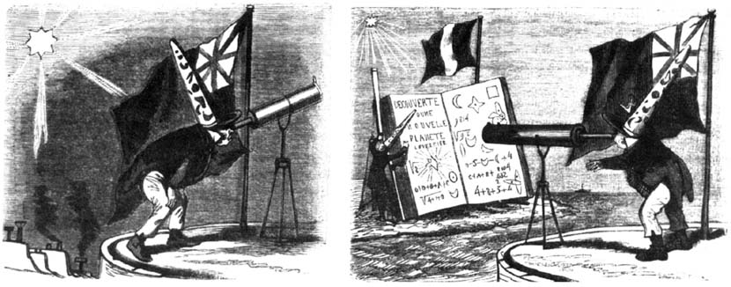
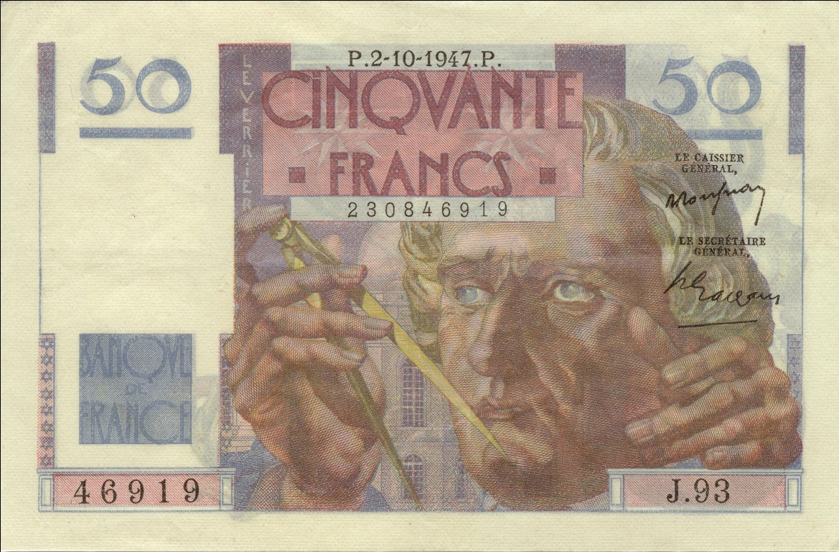
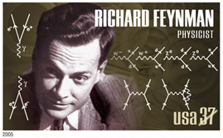
Newton Vindicated
Le Verrier won: September 18, 1846 he wrote a letter asking Johann Galle at the Berlin Observatory if he might have a look
On September 23 Galle in Berlin found Le Verrier’s planet
Le Verrier had “discovered a planet with the tip of his pen, without other instrument than the strength of his calculations alone”
Flammarion
Neptune had already been seen by Galileo!
Notes:
Le Verrier won, the same day Johann Galle in Berlin received a letter from Le Verrier suggesting that he search a particular part of the sky for the new planet, he found it. (Note, by the way, how fast the mail travelled back then!) The discovery caused a sensation in France, Le Verrier was awarded the Legion of Honor by Napoleon III. It was said that he had “discovered a planet with the tip of his pen, without other instrument than the strength of his calculations alone.” It was a triumph for Newton as well, and the newly developed perturbation theory techniques, and last, but not least, a triumph of French science. England may rule the waves, but France ruled the heavens.
Here’s a contemporary French cartoon showing the British astronomers looking vainly for the planet, when in fact they should have been turning their telescopes across the channel to Le Verrier’s calculations.
Le Verrier is still renowned in France. You used to see his likeness on a 50 franc note. That’s something the Europeans do that we don’t: celebrate their scientists and artists. You see their names on streets, currencies, stamps. With the exception of a fairly recent series of stamps, we just don’t do so in the states.
Note, by the way, the loop diagram in this stamp issued a few years ago honoring Feynman.

Slide 12
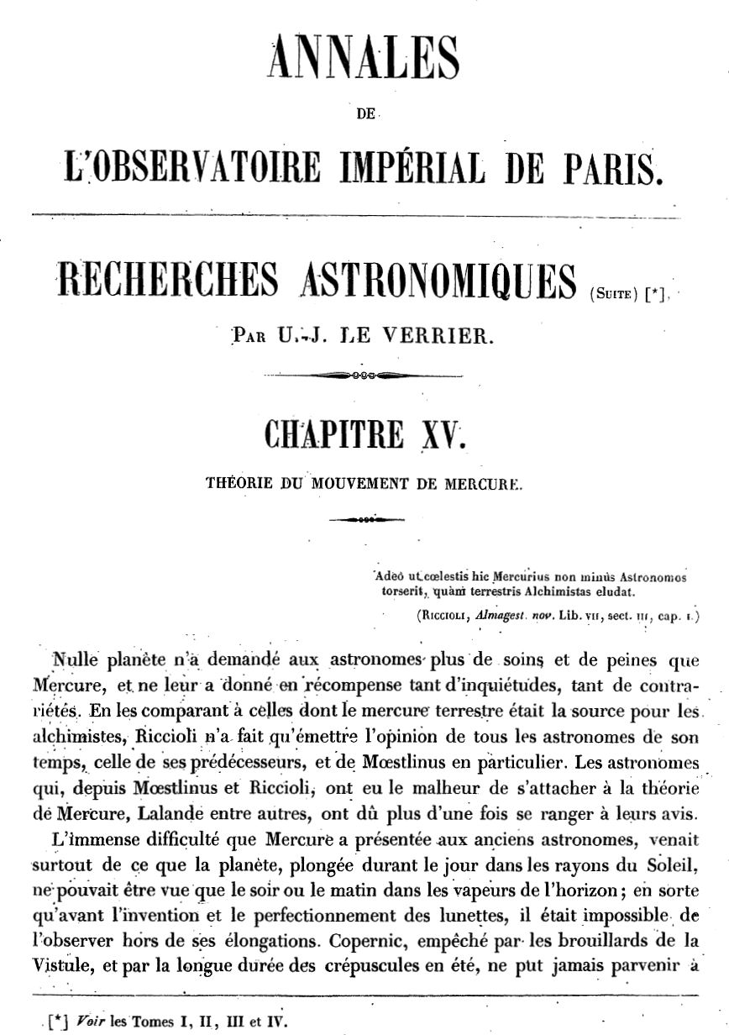
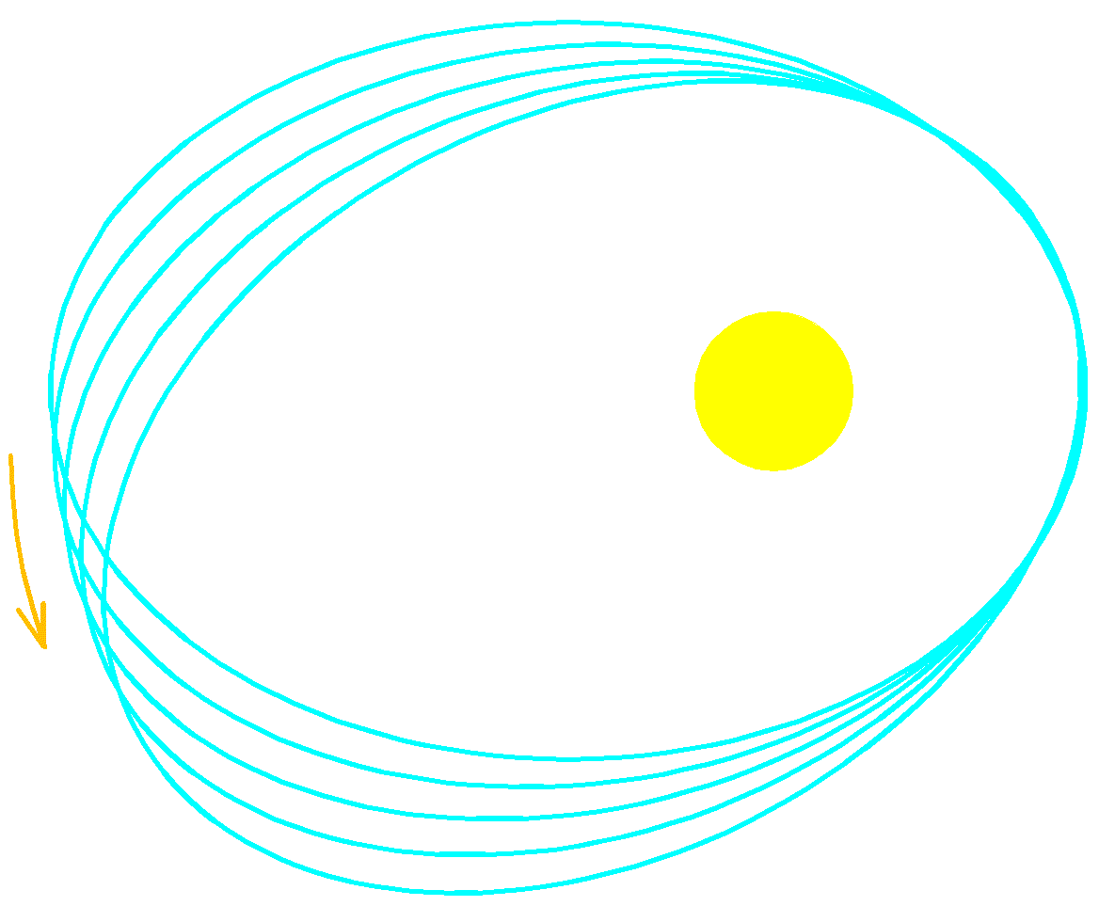

What about Mercury?
Le Verrier turned his formidable talents to the orbits of the planets and found a discrepancy in the precession of the perihelion of Mercury
Effect of the planets on the precession of Mercury’s perihelion
Venus | 280.6”
Earth | 83.6”
Mars | 2.6”
Jupiter | 152.6”
Saturn | 7.2”
Uranus | 0.1”
Total per century: | 527”
Observed: | 527”+38”
The race to find planet Vulcan had begun!
In 1859 he found a discrepancy of 1/10,000 of a degree per year!
Notes:
Emboldened, Le Verrier turned his considerable talents to the orbits of all the planets and, after a heroic calculation on the effect of all the planets on each other, he found one discrepancy, that of the precession of the perihelion of Mercury, which is the point of closest approach it makes with the Sun. It was off by 1/10,000 th of a degree per year from what was expected from the perturbations due to the other planets. And so Le Verrier, having succeeded once, turned again to the most obvious explanation: a new planet inside the orbit of Mercury. The race to find the planet Vulcan had begun.

Slide 13
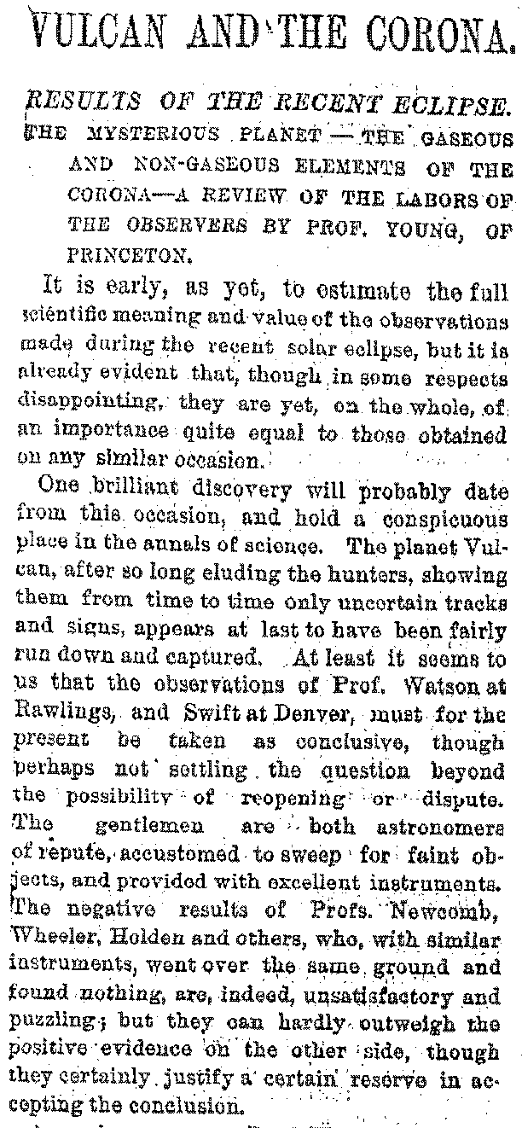
Race to Find Vulcan
New York Times, Aug. 16, 1878
Vulcan was seen many times, but never confirmed
“Dark matter” near the sun was invoked as a solution
A modification of Newton’s law of gravity was another: 1/r^{2.00000016}
The problem remained outstanding at the beginning of the 20th century
Notes:
And Vulcan was seen, indeed seen many times. But none of these sightings was confirmed. Here’s an excerpt from an article in 1878 in which even the New York Times claims it was finally confirmed. But that sighting too was fleeting.
One explanation was that there was no single planet, but a lot of non-luminous dust, what we would call dark matter today. And a slight modification of Newton’s law of gravitation was again invoked, but none of these explanations were satisfactory and the problem remained outstanding at the end of the century.

Slide 14
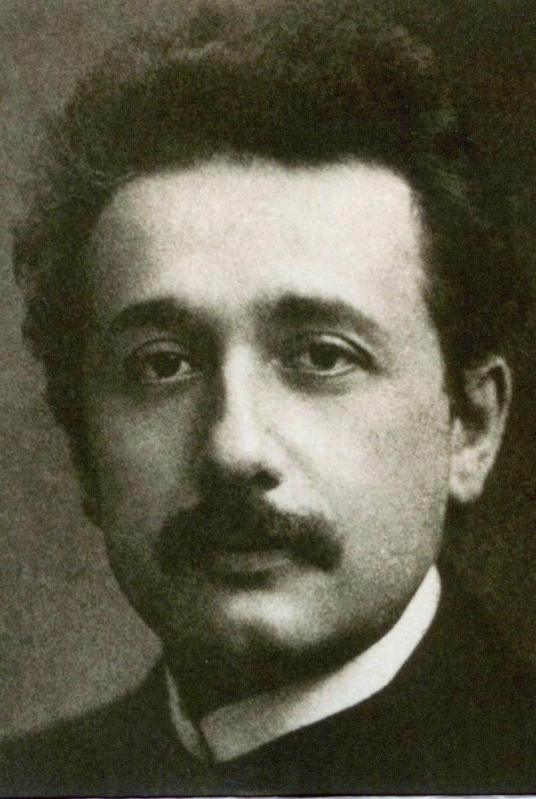
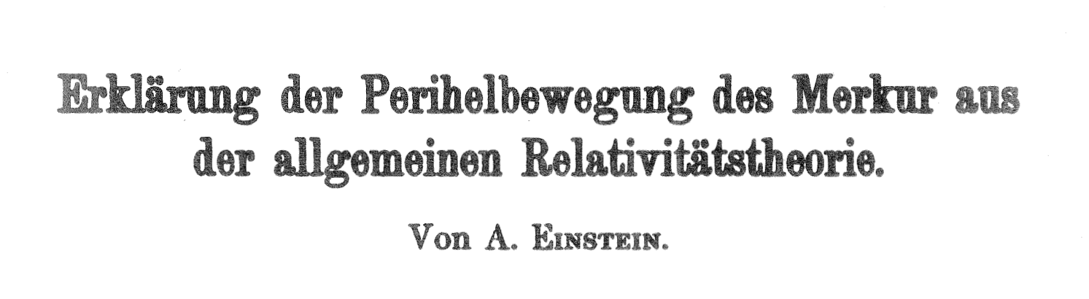
Vulcan not Found but General Relativity is
Einstein calculates the perihelion of Mercury using his new theory of General Relativity and recovers the missing 38”/century found by le Verrier 56 years earlier!
Königlich Preußische Akademie der Wissenschaften (Berlin). Sitzungsberichte (1915): 831-839.
Three weeks later admitted in a letter to Sommerfeld that he had been critical of the “pedantic accuracy of astronomy”.
“For a few days I was beside myself with joyous excitement .”
Albert Einstein, 18 November 1915
Notes:
Finally, Einstein somewhat unwittingly entered the fray with his theory of general relativity. Einstein was desperately trying to find some way to confirm that his theory was indeed correct, and he was well aware of the problem of Mercury’s orbit. When he found that his new theory predicted exactly the rate of precession he was beside himself with excitement, as one can only imagine.
Sometimes tiny effects can lead to profound discoveries.

Slide 15
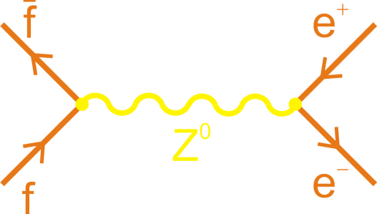
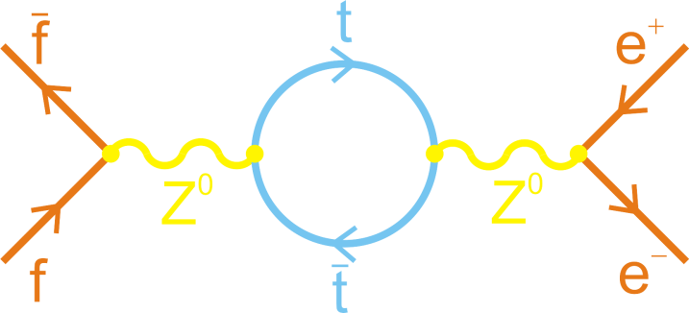
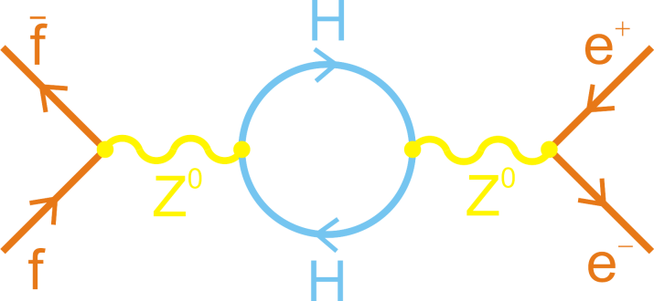
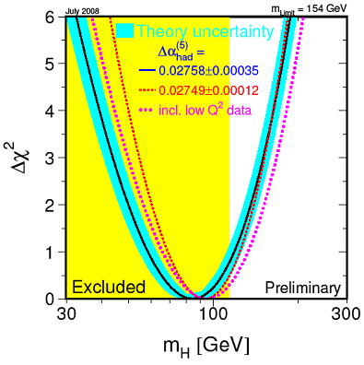
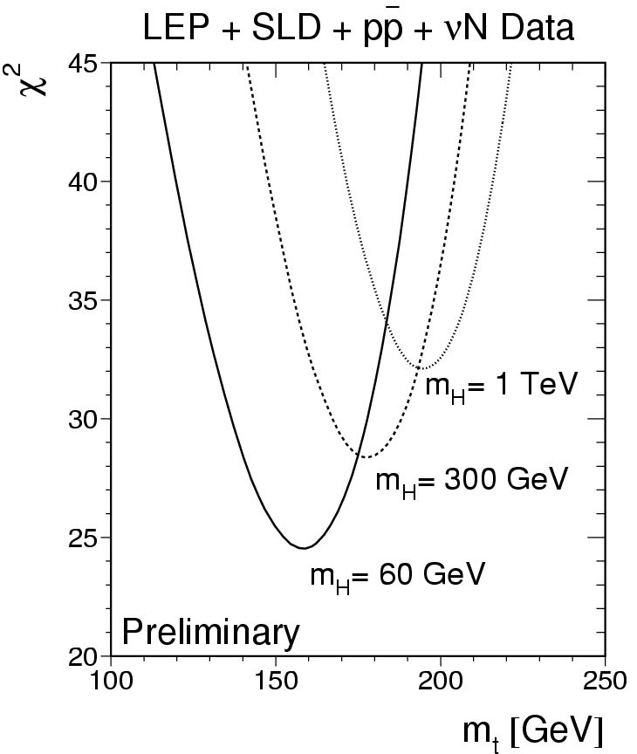
Example: Top and Higgs Masses
Virtual particles relate the properties of the weak force carriers (W, Z), and the masses of the top quark and Higgs
Top quark mass “predicted” by precision electroweak measurements before it was directly discovered by CDF and DØ at Fermilab: m_{t} = 162±9 GeV (Ellis, Fogli, Lisi, 1994).
Now that top quark mass is known the same game is being played to predict the Higgs mass
most probable value:
172.5±1.2 GeV/c²
Notes:
A more recent example of the indirect approach, this one exploiting the Heisenberg Uncertainty Principle, is the prediction of the top quark mass. Virtual particles relate the properties of the carriers of the weak force, the W and the Z, and the top and Higgs masses, again through these loop diagrams. Precision measurements of the carriers of the weak force at CERN, Fermilab, and SLAC, predicted the top mass before it was discovered some ten years ago at Fermilab.
Now that the top quark mass is known, we can play the same game with the Higgs mass, and we find it to be relatively light, perhaps 90 times the mass of the proton, which is why we think the LHC will discover it, if it isn’t already found at Fermilab.
Actually the predicted value is less than the region eliminated by direct searches! But not yet alarmingly so.

Slide 16
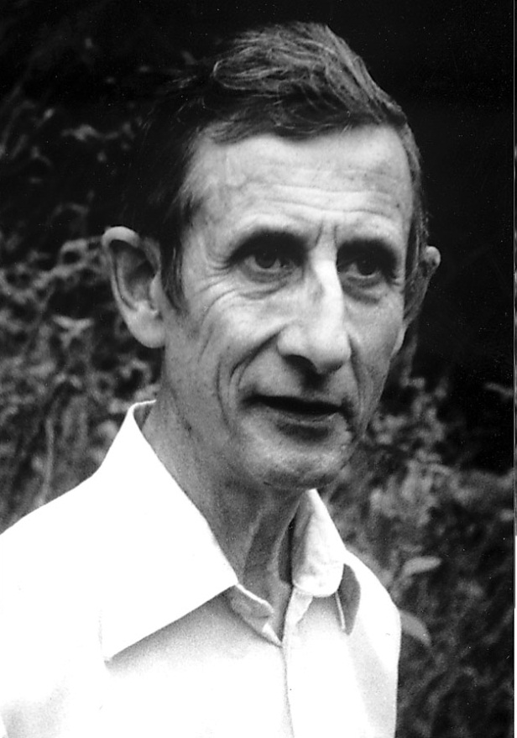
Rare and Precision Physics has a Distinguished Past
“The results of my survey are then as follows: four discoveries on the energy frontier, four on the rarity frontier, eight on the accuracy frontier. Only a quarter of the discoveries were made on the energy frontier, while half of them were made on the accuracy frontier. For making important discoveries, high accuracy was more useful than high energy.”
Freeman Dyson, review of The Lightness of Being, F. Wilczek

Slide 17
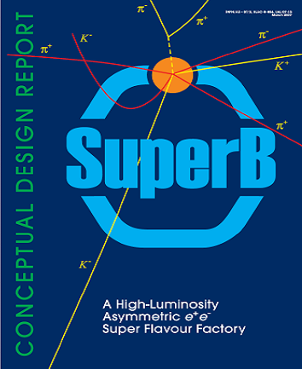
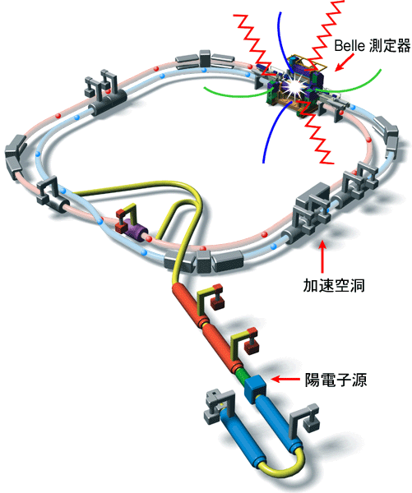
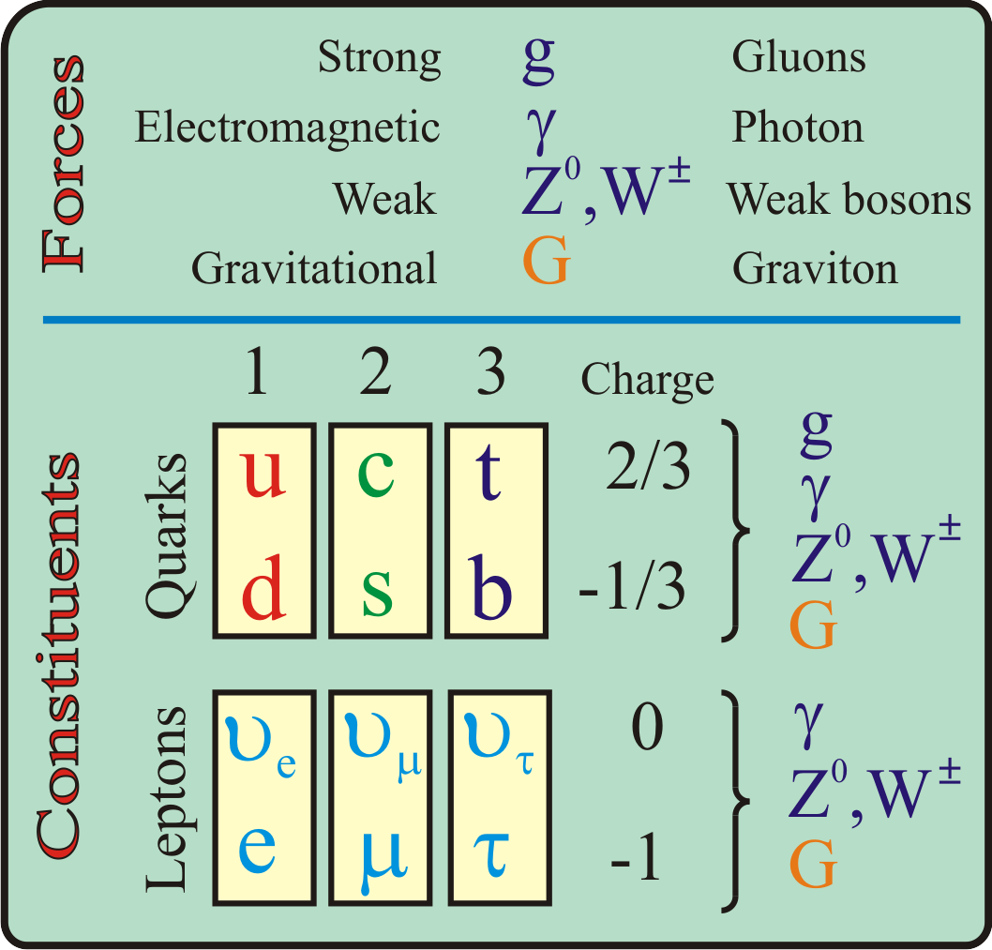
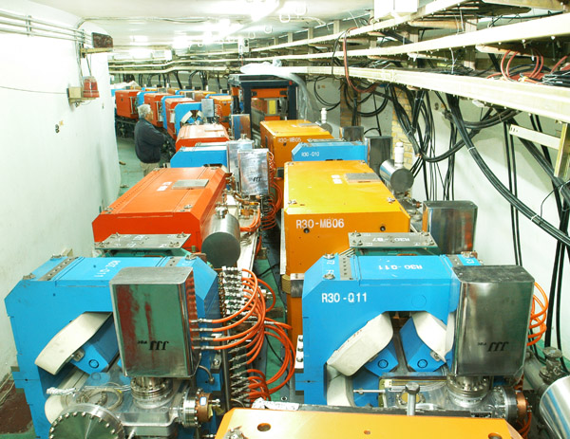
Rare Decays Require Flavor Factories
Highest energy particle accelerators such as the Fermilab Tevatron and the CERN LHC are designed to produce and study the force carriers (gauge sector)
tau-charm factories produce charm/anti-charm quark and tau/anti-tau lepton pairs
B factories produce bottom/anti-bottom quark pairs
Flavor factories are designed to produce and study the properties of the constituent quarks and leptons (flavor sector)
10 billion b/anti-b pairs/yr
10 billion τ/anti-τ pairs/yr
10 billion c/anti-c pairs/yr
10 billion τ/anti-τ pairs/yr
Super Flavour Factory at
Tor Vergata, Italy
Super-B Factory at
KEK, Japan
BES-III tau-charm
Factory at Beijing, China
Notes:
Exploiting the Heisenberg Principle requires what particle physicists call flavor factories to get the required statistics. To understand what a flavor factory is, let’s look at the periodic table for particle physics. We have the four forces and the fundamental particles, the quarks and leptons, on which they act, where the constituents are divided up into quarks and leptons, particles like the neutron being composed of quarks, whereas particles like the electron are leptons.
The highest energy particles accelerators, such as the Tevatron at Fermilab and the LHC at CERN, are designed to study the force carriers, whereas the flavor factories are designed to study the quarks and leptons.
B factories, for example, produce particles composed of the bottom quark. We’ll learn more about them in the next talk. tau-charm factories produce charm-anticharm quarks, as well as tau leptons.

Slide 18
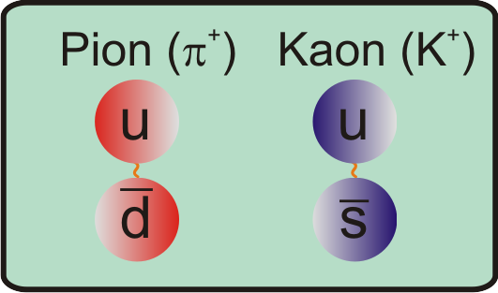
Proton Accelerators are General Purpose Flavor Factories
Produce beams of pions and kaons
Which in turn produce beams of muons and muons neutrinos
~1-100 billion/s can be produced
Notes:
Proton accelerators are general purpose flavor factories. The produce, for example, beams of particles composed of up, down and strange quark-antiquark pairs, called pion and kaons. These in turn decay to produce lepton beams: in particular beams of muons and muon neutrinos.

Slide 19
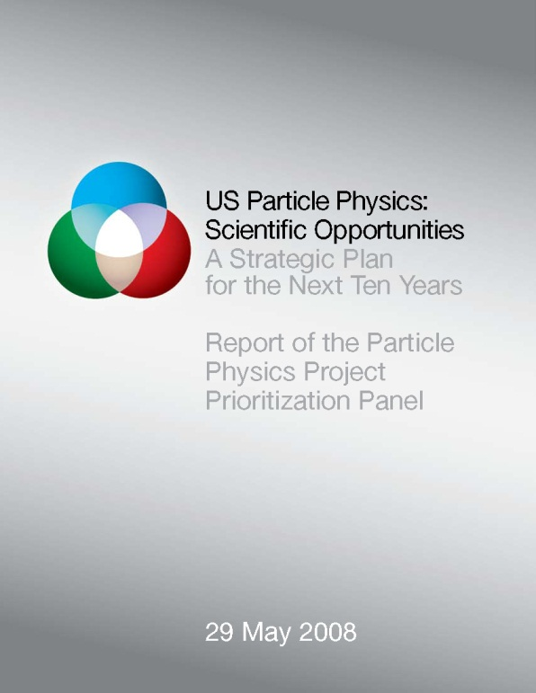
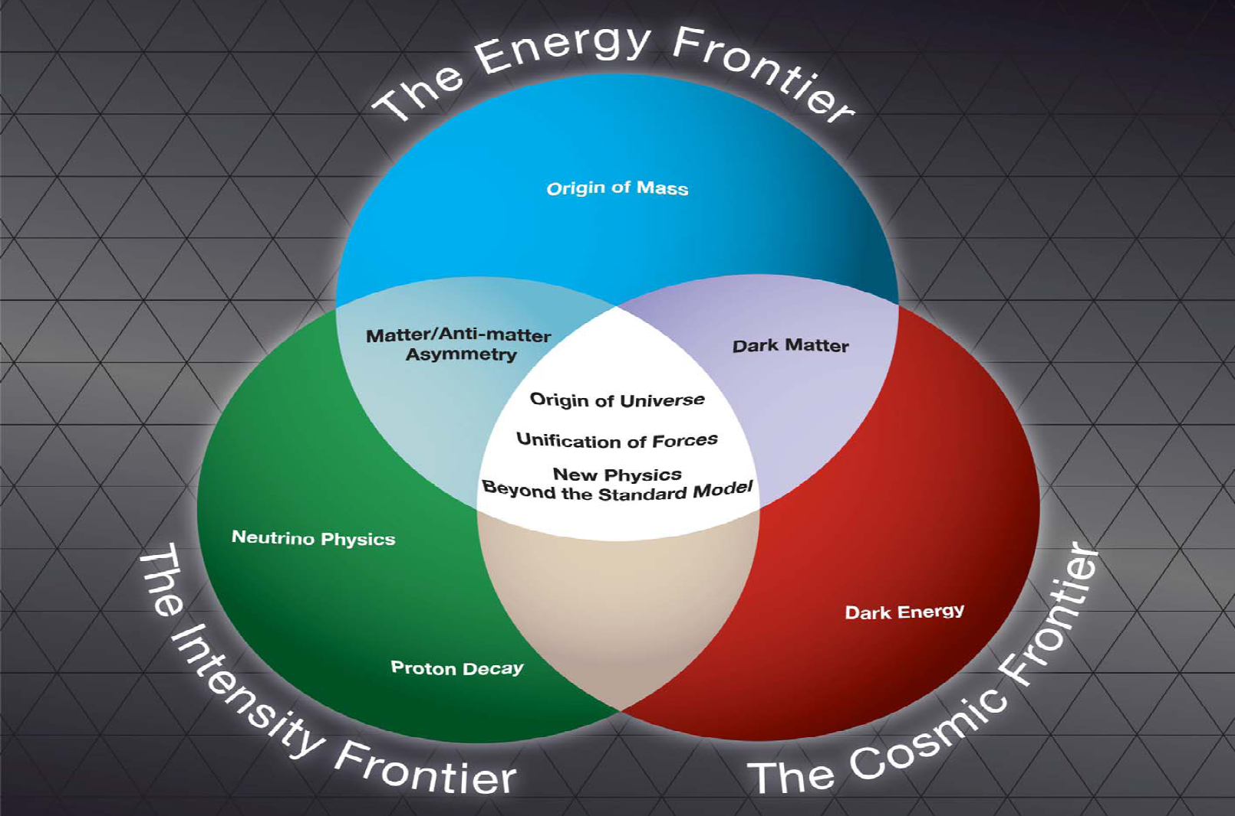
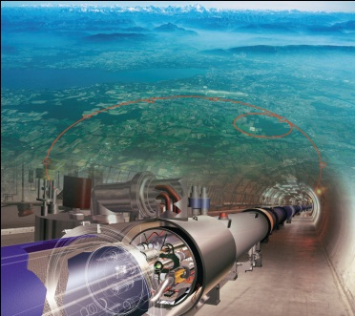
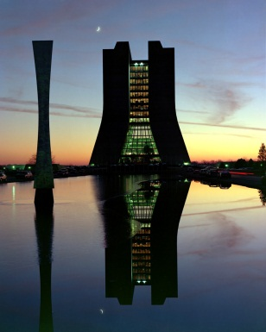
Fermilab Pushing Forward on Intensity Frontier
Strategic Plan for the Next Ten Years:
“The panel recommends an R&D program in the immediate future to design a multi-megawatt proton source at Fermilab…”
LHC
Fermilab
Notes:
Two years ago a special panel was convened to chart the course of particle physics over the next decade. In this figure, from their report, they separated the field into three frontiers, the Energy Frontier, the Intensity Frontier, and the non-accelerator based Cosmic Frontier. There is much overlap between the three frontiers: the big questions are the same: the orgin of the universe, the unification of the forces, and new physics beyond the standard model.
The energy frontier has moved from Fermilab, where it has been for the last two decades, to CERN. The panel recommended that Fermilab push forward on the intensity frontier with the design of a multi-megawatt proton acclerator. This intensity upgrade of Fermilab is called Project X. For the rest of my talk I will focus on what Project X might do in the realm of rare paritcle decays and precision physics.

Slide 20
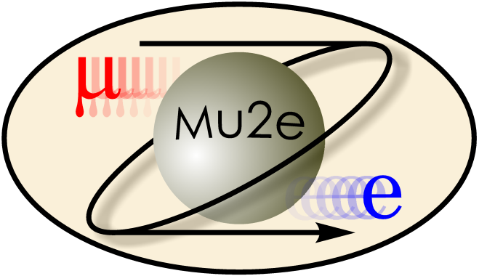
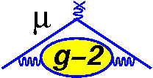
A Snapshot of Two Intensity Frontier Experiments
Rare muon decay experiment
Precision muon experiment

Slide 21
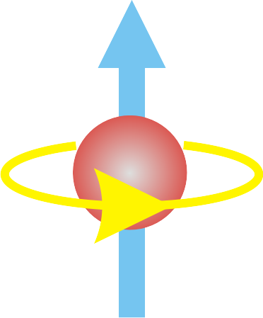
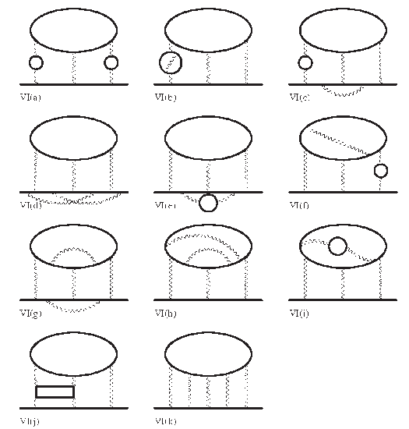
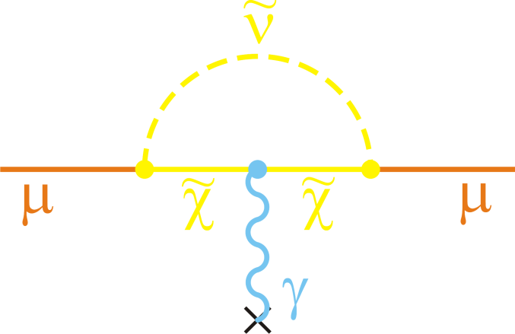
Magnetic Moment of the Muon: Theory
Measuring magnetic moments of fundamental particles has long and productive history
anomalous magnetic moments of protons and neutrons implied substructure ⇨ quarks
Most precise test of quantum electrodynamics (QED)
Muon’s magnetic moment
40,000 times more sensitive
than electron’s to new physics
Heroic theoretical calculation over past 40 years by Kinoshita and others akin to le Verrier’s in calculating QED corrections to the magnetic moment
Dirac
QED
New Physics
+
+

Slide 22
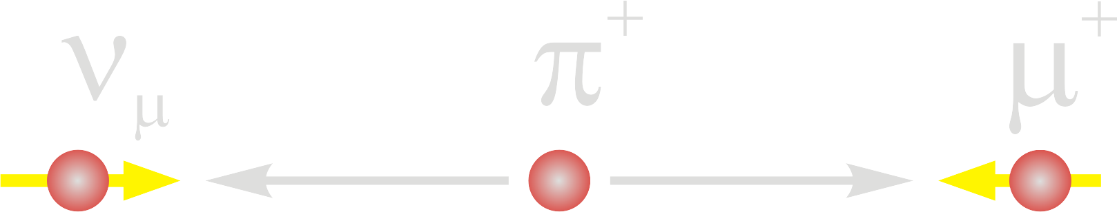
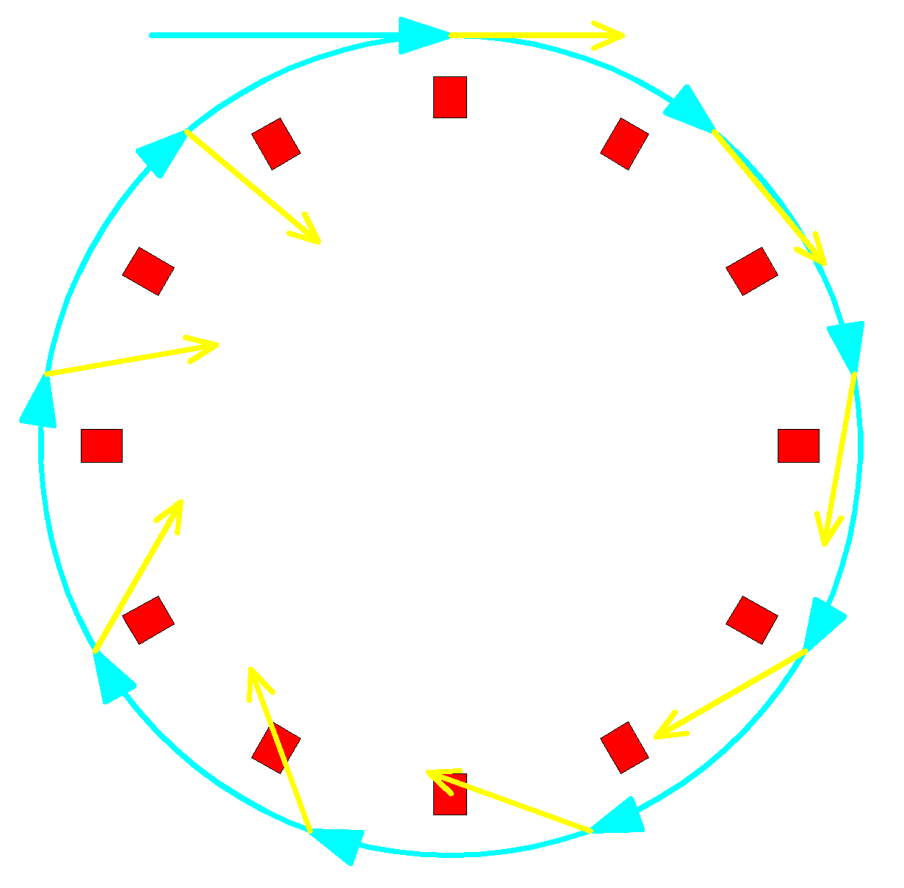



Magnetic Moment of the Muon: Experiment
Pion decay produces polarized muons
Precession in magnetic field proportional to anomalous magnetic moment
Parity-violating decay of muons reveals precessed magnetic moment direction
BNL g-2 Experiment
22

Slide 23




Theory Meets Experiment
Theory and experiment differ by > 3σ
= (296±81)x10⁻¹¹
New Physics?
Theory

Slide 24

Pushing the Precision at Fermilab: E989
Approved February 2011
Error Budget (ppm)
 | BNL |  | Fermilab
Statistical | 0.46 | → | 0.10
Systematic | 0.18 | → | 0.07
Total: | 0.54 | → | 0.14
20X more beam
Better calorimeter/DAQ
Longer beamline

Slide 25




Moving the BNL Magnet to Fermilab

Slide 26

SUSY Meets Muon g-2
FNAL
BNL
LHC (Sfitter)
SPS1a: 100 fb⁻¹, 14 TeV
“g-2 is the most important constraint (for SUSY), even more important than dark matter”
Fittino-collaboration, arXiv:0907.2589

Slide 27

Proposed Schedule
E989 approved in Feb. 2011
Data taking in 2016

Slide 28

Search for Charged Lepton Flavor Violation

Slide 29














Quark and Lepton Alchemy
Quarks
Neutral weak interaction does not change one type of quark into another
Charged weak interaction converts one type of quark into a different type, or flavors
Neutrino oscillations! First evidence of physics beyond Standard Model.
Leptons
Do charged leptons convert to one another: is charged lepton flavor violated?
Lepton flavor is conserved since no cross-generational transitions

Slide 30



Why Search for Charged Lepton Flavor Violation?
In Standard Model not there ⇨ neutrino mass discovery implies an unobservable 10⁻⁵² rate
Hence, any signal unambiguous evidence of new physics
Exquisite sensitivities can be obtained experimentally
  sensitivities that allow favored beyond-the-standard-model theories to be tested
Lepton flavor conservation
accidental
in the extended Standard Model
Almost all models explaining the
neutrino mass hierarchy produce
μ⁻N → e⁻N at levels that will be
probed by Mu2e
New heavy neutrino
Supersymmetry

Slide 31


Incomplete History of Lepton Flavor Violation Searches
Muon established as independent lepton in 1947 as μ→eγ not seen
Number of muons needed: ~5x10¹⁹
Number of grains of sand on Earth: 7.5x10¹⁸
Feinberg 1958 loop calculation: μ→eγ must be 10⁻⁴-10⁻⁵
Non-observation of μ→eγ implies two neutrinos
Mu2e at Fermilab
intends to improve
sensitivity by ~10,000
and then up to
~100,000 with
Project X!
Present limit constraining New Physics theories

Slide 32



CLFV in μ⁺→e⁺γ and μ⁻N→e⁻N
Model independent effective CLFV Lagrangian
Mass
scales probed
~10,000 times that
probed directly
by LHC
κ << 1
magnetic moment type operator
μ → eγ rate ~300X
μN → eN rate
κ >> 1
four-fermion interaction
μN → eN >> μ → eγ rate

Slide 33

Two Methods are Complementary
Observation of CLFV in both μ⁻N→e⁻N and μ⁺→e⁺γ could elucidate SUSY parameters
MSSM/msugra/seesaw
μ = mass term mixing 2 Higgs doublets
tanβ = ratio of 2 vacuum values of 2 neutral Higgs

Slide 34
CLFV Sensitive to Many Sources of New Physics
Supersymmetry
Compositeness
Predictions at 10⁻¹³
Heavy Neutrinos
Second Higgs doublet
Leptoquarks
Heavy Z’ Anomalous Z coupling
New physics probed by μN→eN (Marciano)

Slide 35

What Sensitivity is Needed?
Present sensitivity already interesting and constraining!
~10⁻¹⁶ removes many models
~10⁻¹⁸ extremely difficult for theorists to deal with
Current limit
SUSY GUT w Seesaw
PMNS: neutrino-like mixing
CKM: minimal flavor violation
M_{1/2} = gaugino mass

Slide 36


What Sensitivity is Needed?
Randall-Sundrum
Littlest Higgs

Slide 37







How to Search for μ⁻N→e⁻N
Stop muon in atom
Muon rapidly (10⁻¹⁶s) cascades to 1S state
Circles the nucleus for up to ~2 μs
Two things most likely happen:
  muon is captured by the nucleus: μ⁻N_{A,Z}→ν_{μ}N_{A,Z-1}
  muon decays in orbit: μ⁻N_{A,Z}→e⁻ν_{μ}ν_{e}N_{A,Z}
ν_{μ}
μ⁻
He⁵
He⁶
Li⁶
New nucleus (NA,Z-1) “de-excites” emitting neutrons, protons, and gammas
Al: 1.3 n + 0.1 p + 2γ
These particles can produce “noise” in the detector
Muon Capture

Slide 38


How to Search for μ⁻N→e⁻N
Stop muon in atom
Muon rapidly (10⁻¹⁶s) cascades to 1S state
Circles the nucleus for up to ~2 μs
Two things most likely happen:
  muon is captured by the nucleus: μ⁻N_{A,Z}→ν_{μ}N_{A,Z-1}
  muon decays in orbit: μ⁻N_{A,Z}→e⁻ν_{μ}ν_{e}N_{A,Z}
Li⁶
Note: tail not present in free decay due to recoil of nucleus
e⁻
Muon Decay-in-Orbit

Slide 39

Relative Rate of Capture to DIO Depends on Target Z

Slide 40

Mu2e Searching for a Third Process: μ⁻N→e⁻N
In μ⁻N→e⁻N the muon coherently interacts with nucleus leaving it in ground state
  signature single isolated electron
  Electron energy given by the rest mass of the muon minus the nucleus recoil energy and the binding energy:
  E_{e} = m_{μ} – E_{NR} - E_{b} ~ 104.97 MeV (Al)
Li⁶
e⁻
Measure ratio of conversion rate to capture rate

Slide 41


Bunched Beam Technique Needed
Need ~10¹⁸ stopped muons
Rate too high for continuous beam: need bunched muon beam: 50x10⁹ μ/s
Need gate off detector for ~ t_{mN} (~800 ns) while bad stuff (pions, electrons) is around
Need < 10⁻¹⁰ interbunch contamination
Signal: 105 MeV electron coming
from the target, ~1 μs after
the μ is stopped in the foils
Bunched beam arrives with μ’s, π’s, and electrons
Resonant Dipole Extinction
A huge amount of stuff comes off the target from scatters, captures etc.
About 50% of the muons stop in target
Stopping target
Need to be sure it isn’t a scattered electron or π capture electron
Look for a delayed
105 MeV electron

Slide 42


Producing ~10¹⁸ Bunched Muons
new detector hall and beamline
Energy: 8 GeV Booster beam optimal
Structure: need bunch spacing on order of muon lifetime ~1 μs ⇨ orbit period of Accumulator/Debuncher optimal at 1.7 μs
Use Recycler as a transfer line
Stack in Accumulator; bunch in Debuncher
Slow spill extraction: 90% duty factor
One of several possible schemes
Mu2e cannot take any
protons away from the
neutrino program
Debuncher
6 batches x 4x10¹² /1.33 s x 2x10⁷ s/yr
= 3.6x10²⁰ protons/yr
Accumulator
Mu2e “steals” 6 of 20 booster batches NOvA cannot use during Main Injector cycle

Slide 43


New Beamline and Detector Hall to be Built
Antiproton Accumulator/Debuncher
Booster

Slide 44





Backgrounds, Backgrounds, Backgrounds . . .
1. Stopped Muon Backgrounds
Muon decay in orbit (DIO):
μ⁻N_{A,Z}→e⁻ν_{μ}ν_{e}N_{A,Z}
defeated by good energy resolution
Radiative muon capture (RMC):
μ⁻N_{A,Z}→ν_{μ}γN_{A,Z-1}, γ→e⁺e⁻
defeated by m_{Z} < m_{Z-1}
defeated by good energy resolution
Muon capture:
μ⁻N_{A,Z}→ν_{μ}N’_{A’,Z’} + 1.3n + 0.1p + 2γ
Note: does not produce a physics background, but detector “noise”
defeated by proton absorber
E~(E-E₀)⁵

Slide 45


Backgrounds, Backgrounds, Backgrounds . . .
2. Prompt Beam Related Backgrounds
Radiative pion capture (RPC):
π⁻N_{A,Z}→γN_{A,Z-1} , γ→e⁺e⁻
Note: 1.2% have E_{γ} > 105 MeV
Muon decay in flight:
μ⁻ → e⁻νν
  Note: p_{μ} > 77 MeV/c
Pion decay in flight:
π⁻ → e⁻ν_{e}
Beam electrons scattering in target
Defeated by 10⁻¹⁰interbunch extinction
Defeated by hard cuts on momentum
Antiprotons annihilating
Defeated by thin absorber
3. Time Dependent Backgrounds
Cosmic Rays
Defeated by active shield

Slide 46



Mu2e Apparatus
Salient Features
Graded solenoidal field for pion capture
Muon transport in curved solenoid to eliminate neutral and positive particles
Pulsed beam to eliminate prompt backgrounds
8 GeV/c Booster beam bunched in Accumulator/Debuncher
Look for 105 MeV electron spiraling through detector
Muon Beam
Spectrometer
Production Solenoid
Transport Solenoid
Detector Solenoid
Production Target
Collimators
Stopping Target
Tracker
Calorimeter
85,000 μ⁻ stop every 1.7 μs
50 billion μ⁻ stops/second

Slide 47


Transport Solenoidal Magnet
Curved solenoid:
  separates charges by charge sign
  reduces line-of-sight transport of neutrals
Collimators eliminate wrong-sign particles and particles with too large momentum

Slide 48



What we get at the Stopping Target
17 Al disks
each 200 μm thick
83 mm to 65 mm radius
in graded magnetic field
1/230 incident protons produce a muon at the stopping target
58% of muons stop in target
50x10⁹ μ stops per spill second
85,000 μ stops per microbunch

Slide 49

Choice of StoppingTarget Material
Large Z:
  rate ∝Z|F_{n}|² (F_{n} is the form factor)
  can reveal nature of interaction
Small Z:
  longer lifetime
  higher endpoint energy
Note: Need m_{Z-1} > m_{Z} to place max. energy of radiative capture muons below signal electrons
S, V, D dependence
unique to μN→eN
Initial Choice

Slide 50


Mu2e Spectrometer
Salient Features
No detector element in region of transported beam
Small acceptance for DIO electrons
Minimal amount of material ⇨ detector elements in vacuum
Stopping target
2T
1T
Proton absorber
Straw tracker
Electromagnetic calorimeter

Slide 51


Helical Proton Absorber
Needed to beat down rate of muon capture protons: ~0.1 per capture: ~3 x 10⁹/s
Note: capture proton s not relativistic: KE and momentum not the same!
Geometry exploits different helical trajectories of protons and electrons
Material: 0.5 mm polyethylene
Absorbers 93% of protons from muon capture
Only 13% of the electrons impact absorber
FWHM energy loss: 0.33 MeV
Note: alternative tracker design shown
Protons
Electrons

Slide 52


Heart of the Spectrometer: Straw Tracker
Octagonal vane geometry optimized for reconstruction of 105 MeV helical trajectories
Center beam region empty:
    Intense muon beam passes freely through
    Acceptance for DIO tracks < 10⁻³
Severe operating environment:
  Rates up to 200 kHz
  Operation in vacuum: < 10⁻³ Torr
Front View
Trajectories
P_{t} > 90MeV
DIO Tail
> 57MeV
Low energy DIO tracks
Target Foils
R=57 MeV
38 cm
Notes:
52

Slide 53

Tracker Performance
  Large acceptance: 50% (90°±30°)
Intrinsic energy resolution: σ = 140 keV
5 mm diam. Straws
18 stations:
  24 planes each
  50 straws/plane
21,600 straws total
ArCO₂ 80:20
ADC/TDC readout: 100 μm resolution
No high-side tail!

Slide 54

Electromagnetic Calorimeter
Needed for:
  trigger: 5% energy resolution → 1,000 triggers/s
  Timing
  Confirmation of the electron energy measurements of the straws
Note: must operate in 160 Gy/yr
2112 3x3x13cm³ LYSO crystals
Dual APD readout
σ/E ~ 2-3%
σ_{t} ~ 0.1 ns
PWO-II (PANDA)
@ 100 MeV

Slide 55




Cosmic Ray Veto
MC studies show 416 fake 105 MeV conversion electrons from cosmic-ray muons
Hence need 10⁻⁴ Inefficiency
Surround Detector Solenoid by 3 layers of scintillator read out by waveshifting fibers
SINDUMII

Slide 56

What we Get
Intrinsic tracker energy resolution:
σ(E) ≈ 150 keV
Perfect Detector
Decay in Orbit Tail
Binding + recoil energy
DIO tail
M_{μ}
Average energy loss due to spectrometer material:
E(shift) ≈ 1 MeV
Real Detector
Decay in Orbit Tail
M_{μ}
DIO tail

Slide 57

Mu2e Sensitivity
Proton flux | 1.8x10¹³ p/s
Running time | 2x10⁷ s
Total protons | 3.6x10²⁰ p
μ⁻ stops/incident proton | 0.0025
μ⁻ capture probability | 0.61
Time window fraction | 0.49
Electron trigger eff. | 0.80
Reconstruction and selection eff. | 0.19
Sensitivity (90% CL) | 6x10⁻¹⁷
Detected events for R_{μe} = 10⁻¹⁶ | 4
Estimated background events | 0.4
Roughly half of background is interbunch contamination related
Project X will allow Mu2e to:
If we see nothing: improve sensitivity by another order of magnitude
If we see something: confirm it and explore its origin with different targets

Slide 58


Mu2e Collaboration
Boston University | R. Carey, V. Jorjadze, V. Khalatian, J. Miller*, B. Roberts
Brookhaven National Laboratory | W. Marciano, V. Polychronakos, Y. Semertzidis, P. Yamin
Caltech | D. Hitlin, F. Porter, R.-Y. Zhu
University of California, Berkeley | Yu.G. Kolomensky
University of California, Irvine | D. Kocen, G. Lim, W. Molzon, Z. You
City University of New York | K. Lynch, J. Popp
Duke University | S. Oh, C. Wang
Fermi National Accelerator Laboratory | G. Ambrosio, C. Ankenbrandt , R. Bernstein*, D. Bogert, R. Coleman, M. Crisler, D. DeJongh, N. Evans, S. Feher, M. Fischler, S. Geer, D. Glenzinski, J. Johnstone, P. Kasper, K. Krempetz, R. Kutschke, M. Lamm, V. Logashenko, M. Martens, M. McAteer, L. Michelotti, A. Mukherjee, S. Nagaitsev, V. Nagaslaev, D. Neuffer, A. Norman, R. Ostojic, C. Polly, M. Popovic, E. Prebys, V. Pronskikh, R. Ray, P. Rubinov, V. Russo, P. Shanahan, R. Tschirhart, S. Werkema, H. White, K. Yonehara,
INFN Lecce | F. Grancagnolo, S. Indennidate, A. L’Erario, G. Onorato, C. Pagliarone, G. Piacentino, S. Rella, G. Tassielli
University of Houston | E. Hungerford, K. Lau
University of Illinois | P. Debevec, G. Gollin
Institute for Nuclear Research, Moscow | V. Lobashev, R. Djilkibaev, V. Matushko
JINR, Dubna | A. Artikov, I. Budagov, V. Glagolev, A. Simonekno, I. Suslov
University of Houston | E. Hungerford, K. Lau
INFN, Frascati | M. Cordelli, S. Giovannella, F. Happacher, M. Martini, S. Miscetti, I. Sarra, G. Venanzoni
LBNL | D. Brown, M. Lee
Lewis University | J. Kozminski
Los Alamos | M. Cooper, T. Ito, X. JIang, R. McCrady, P. Walstrom
University of Massachusetts | D. Kawall, K. Kumar
Muons, Inc. | R. Abrams, M. Cummings, R. Johnson, S. Kahn, S. Korenev, T. Roberts, R. Sah, C. Yoshikawa
Northern Illinois University | D. Hedin, A. Dychkant
Northwestern University | A. deGouvea
INFN Pisa, Universitµa Di Pisa | F. Cervelli, R. Carosi, M. Incagli, T. Lomtadze, L. Ristori, F. Scuri, C. Vannini
Rice University | M. Corcoran
Syracuse University | R.S. Holmes, P.A. Souder
Universita di Udine | D. Cauz, G. Pauletta
University of Virginia | M. Bychkov, E.C. Dukes, R. Ehrlich, M. Frank, E. Frlez, C. Group, R. Hirosky, P.Q. Hung, Y. Oksuzian, K. Paschke, D. Pocanic
College of William & Mary | J. Kane
University of Washington | D. Hertzog, P. Kammel
Currently:
134 scientists
28 institutions

Slide 59

Mu2e Status
1992 | Solenoidal collection scheme first proposed by MELC collaboration at Moscow Meson Factory
1997 | MECO proposed for the AGS at Brookhaven as part of RSVP
1998-2005 | Intensive work on MECO technical design: magnet system costed at $58M, detector at $27M
July 2005 | RSVP cancelled for financial reasons not related to MECO
2006 | Steering committed set up to work out means to mount experiment at Fermilab, keeping detector the same
June 2007 | Mu2e EOI submitted to Fermilab
October 2007 | LOI submitted to Fermilab
May 2008 | P5 “recommends pursuing the muon-to-electron conversion experiment, subject to approval by the Fermilab PAC, under all budget scenarios considered by the panel.”
Fall 2008 | Proposal submitted to Fermilab and receives Stage I approval. Total project cost estimated at $180M
November 2009 | Approval of mission need by DOE (CD-0) granted ($145M - $205M)
FY2010 | Mu2e receives $4M in R&D funding ($10M FY2011, $20M FY2012)
Fall 2011 | Approval of preliminary baseline range by DOE (CD-1)
2014 | Start of Construction (CD-3)

Slide 60

The End
So we are now embarking on a great campaign in this intensity frontier, guided by our theoretical friends, to search for the New Physics that we think must exist. Will we succeed in finding something new like le Verrier and Galle with their discovery of Neptune, or fail to find anything, like le Verrier did with Vulcan? Perhaps we should wish to fail: in the end the non-observation of Vulcan proved far more profound than the discovery of Neptune.
Notes:
So I hope you have gotten a bit of the flavor of this great intensity frontier campaign upon which we are embarking to search for the new physics that we are convinced must exist. I’ve outlined one front in this campaign, our next two speakers will lay out two other fronts. And I say campaign, because it will be long and there will be setbacks.
Will we succeed in finding something new, like le Verrier and Galle with their discovery of Neptune, or find nothing like le Verrier and others did with Vulcan. In either case the consequences will be profound.

