Slide 1


NOνA Monopole Search
Craig Dukes
July 30, 2012

Slide 2
why monopoles

Slide 3
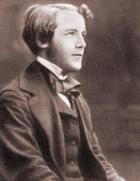
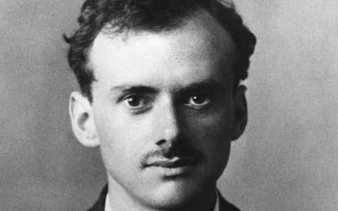
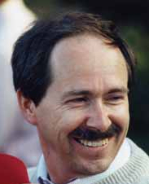
Why Monopoles
Make Maxwell’s Equations more symmetric
Dirac monopoles
Note the large charge
Existence of a single monopole implies charge quantized due to quantization of angular momentum of electron-monopole system
Dirac monopole
Grand Unified Theory monopoles
  ‘t Hooft-Polyakov monopoles: fundamental solutions to non-Albelian gauge theories
  Produced early in the Big Bang
  Extremely heavy: GUT mass (≥ 10¹⁶ GeV)

Slide 4
Why Monopoles
“The existence of magnetic monopoles seems like one of the safest bets that one can make about physics not yet seen.”
Joseph Polchinski
2002 Dirac Centennial speech
“Almost all theoretical physicists believe in the existence of magnetic monopoles, or at least hope that there is one.”
Ed Witten
Loeb Lecture, Harvard

Slide 5
Monopole Properties
Caution: most every statement I make here should have an asterisk associated with it as there are almost always assumptions that have been made.
Mass:
  Grand unified theories predict the existence of monopoles, produced in the early Universe with masses greater than the GUT scale: M_{m} ≥ 10¹⁶ GeV/c².
  Some GUT and some SUSY models predict intermediate mass monopoles: 10⁵ GeV/c² ≤ M_{m} ≤ 10¹² GeV/c², that were produced in later phase transitions in the early Universe.
Magnetic charge: g_{D} = nħc/2e. Charge can be quite large if n > 1. Note that since α_{g} = g²_{D}/ħc = 34 perturbation calculations cannot be used.
Electric charge: monopoles can have an intrinsic electric charge (Dyons) or pick up an electric charge from an attached proton or nucleus.
Spin: undefined; can either be ½ or 0.
Energy: the energy gained by a monopole with the minimum Dirac charge over a coherent galactic length is 2 x 10¹¹ GeV. GUT monopoles are expected to have velocities of 10⁻⁴ < β < 10⁻¹.
Cross section: Uncertain, but presumably large.
Lifetime: lowest mass stable due to conservation of charge.

Slide 6

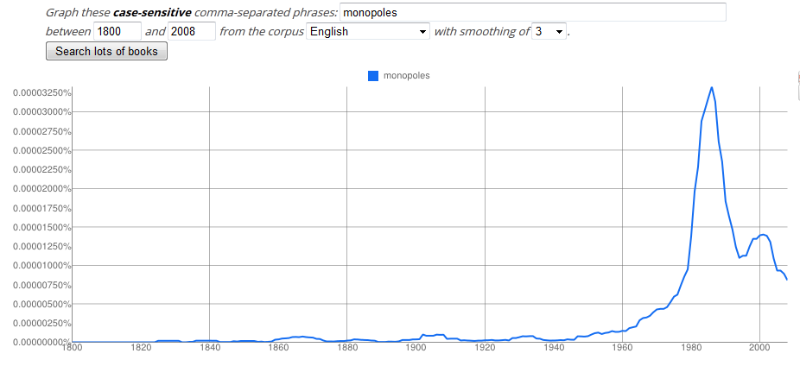
Monopoles in Literature

Slide 7
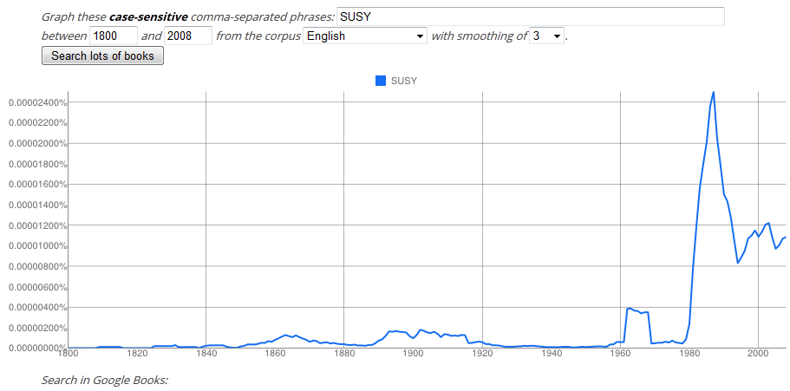
SUSY in Literature

Slide 8
where to find monopoles

Slide 9
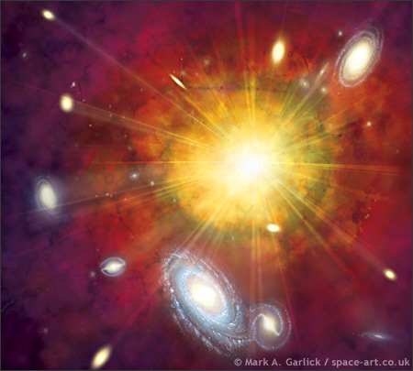
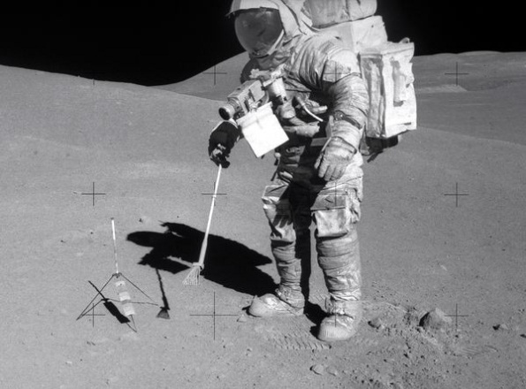
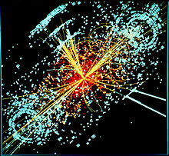
Where to Find Monopoles
In flight (cosmic and atmospheric)
  Produced early in the Big Bang
  Produced from cosmic rays in the atmosphere
In bulk matter (stellar, cosmic, and atmospheric)
  Produced early in the Big Bang
  Bound in matter before star formation
At accelerators
  Produced in high-energy collisions
Abundances and cross sections are highly uncertain

Slide 10
Monopole Sensitivity
Sensitivity roughly proportional to detector area
Very high-mass monopoles come isotropically from all sides, unlike cosmic rays, lower mass monopoles from above
The observed isotropic rate is: R = πFAε
  F is the flux of monopoles (cm⁻²sr⁻¹)
  A is the total detector area (cm²)
  ε is the detector efficiency, livetime, etc.
What we are after is not R, but the flux F = R/πAε
If we see no monopoles assume R = 2.3 to get the 90% CL limit:
  F(90% CL) = 2.3 / πAε
Some areas
  NOvA: 4290 m²
  MACRO: 3482 m²
  SLIM: 427 m²
  OHYA: 2000 m²

Slide 11
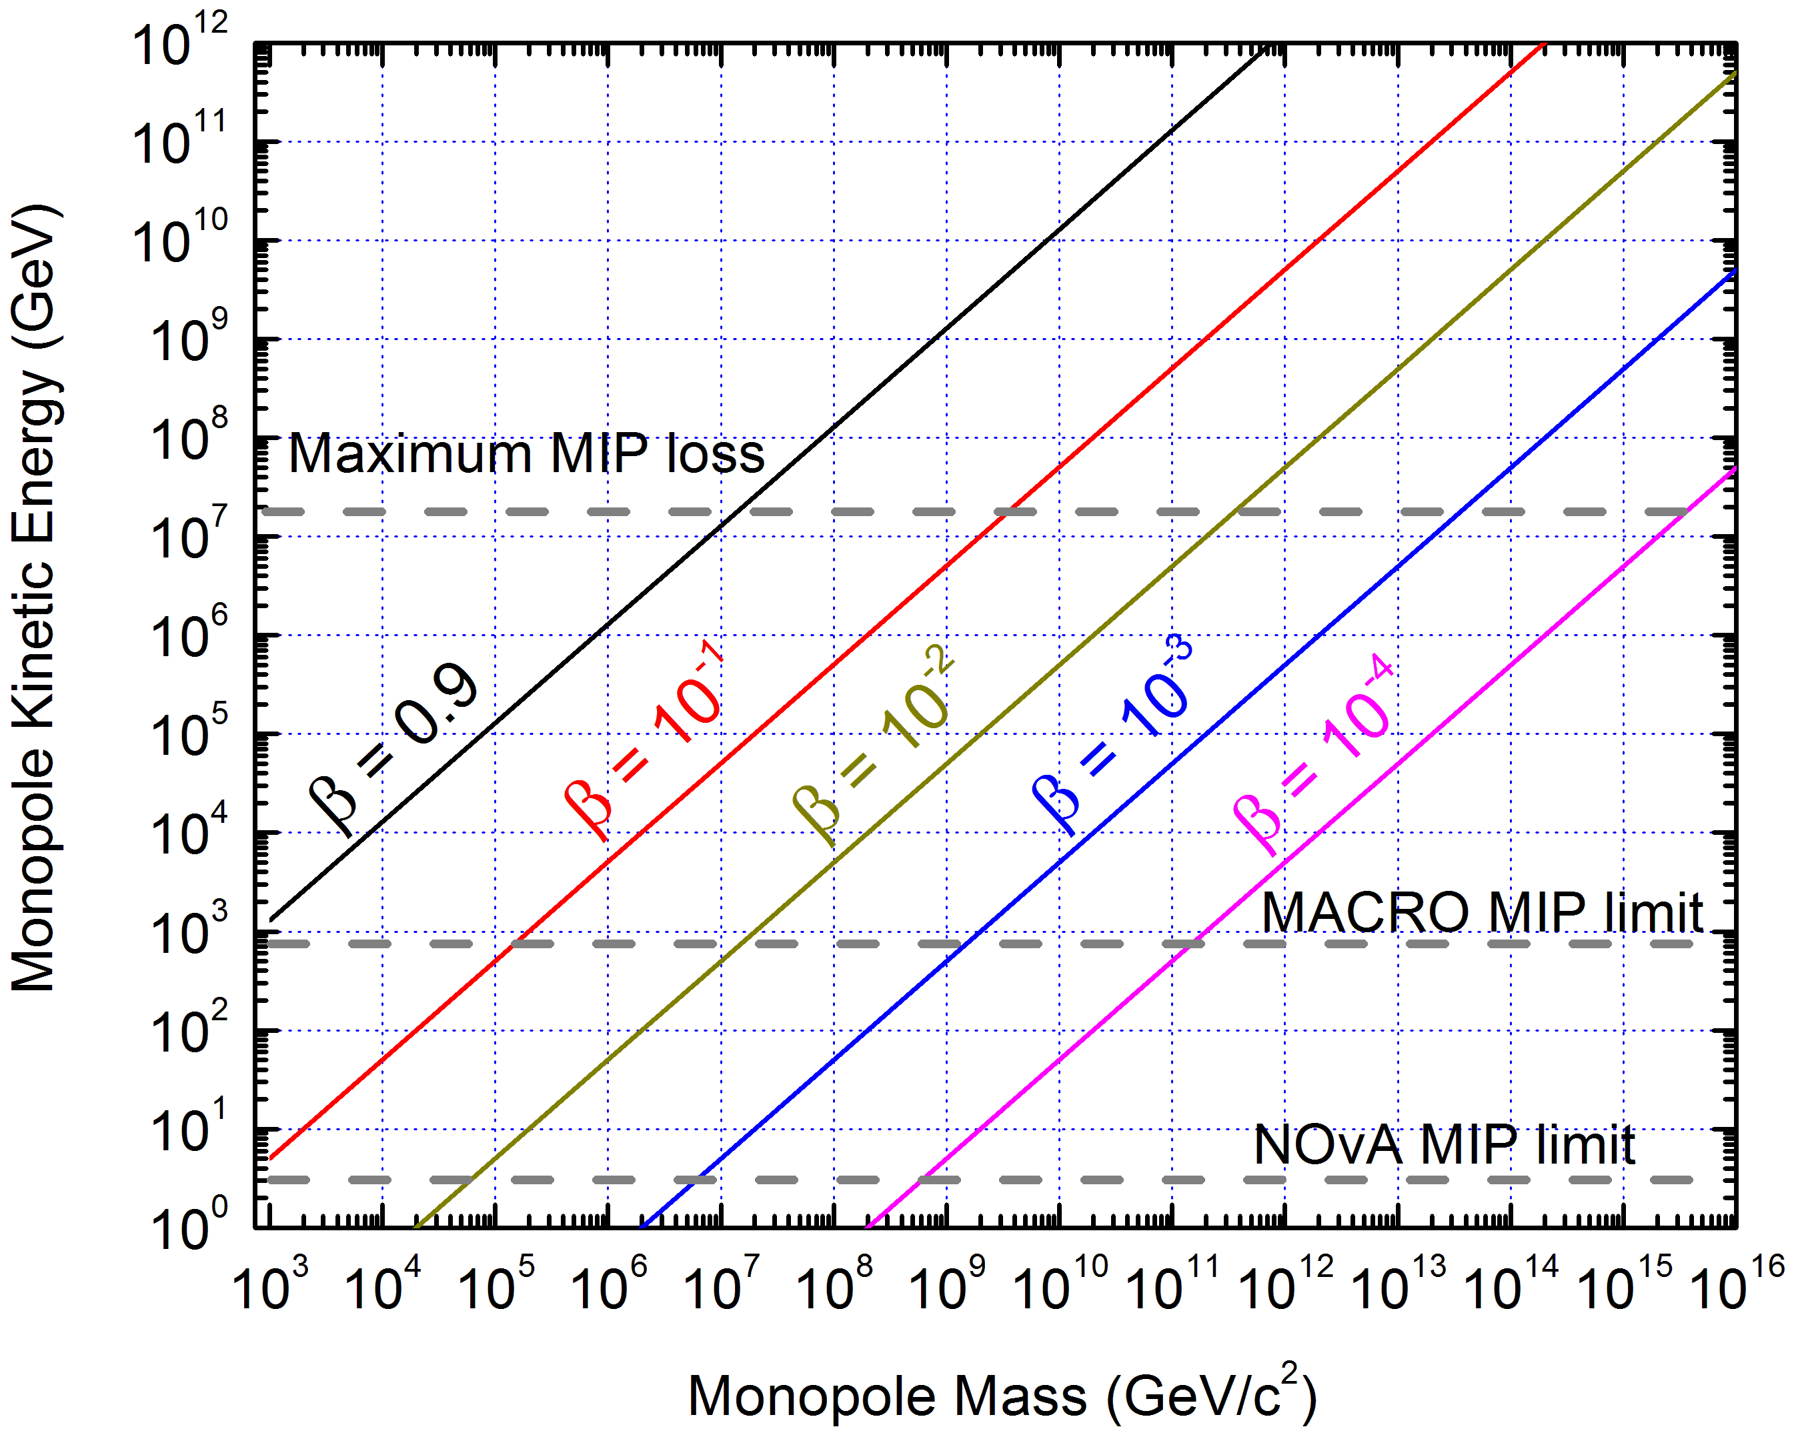

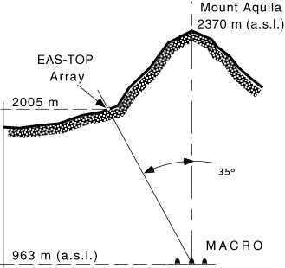
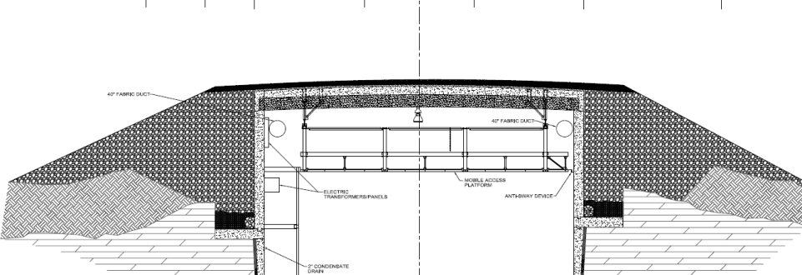
Some Limits Due to Energy Loss
β > 10⁻³ to escape galaxy
β > 10⁻⁴ to escape solar system
β > 10⁻⁵ to escape earth

Slide 12
monopole energy loss

Slide 13
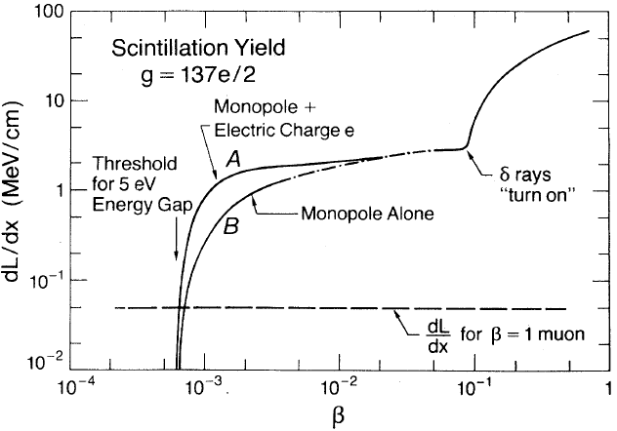
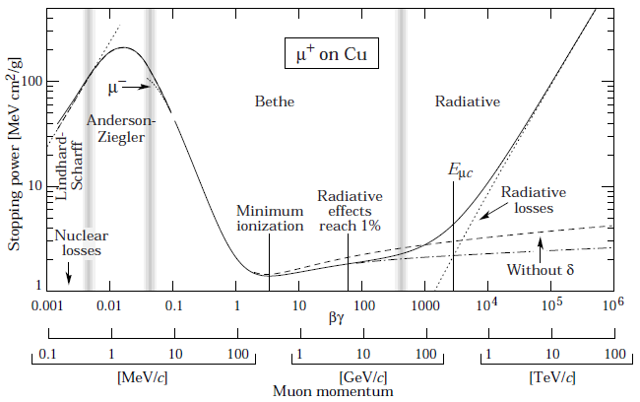
Monopole Energy Loss
Complicated subject: calculations are difficult
Salient feature: the higher the energy the more the energy loss → opposite of electric monopoles (no Bragg peak)
MIPP
MM
A few regimes:
  10⁻³< β: electronic energy loss predominates
  10⁻⁴ < β < 10⁻³: excitation of atoms predominates
  β < 10⁻⁴: monopoles cannot excite atoms, but only lose energy in elastic collisions with atoms and nuclei
Ahlen and Tarle (1983)

Slide 14
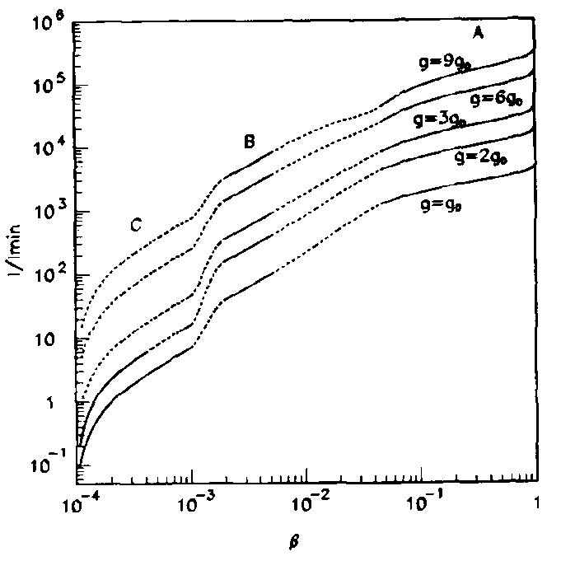
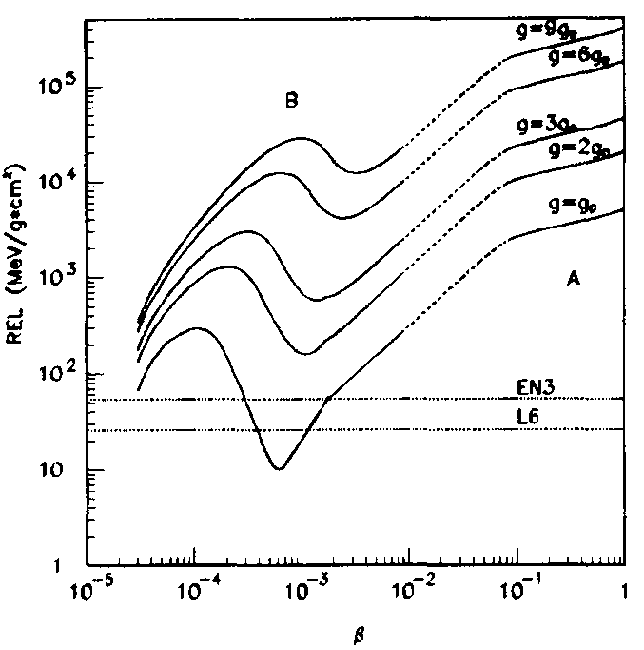
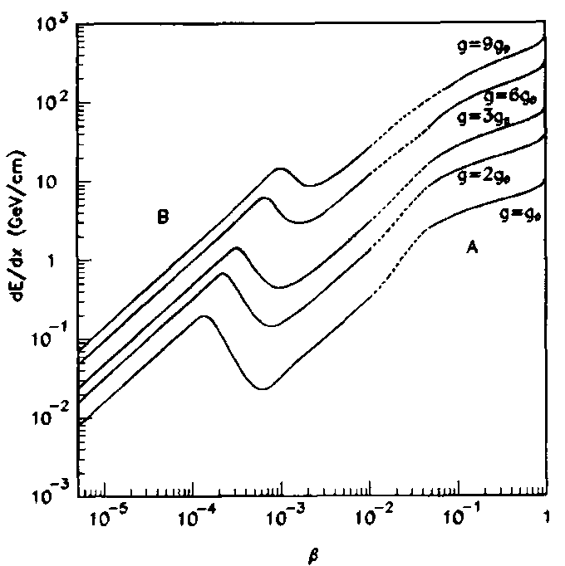
Monopole Energy Loss: MACRO Calculations
Derkaoui et al., Astro. Phys. 10, 229 (1999)
MACRO streamer chamber estimate
MACRO CR-39 estimate
MACRO liquid scintillator estimate

Slide 15
Energy Loss: References
Ahlen, PRD 14, 2935 (1976)
  Total and restricted energy loss in Lexan for g = 137e.
Ahlen, PRD 17, 229 (1978)
  Stopping-power formula for g = 137e and g = 137e/2.
Ahlen and Kinoshita, PRD 26, 2347 (1982)
  Find that below β < 0.01 dE/dx is proportional to monopole velocity. For monopoles with g = 137e the stopping power is at least as large as for a proton with the same velocity.
Ahlen and Tarlé, PRD 27, 688 (1982)
  Find light yield for organic scintillators. Showed that monopoles with β > 6 x 10⁻⁴ could be observed.
Kajino, Matsuno, Yuan, and Kitamura, PRL 52, 1373 (1984)
  Calculate Drell-Penning mechanism for He-methane PWC.
Ahlen, Liss, Lane, and Liu, PRL 55, 181 (1985)
  Measure light yield in organic scintillator from neutron-recoil protons with energies as small as 410 eV. Claim monopoles with β > 6 x 10⁻⁴ could be observed.
Ficenec, Ahlen, Marin, Musser, Tarlé, PRD 36, 311 (1987)
  Using slow (2.5 x 10⁻⁴c) protons they see light well below the 6 x 10⁻⁴ electronic-excitation threshould expected from two-body kinematics.
Derkaoui et al., Astroparticle Physics 10, 229 (1999)
  Treats energy loss and light yield in liquid scintillator, ionization in streamer tubes, restricted energy loss in CR-39 track-etch detectors. MACRO collaborators.
Wick et al., Astroparticle Physics 18, 663 (2003)
  Calculates energy loss for highly relativistic monopoles: γ > 100 (β > 0.9999)

Slide 16
detection techniques

Slide 17
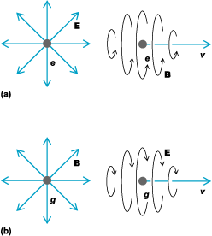
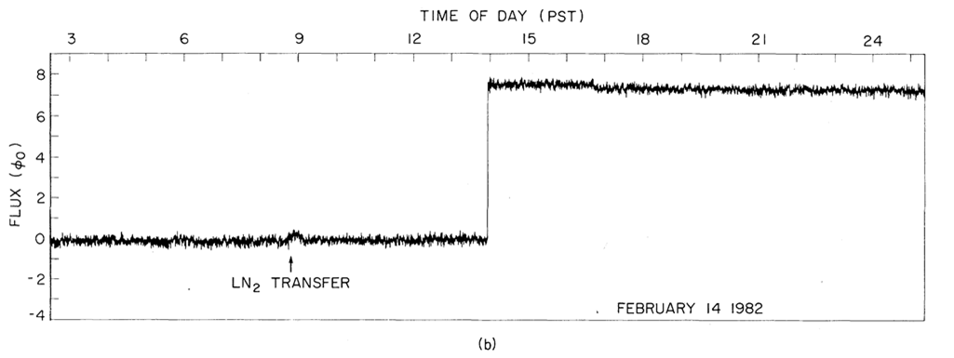
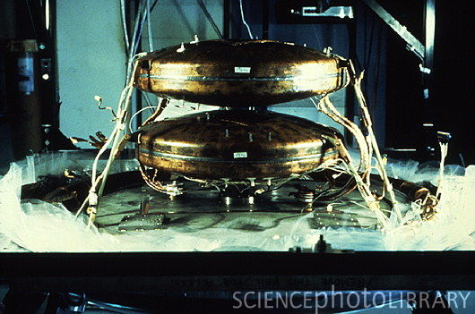
Detection Techniques: Electric Induction
Unambiguous evidence if a coincidence signal is seen
Sensitivity independent of monopole speed
Large areas expensive to build
Present Limit: 2 x 10⁻¹⁴ cm⁻²s⁻¹sr⁻¹
Cabrera’s St. Valentine’s Day Monopole, PRL 48, 1378 (1982)
Chicago-FNAL-Michigan detector

Slide 18
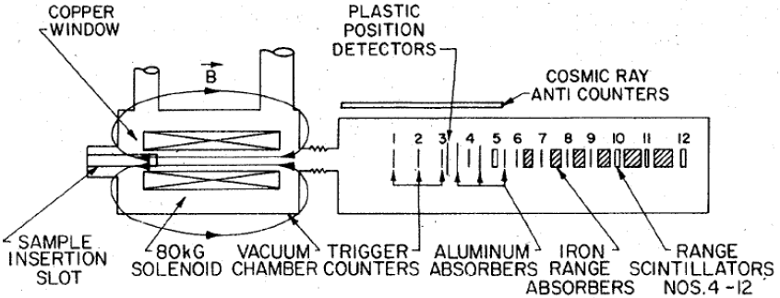
Detection Techniques: Electric Induction
Use a strong magnetic field to extract monopoles trapped in matter
Moon rocks, meteorites, schists, ferromanganese modules, iron ores ,etc
Alvarez performed one of the first scientific experiments with moon rocks looking for monopoles

Slide 19
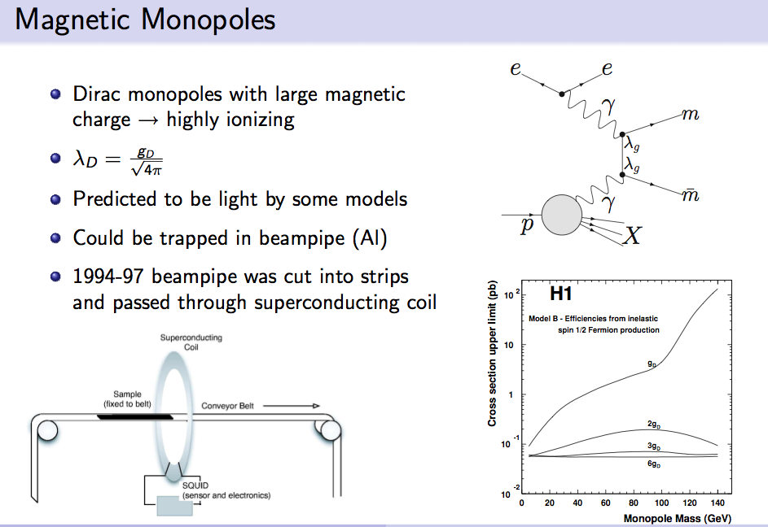
Beampipe Monopole Search
H1 experiment at the ep collider HERA, Hamburg
trapped in the beampipe material?

Slide 20
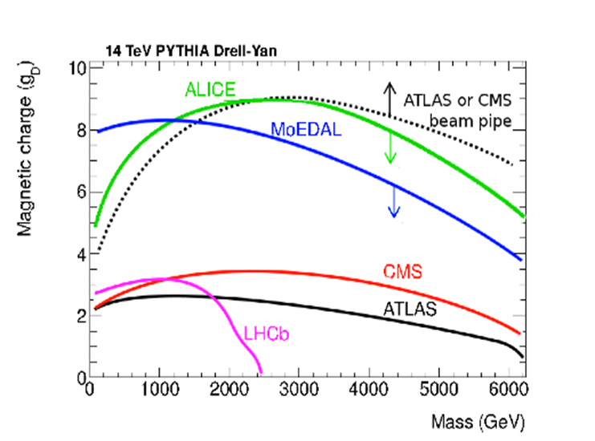
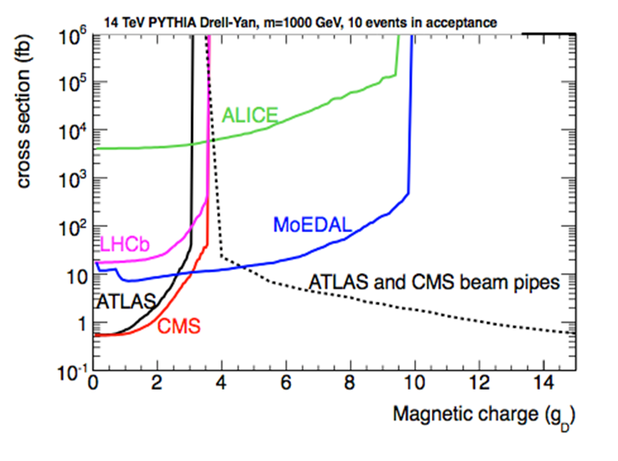

Slide 21
Detection Techniques: Time of Flight
Relies on monopoles being sub-luminal, massive, and non-hadronic
Does not provide unambiguous evidence of a monopole: could be an exotic
Wire chambers
  At β > 10⁻³ ionization used
  At 10⁻⁴ < β < 10⁻³ Drell mechanism used
    M + He → M + He*, He* + CH₄ → He + CH₄⁺ + e⁻ (Penning effect)
  Expensive
Scintillator
  Only good for β > 10⁻⁴
  Solid scintillator expensive, liquid scintillator less so

Slide 22
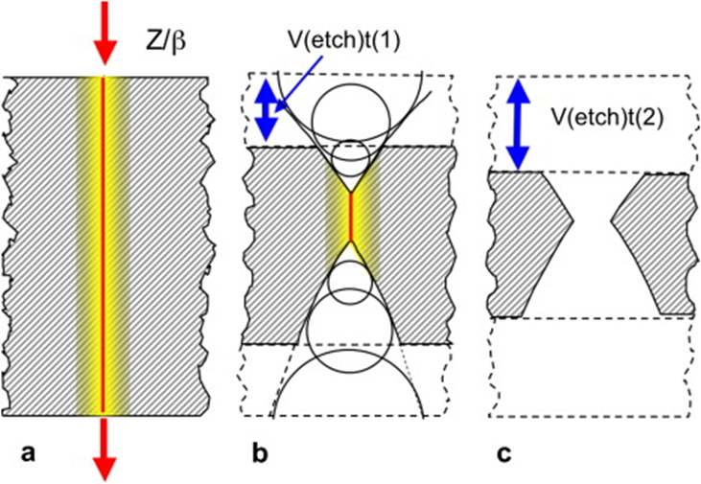
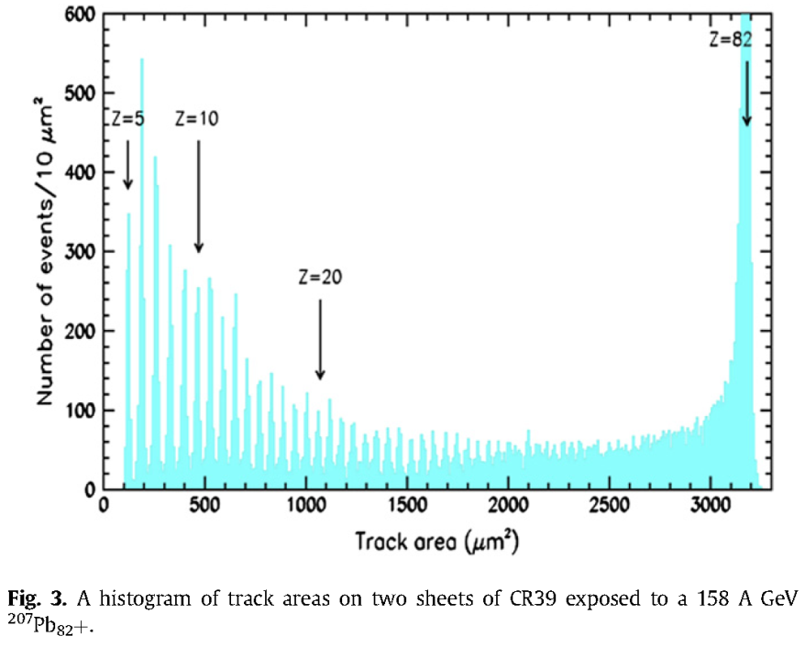
Detection Techniques: Nuclear Track Detectors
Employs thin sheets of inexpensive plastic, usually CR-39 (ADC, used in eyeglasses)
How it works:
  Heavily ionizing particles produce invisible damage to the polymer.
  When etched with hot sodium hydroxide (NAOH) a cone appears.
  Depth of etch pit is proportional to Z/β, which can be as low as 5.
Lexan, Makrofol, and glass (UG-5) have also been used, but they have a higher Z/β threshold.
Calibrated using ions at accelerators.
Advantages:
  No need for a trigger
  Totally insensitive to minimum ionizing particles
  Radiation hard
Does not provide unambiguous evidence of a monopole: could be another exotic

Slide 23
Detection Techniques: Nuclear Track Detectors
Mica
  Incoming monopole captures an Al or Mn nucleus and drags it through ancient muscovite mica
  Samples are small, best limit uses 3.5 cm² and 18 cm² samples
  Integration time large: 4-9 x 10⁸ years
  Best limit: ~2 x 10⁻¹⁷ cm⁻²s⁻¹sr⁻¹ (Ghosh and Chatterjea, Europhysics Lett. 12, 25 (1990))
  10⁻⁴ < β < 10⁻³
  Many assumptions in this limit

Slide 24
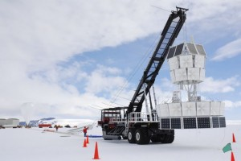
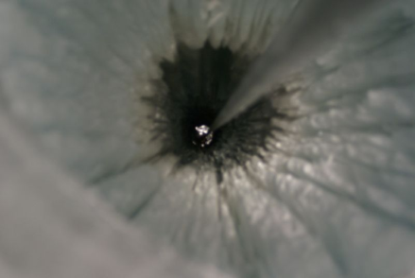
Detection Techniques: Radiowave
Only works for ultrarelativistic monopoles
Bright showers produced detectable radio waves
ANITA
  Balloon born detector over Antarctica
RICE (Radio Ice Cerenkov Experiment)
  16 antennas buried in the Antarctic ice
  Status: running
  < 10⁻¹⁸ cm⁻²s⁻¹sr⁻¹ for 10⁷ < γ < 10¹²

Slide 25
Detection Techniques: Indirect Searches
Survival of galactic and intracluster magnetic fields
Parker Bound:
    F < 10⁻¹⁵ cm⁻²s⁻¹sr⁻¹
    roughly speaking the monopoles cannot take away more energy from the galactic magnetic field (~3 μG)
Extended Parker Bound:
    F < 1.2 x 10 ⁻¹⁶ (m/10¹⁷)cm⁻²s⁻¹sr⁻¹
    considers survival of an early seed field
Monopole catalysis of nucleon decay
  ~3 x 10⁻¹⁶ cm⁻²s⁻¹sr⁻¹ for 1.1 x 10⁻⁴ < β < 5 x 10⁻³ (MACRO) p + M → M + e⁺ + π⁰
  Catalysis in the Sun:
    2 x 10⁻¹⁴β² cm⁻²s⁻¹sr⁻¹ (Kamiokande) assuming a 1 mb catalysis cross section (cross section highly uncertain)
Luminosity limits from monopole-catalyzed nucleon decay or monopole-antimonopole annihilation
  X-ray flux in neutron stars
  Heat limits in planets

Slide 26
limits

Slide 27
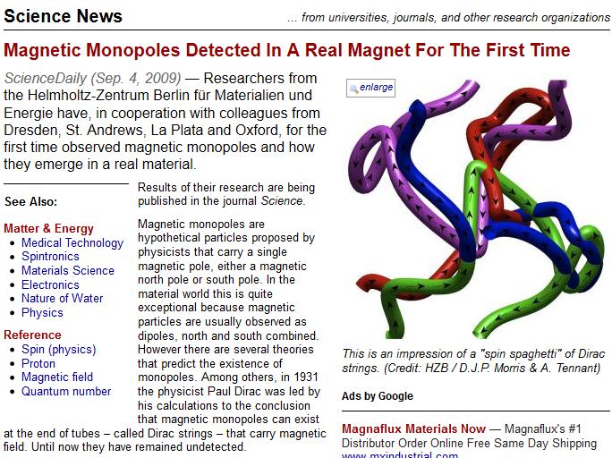
A Recent Discovery

Slide 28
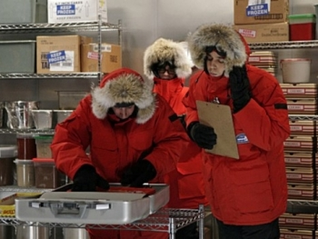
A More Recent Discovery
Sheldon Cooper found one in the ice on the North Pole…..which turned out to be a cruel joke by his colleagues

Slide 29
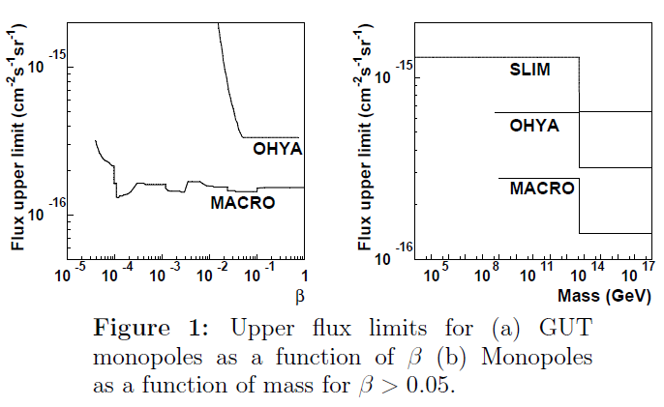
Present Limits
No searches, to my knowledge, systematic limited

Slide 30
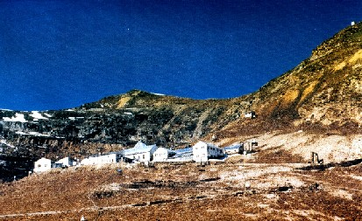
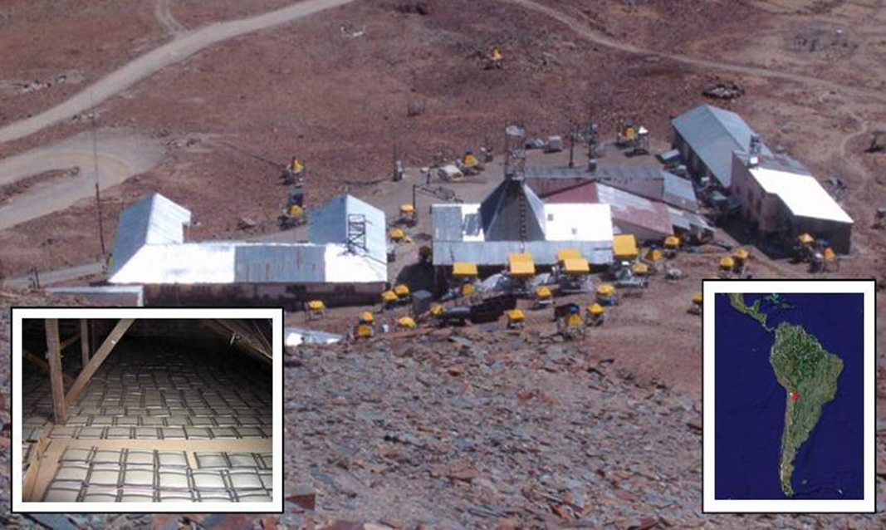
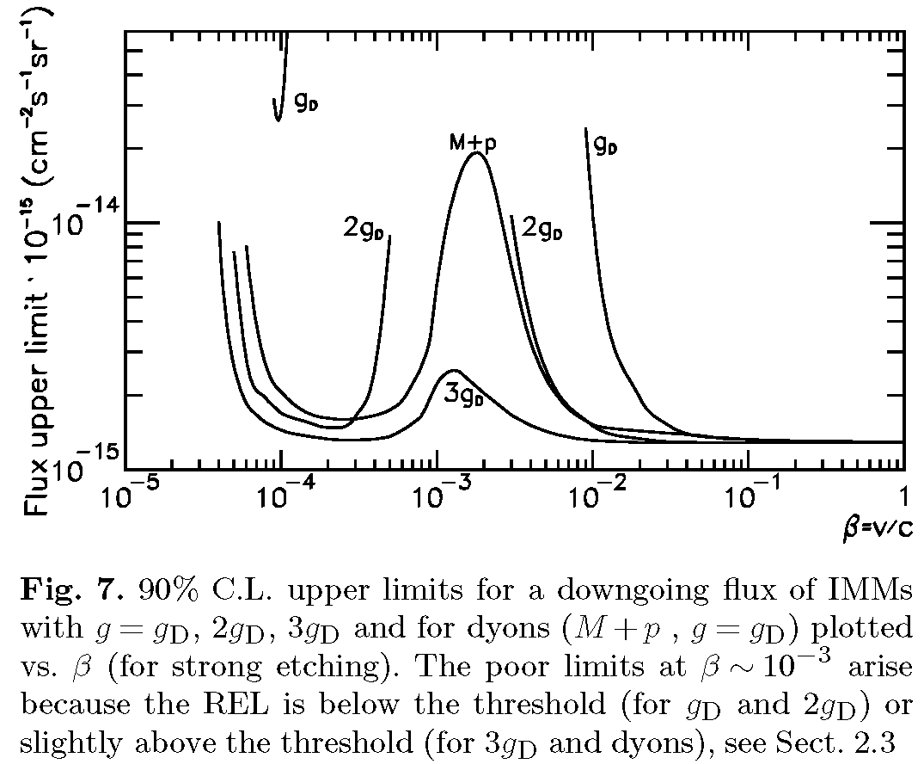
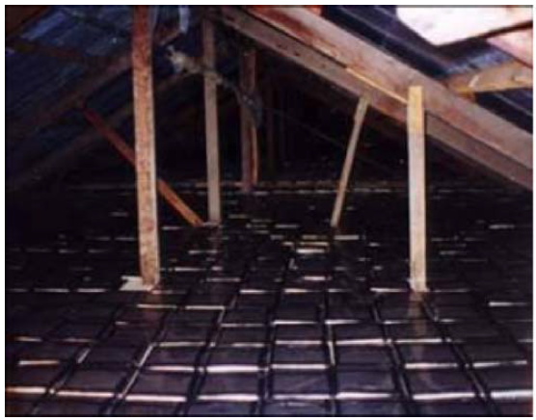
Experiments: SLIM
Technology: CR39 plastic track-etch detector
Area: 427 m²
Altitude: 5230 m a.s.l.
Status: complete (2008)
Chacaltaya lab

Slide 31
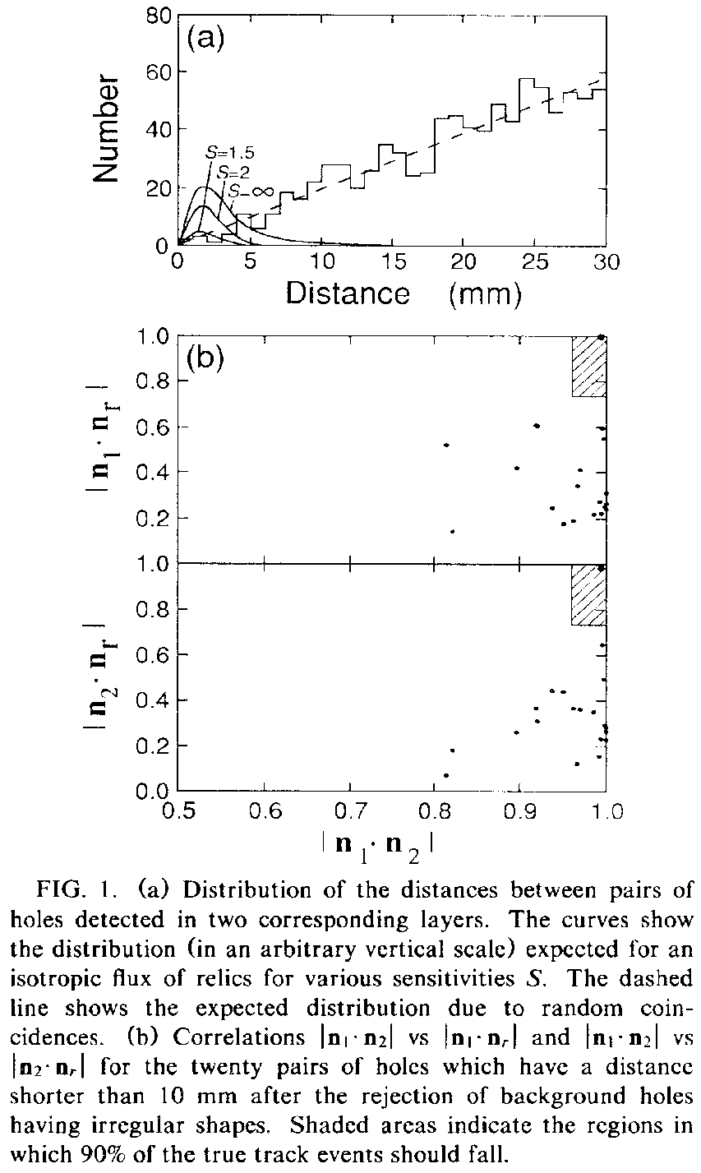
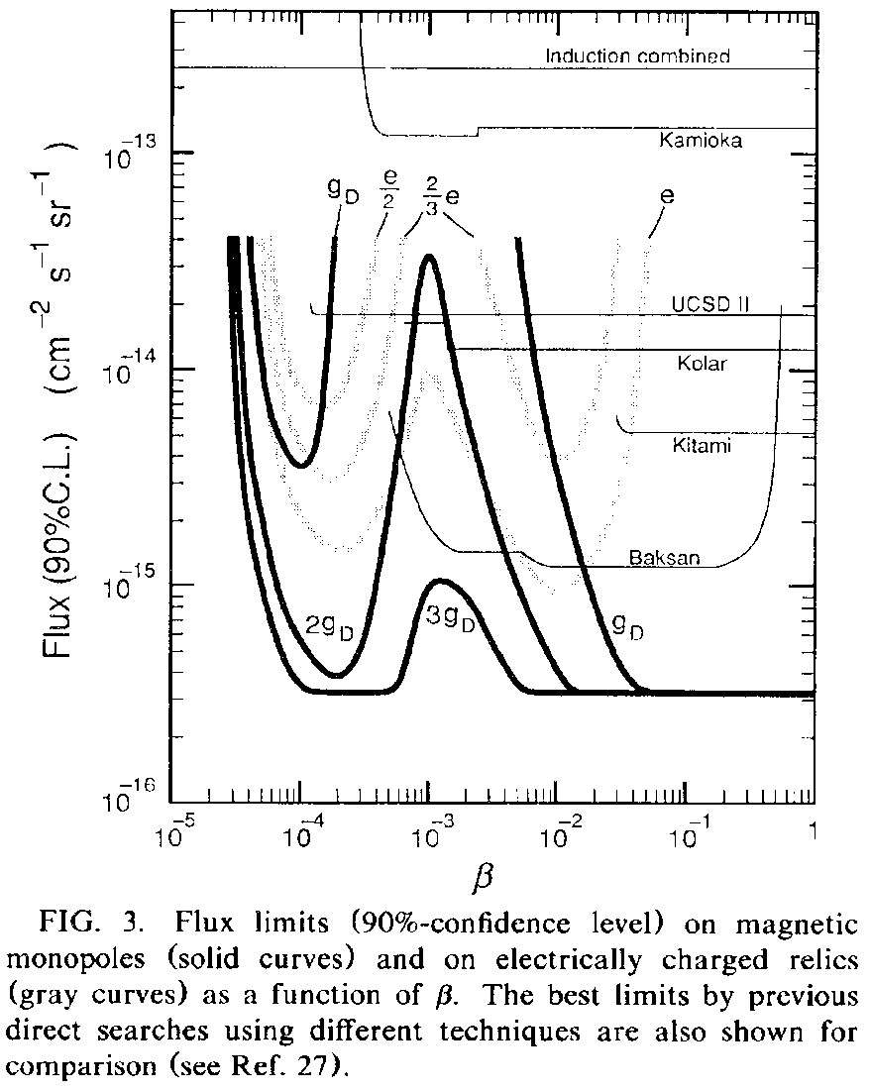
Experiments: OHYA
Technology: CR39 plastic track-etch detector
Area: 2000 m²
Depth: 10⁴ g/cm² (in stone quarries in Ohya, Japan)
Status: complete (1990)

Slide 32
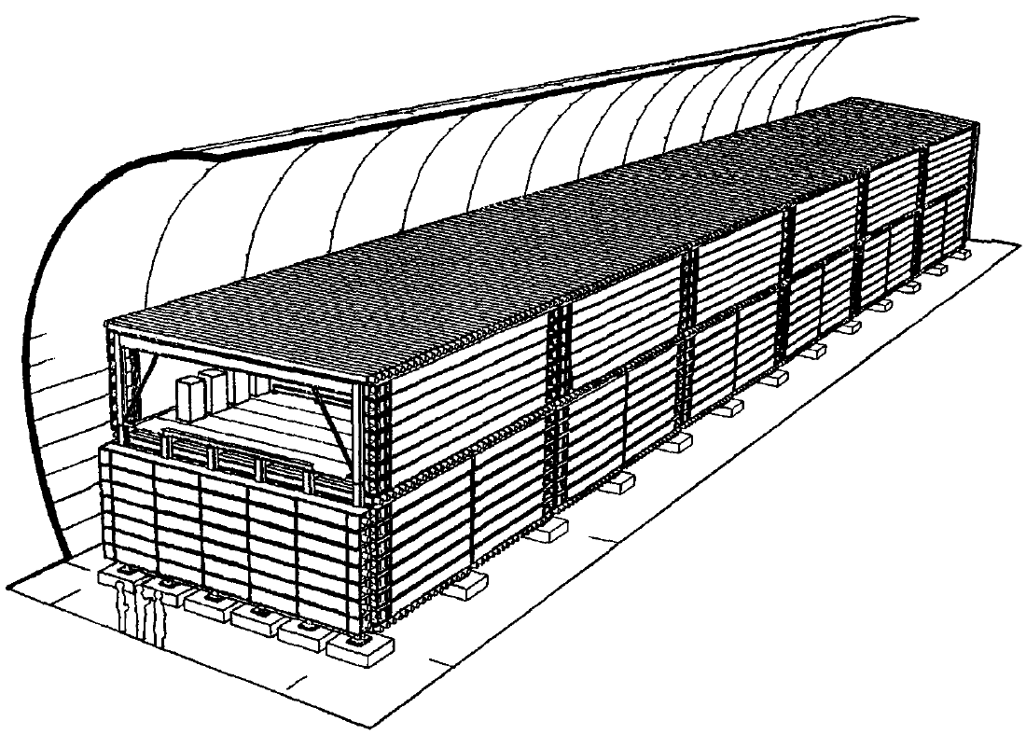
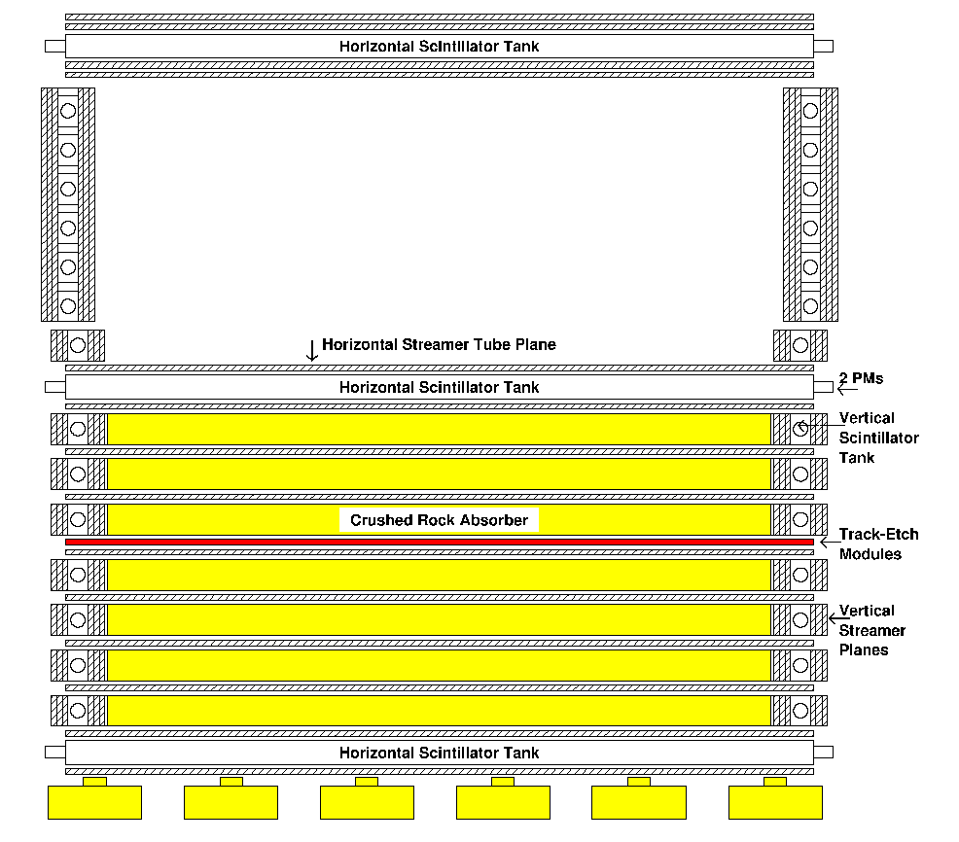
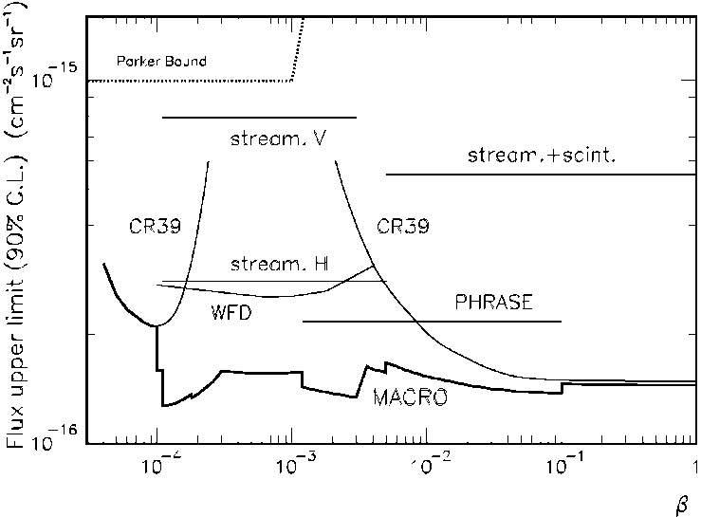
Experiments: MACRO
The gold standard for monopole searches
Technologies: streamer chamber, liquid scintillator, and track-etch
Area: 3482 m² (76.5 x 12 x 9.2 m³)
Depth: 3700 m.w.e. (min.)
Status: complete (2000)
Largely a surface instrumented detector, unlike NOvA
Much lower dE/dx sensitivity than NOvA: ~2%MIP

Slide 33
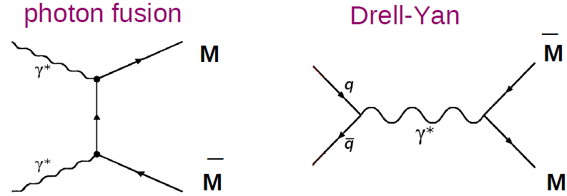
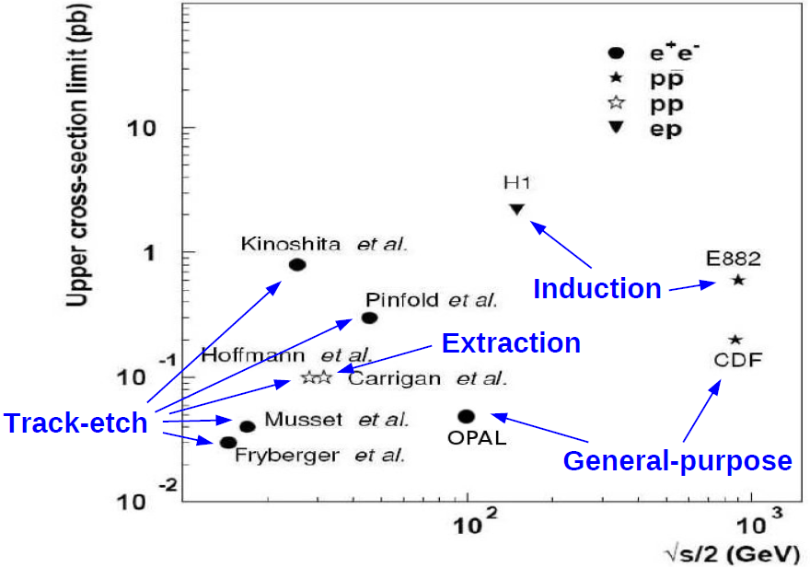
Experiments: Direct Production of Monopoles
Collider detectors have been searching for low-mass monopoles produced in proton-proton and proton-antiproton collisions
ATLAS and CMS performing monopole searches
New experiment: MoEDAL proposed at LHC-IP-8

Slide 34
NOνA

Slide 35
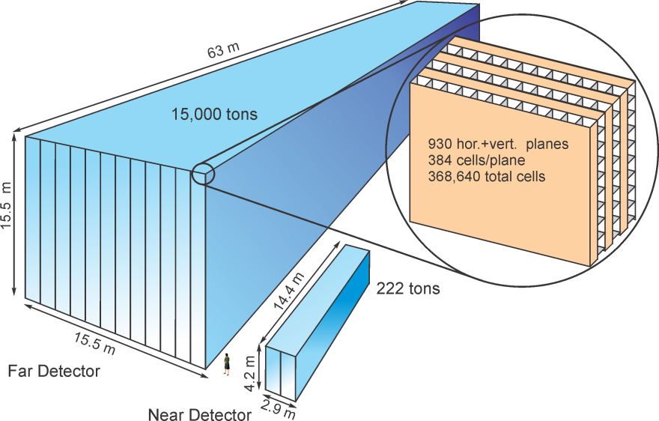
Why Search for Monopoles with NOvA?
NOvA has a very large area detector
  NOvA: 4290 m²
  MACRO: 3482 m²
  SLIM: 427 m²
  OHYA: 2000 m²
NOvA will run a long time: at least 6 years, most likely more
NOvA has little overburden:
  Allows access to intermediate-mass monopoles that deep underground detectors cannot see
  Means backgrounds are much larger: muon rate 10⁶ X MACRO!
NOvA is a highly-instrumented detector with sufficient timing to allow sub-luminal particles to be identified

Slide 36
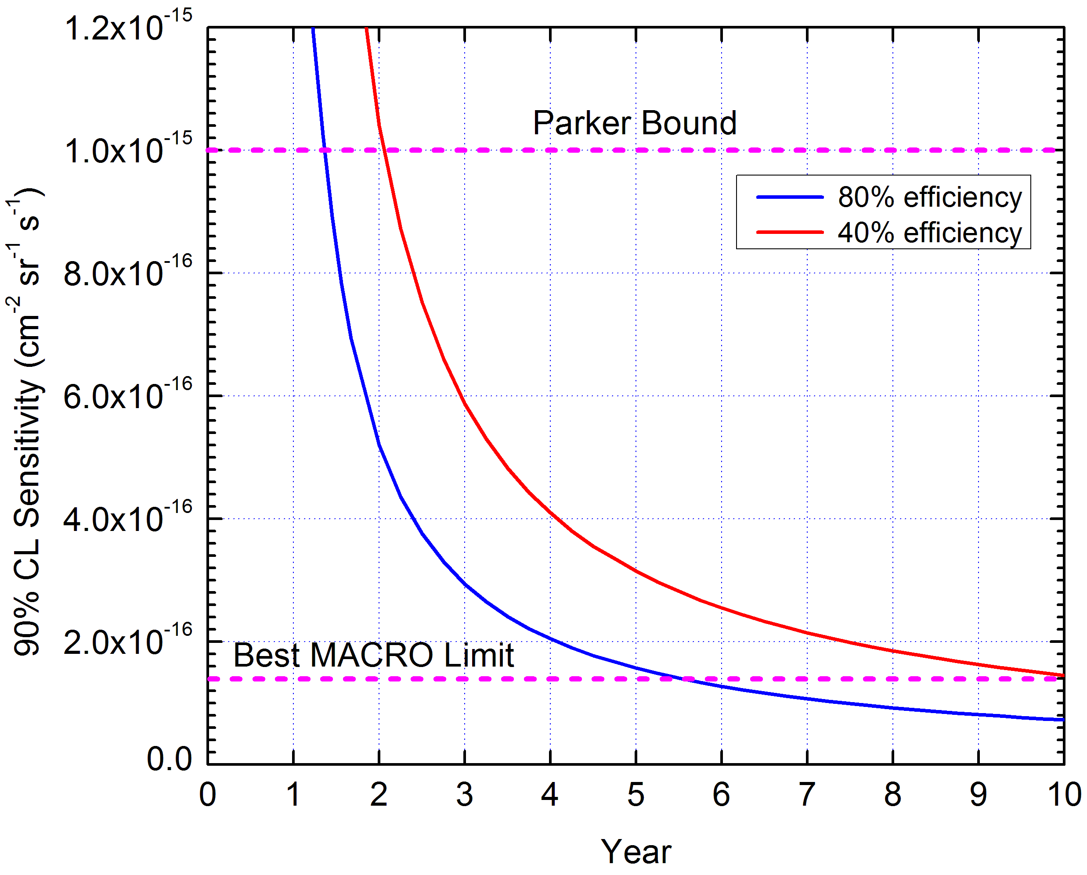
NOvA Sensitivity vs Time
Sensitivity goes as surface area: πFA, where F is the flux
Our acceptance is not yet known: we hope we can do better for 80% for high-mass monopoles and perhaps half that for low-mass
Eventually, if the acceptance is large enough, we can beat MACRO
Should be able to beat SLIM for intermediate-mass monopoles

Slide 37
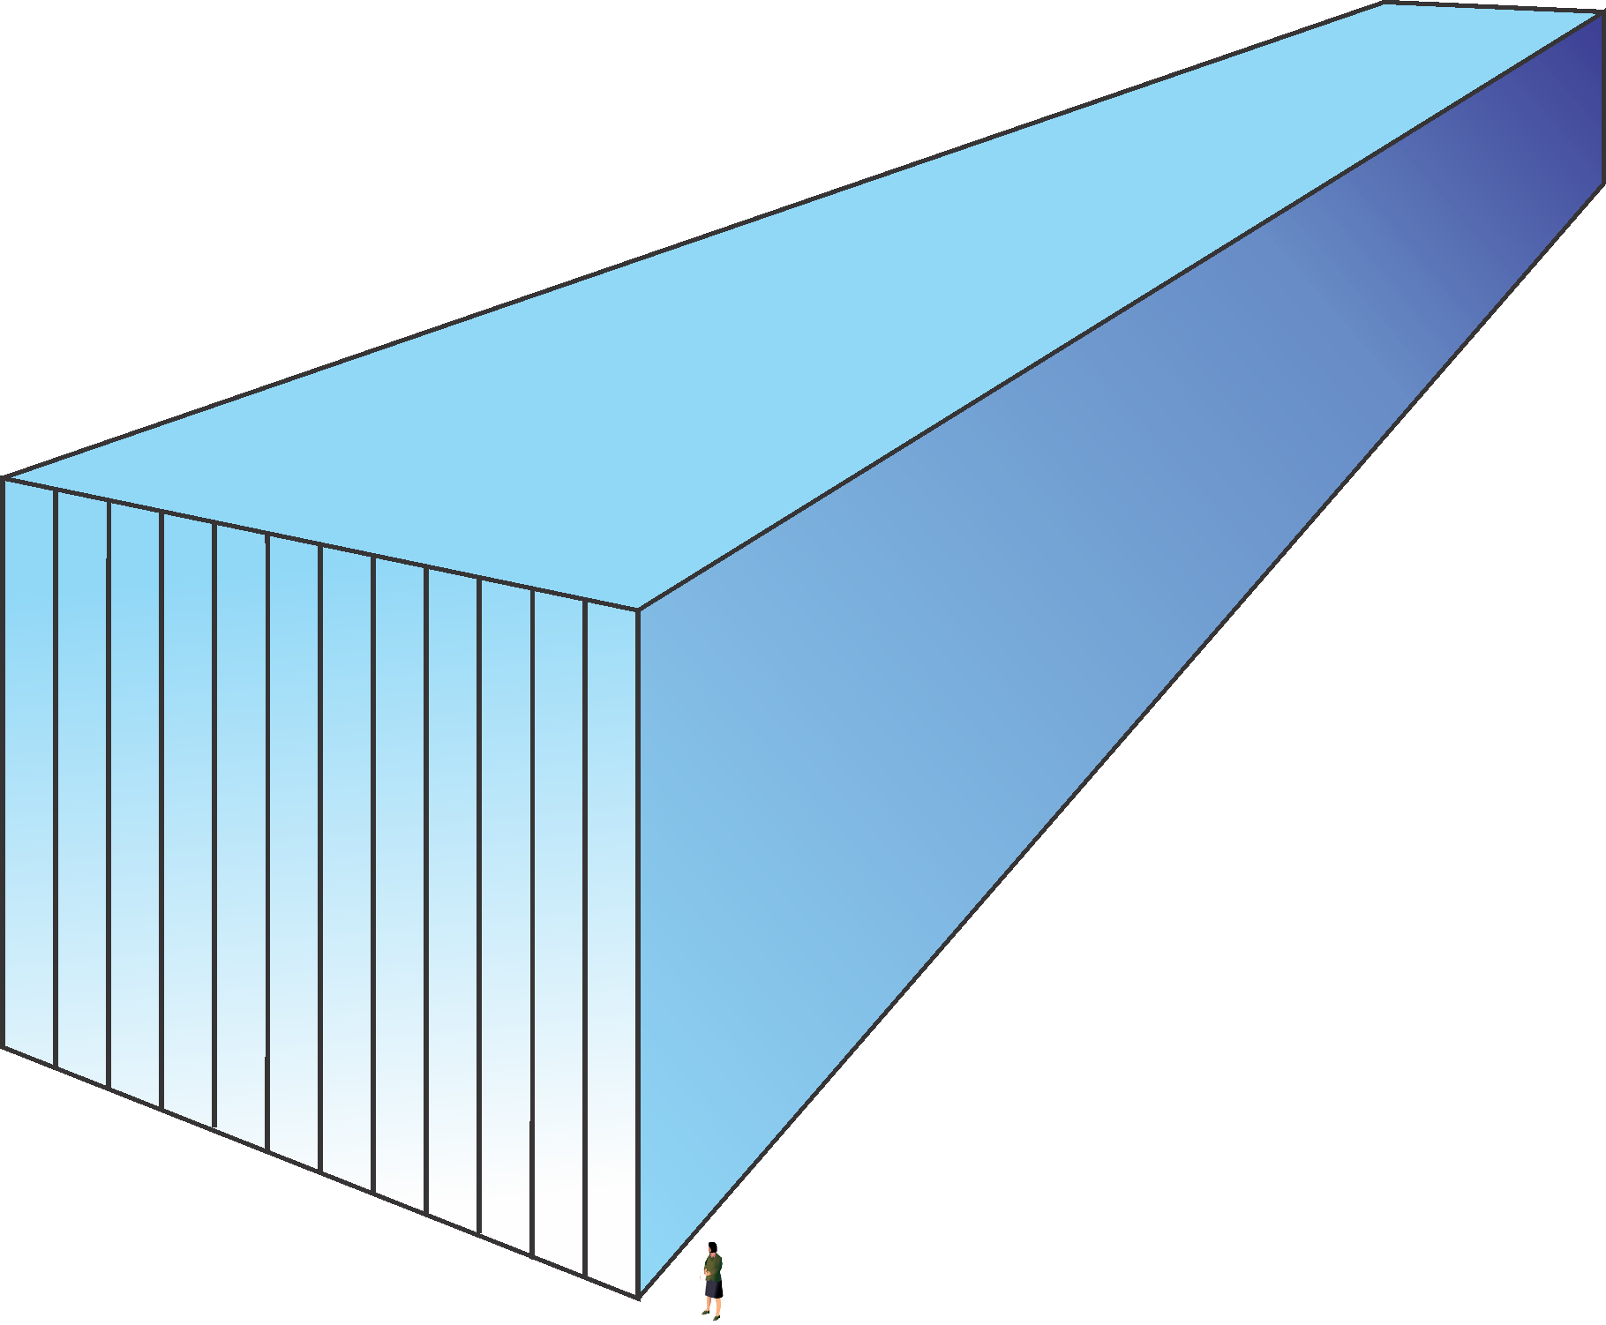
NOvA Monopole Search Strategy
Look for highly-ionizing, penetrating particles
  Covers the high-β range: β > 10⁻²
Look for sub-luminal, penetrating particles
  Covers the low-β range: β < 10⁻²
dE/dx
dt/dx

Slide 38
Goals of the Monopole Group
Determine the NOvA monopole reach in β and mass and compare to existing limits
Model the response of the NOvA detector to monopoles, both the energy deposition and the electronics response
Produce a NOvA monopole Monte Carlo, including a model of the detector overburden
Produce monopole reconstruction algorithms for the entire β range, based on timing and dE/dx
Produce and implement a fast trigger algorithm
Investigate the cosmic-ray backgrounds
  β ≥ 0.1: very-high energy muons
  β ≤ 0.1: multiple muons
People: Dukes, Ehrlich, Frank, Group, Norman, Wang

Slide 39
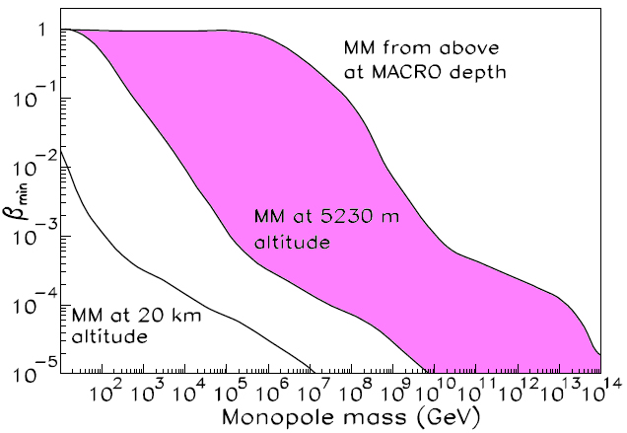
NOvA Monopole Reach
NOvA sensitivity will be somewhere in the colored area. One of our goals is to determine the NOvA curve

Slide 40
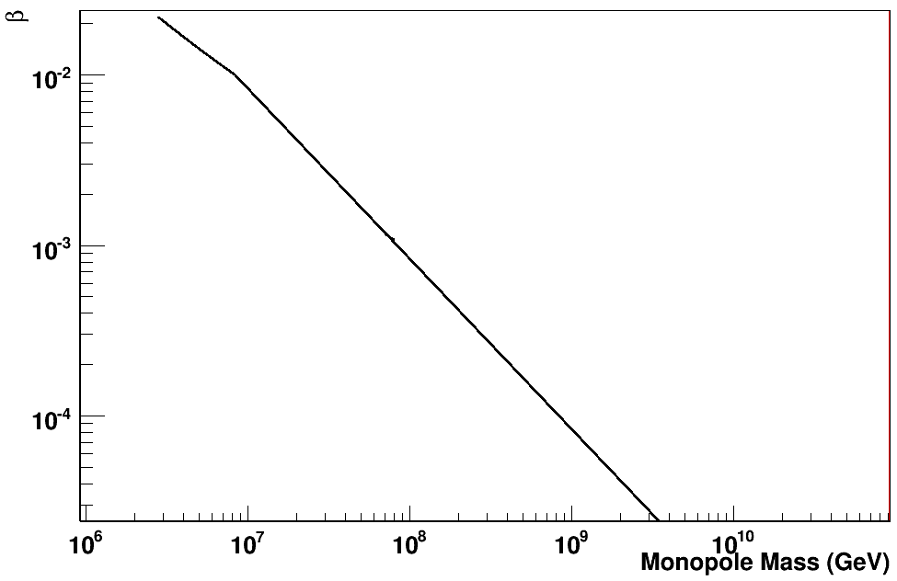
NOvA Monopole Reach
First estimate from Zukai

Slide 41
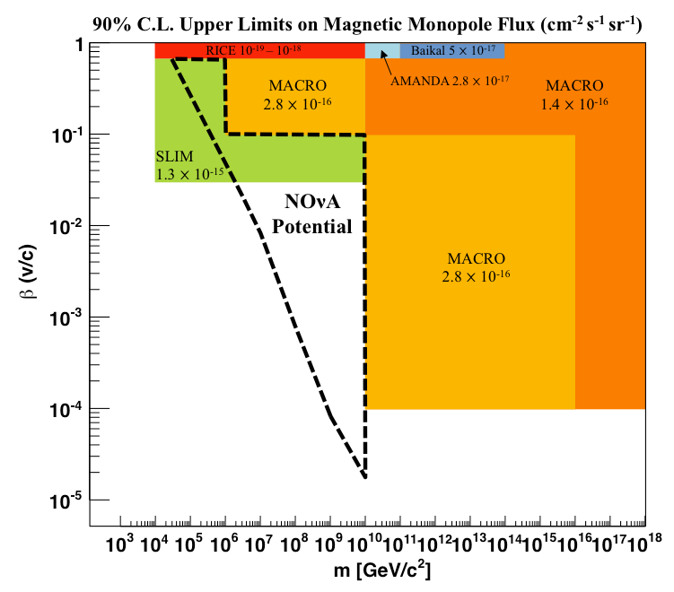
NOvA Monopole Reach
Martin

Slide 42
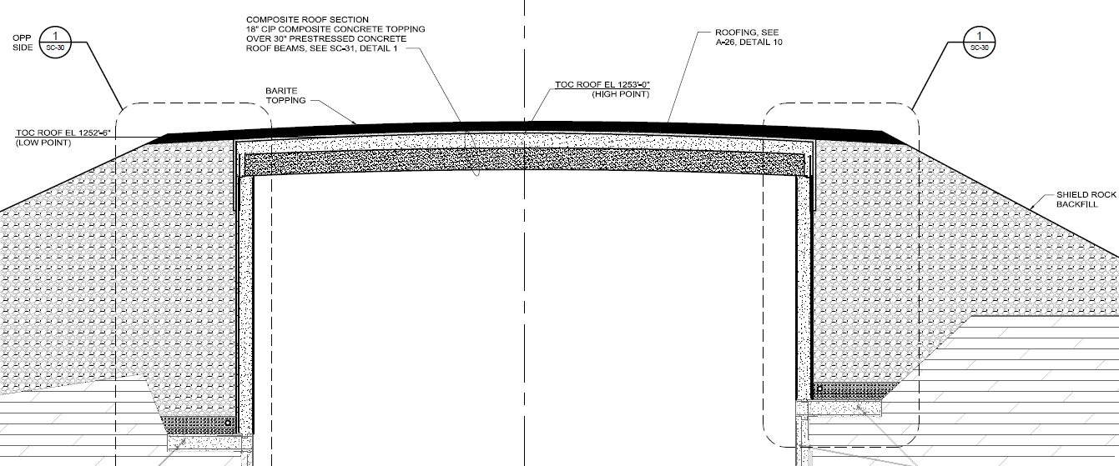
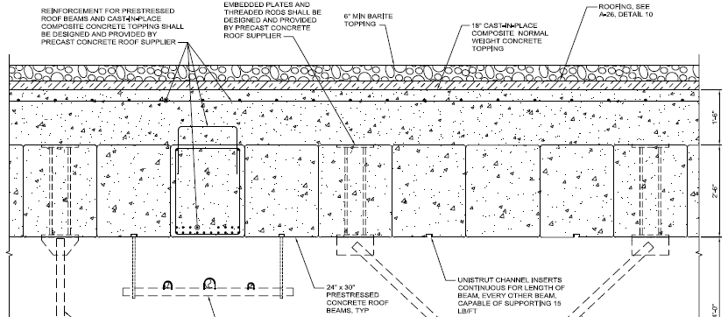
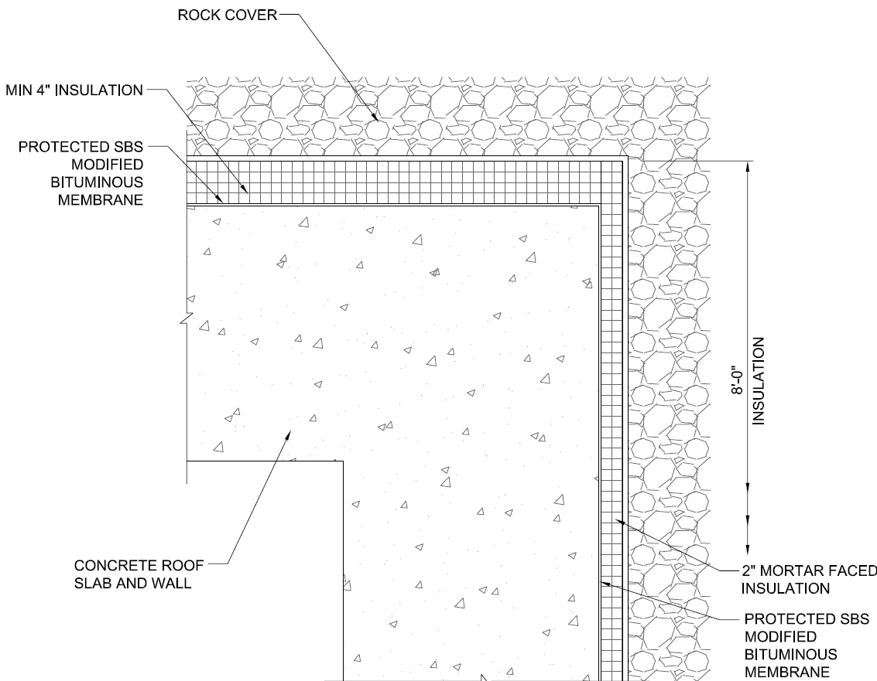
NOvA Monopole Reach: Overburden
Vertical Overburden (Zukai):
  6” barite: 4.48 g/cm³ 68.3 g/cm²
  55” concrete: 2.49 g/cm³ 347.9 g/cm²
  atmosphere: 1000 g/cm² 1030.0 g/cm²
  Total: 1446.1 g/cm²
6” min. Barite.
How much?
48” concrete Type?
Min. 4” insulation

Slide 43


Acceptance Estimate from Toy Monte Carlo
Acceptance vs timing cut
Require more than one module to avoid “hot” modules
Require a minimum # of cells
Require a minimum track length
Require a penetrating track
These values need to be determined
# modules ≥ 2
# cells ≥ 40
Track length ≥ 2.0 m
# modules ≥ 2
# cells ≥ 40
Track length ≥ 5.0 m
Ralf Ehrlich

Slide 44




Istotropic Acceptance from Toy Monte Carlo
Ralf Ehrlich

Slide 45


Isotropic Acceptance from Real Monte Carlo
Zuka Wang

Slide 46

Detector Energy Response
GEANT does not have monopoles
Zukai putting in a model of the energy response of the detector
  NOvA-7660
  Includes Birks rule
Work in progress

Slide 47

Detector Energy Response
Zuka Wang

Slide 48



NOvA Timing: Monopole Traversal Times
Three potential problems:
dilution of signal in cells for low-β events
broken timing due to plateaued-ADCs from high-β events
DAQ time slices for triggering
5 ms
144 ns
56.4 mm
Single-cell timing resolution:
DCS: 500/√12 = 144 ns
Matched filtering: ~40 ns
Timing adequate for β < 0.1 monopoles
36.0 mm

Slide 49


Detector Electronics Response
Zuka Wang
5 slow particles with same dE/dx
5 slow particles with dE/dx ∝ v

Slide 50
Trigger
My biggest worry: do we have time to weed out the huge rate of muons
Andrew has made progress with this
Data-driven trigger requires:
  Buffered Data to be published
    Event Builder w/ shared memory model DONE!
  Data processing framework
    w/ Input from raw buffers DONE!
  Online Analysis data model
    Limited data, minimal geom, non-persistent DONE!
  Hierarchical Analysis modules
    w/ early decision capabilities
  Message layer to Global trigger
Andrew did a test of a Hough transform on NDOS data
  NOvA-7634
  Results look promising with scaling them to ND

Slide 51

Trigger
FEB
FEB
FEB
FEB
11,160 Front End Boards
FEB
FEB
FEB
FEB
FEB
FEB
Data
Ring
5ms data
blocks
FEB
FEB
Data Driven Triggers System
FEB
FEB
DCM 1
Trigger
Processor
Trigger
Processor
….
Trigger
Processor
DCM 1
Zero Suppressed
at
(6-8MeV/cell)
DCM 1
DCM 1
180 Data Concentrator Modules
DCM 1
DCMs
Minimum Bias
0.75GB/S Stream
Data Driven
Trig. Decisions
Event builder
COtS Ethernet 1Gb/s
Grand
Trigger OR
Trigger Reception
Triggered
Data Output
Data Slice Pointer Table
»140-200 Buffer Node Computers
Extracted Data
Data Time Window Search
Buffer Nodes
Data
Buffer Nodes
Trigger Broadcast
Buffer Nodes
Buffer Nodes
Buffer Nodes
Buffer Nodes
Data Logger
Buffer Nodes
Global Trigger Processor
Beam Spill Indicator
(Async from FNAL @ .5-.9Hz)

Slide 52
Other Searches
Searching for penetrating, subluminal or highly-ionizing particles opens up windows into other possible physics exotics
Q-balls (non-topological solitons; Kusenko, Shaposhnikov, PLB 418, 46 (1998))
Stable micro black-hole remnants
Strange quark matter nuggets
Dyons

Slide 53
Possible Exotic Physics Topics
Monopole searches
Supernova searches
WIMP searches
Cosmic rays

Slide 54
Q-Balls
Aggregates of squarks, sleptons, and Higgs fields

Slide 55

Nuclearites: Strangelets, Strange Quark Matter
Aggregates of u, d, and s quarks
Color singlet
Positive integer electric charge
Stable for all baryon numbers from A = ~10 to 10⁵⁷
Produced shortly after the Big Bang and in violent astrophysical collisions
Galactic velocities: β~10⁻³
Will traverse earth if M_{N} > 0.1 g

